Slide 1
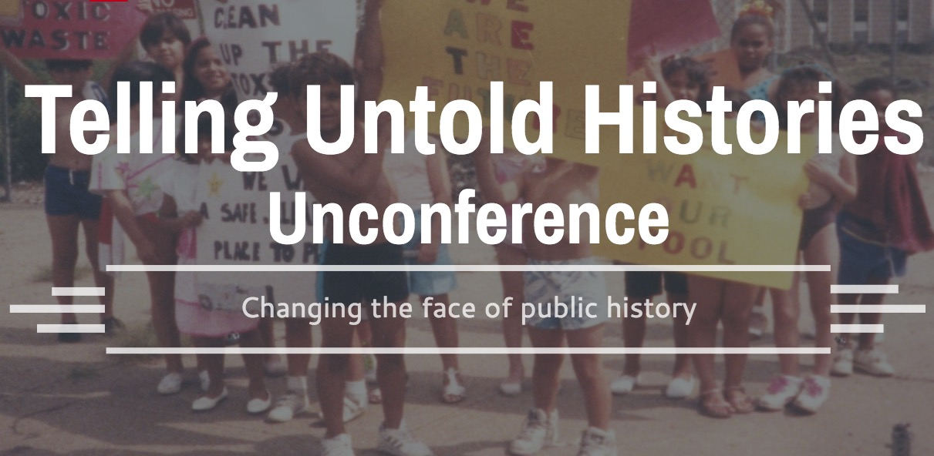

Slide 3
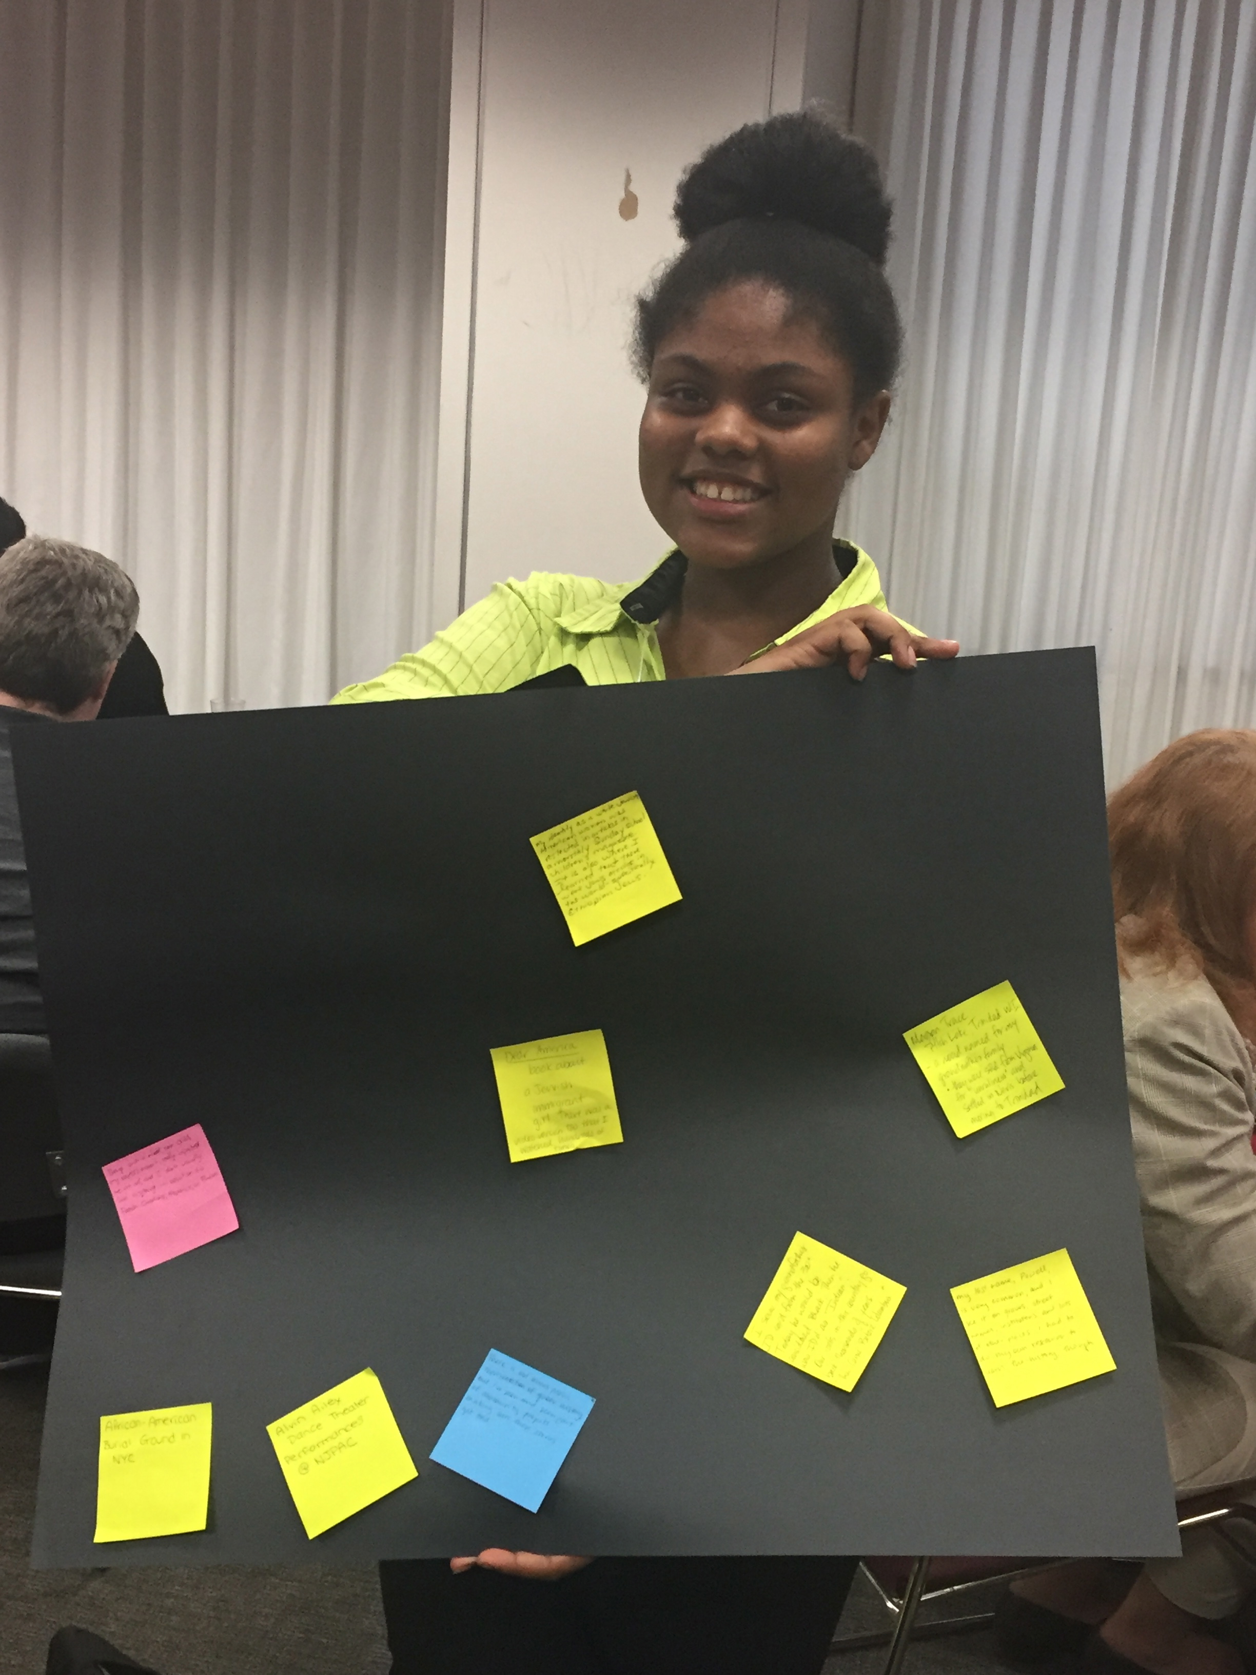

Slide 4
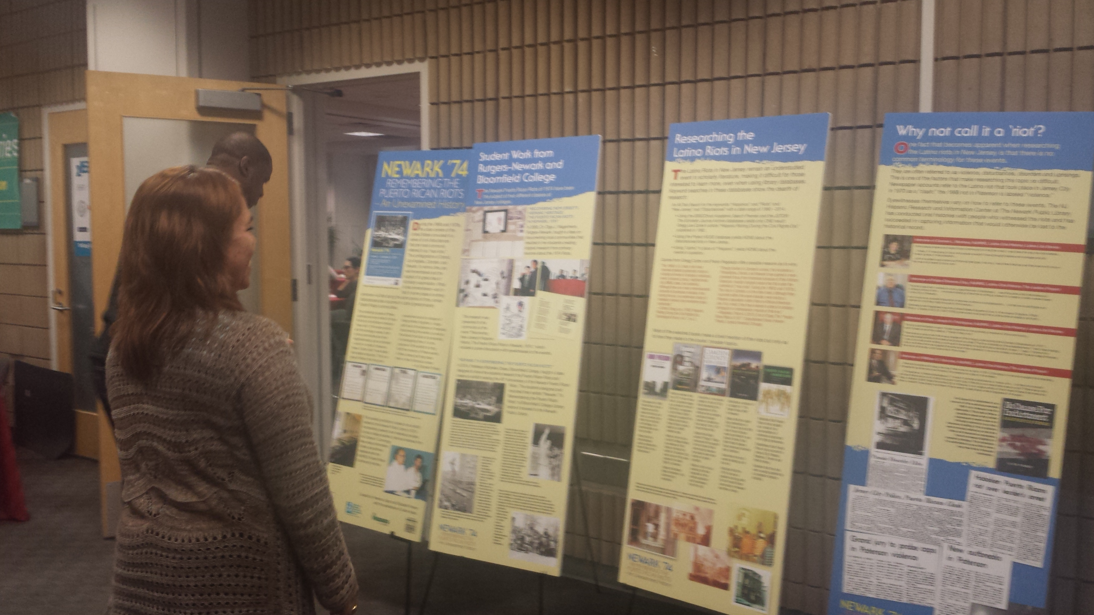

Slide 5
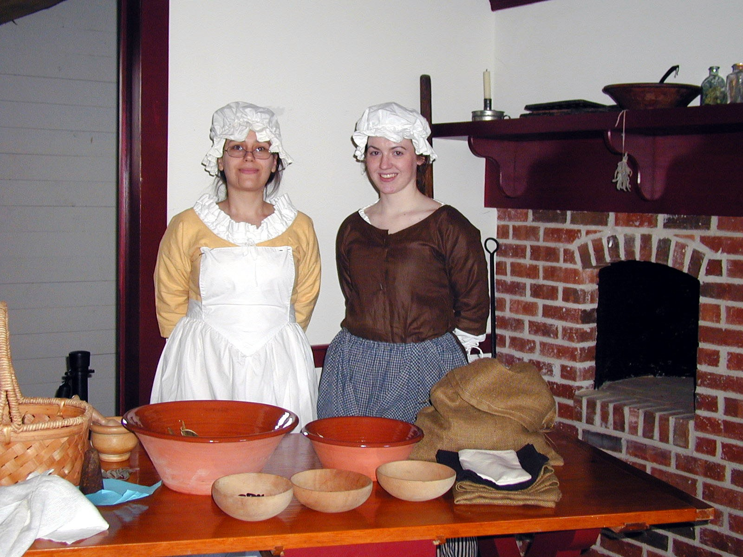
Me!

Slide 6
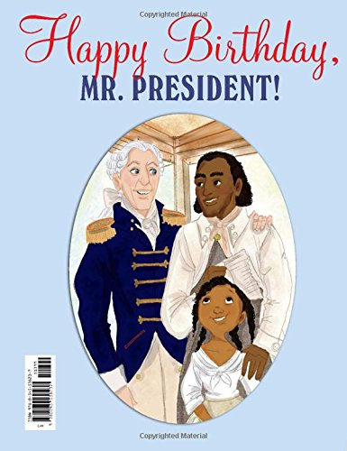

Slide 8
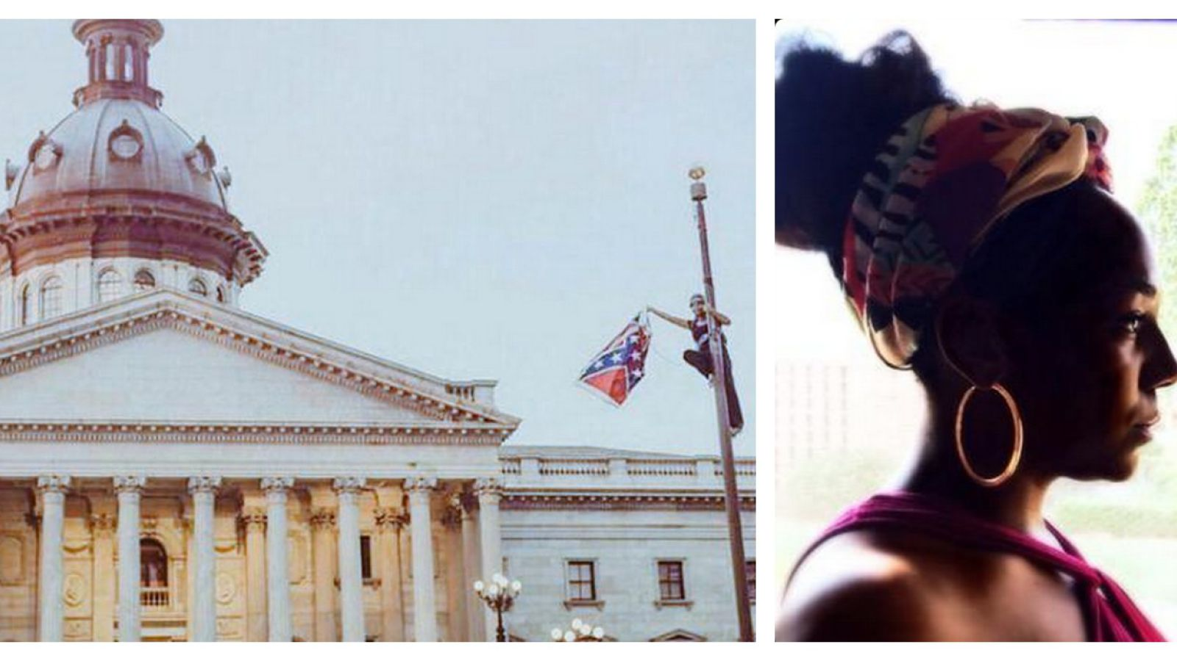

Slide 9
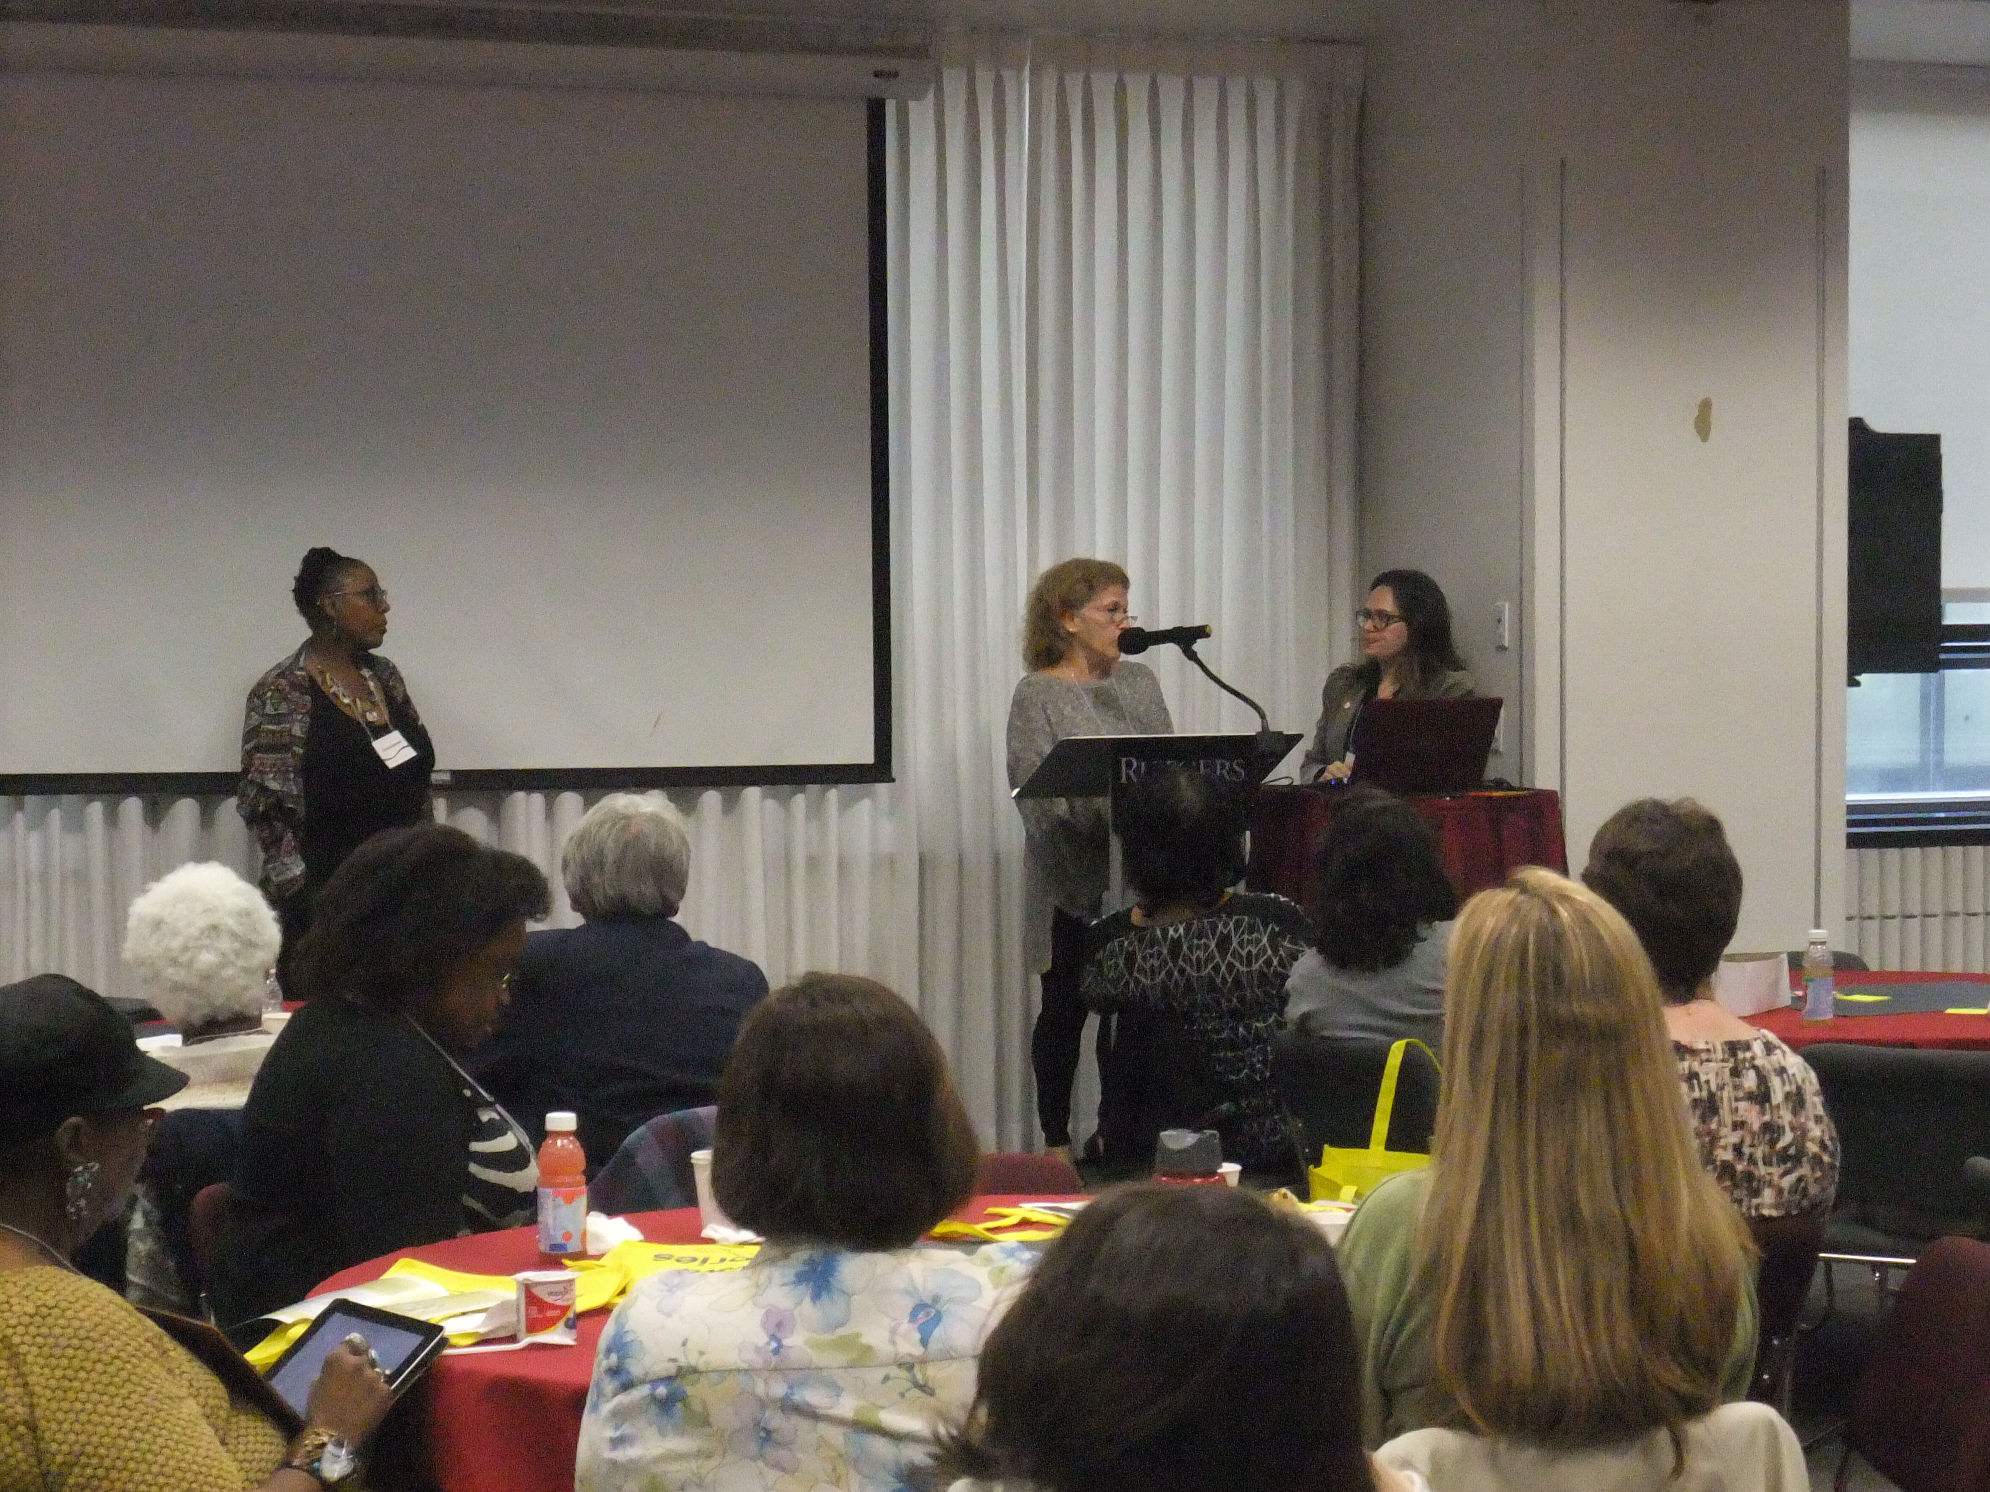

Slide 10
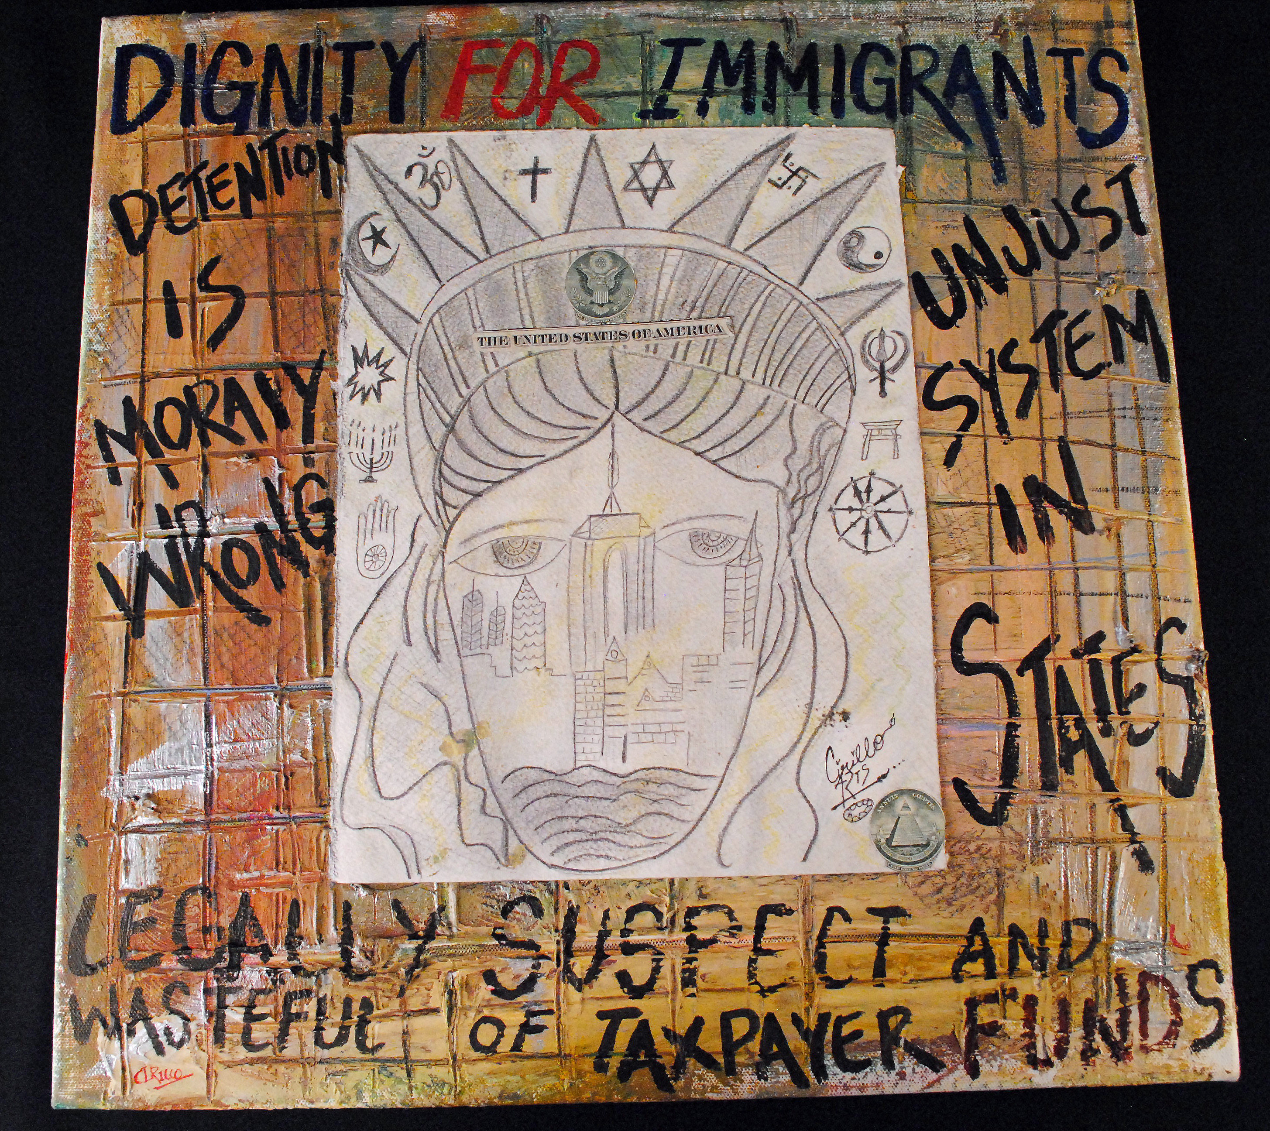

Slide 11
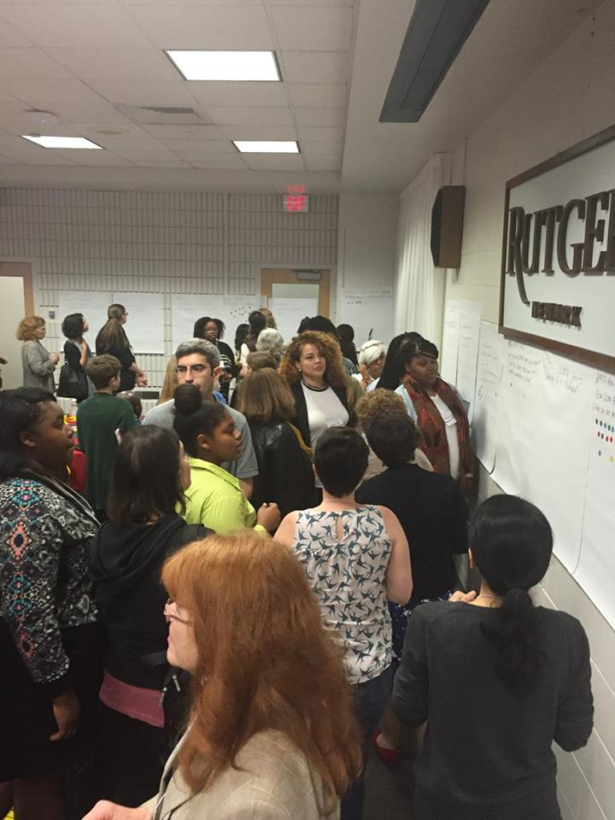

Slide 12
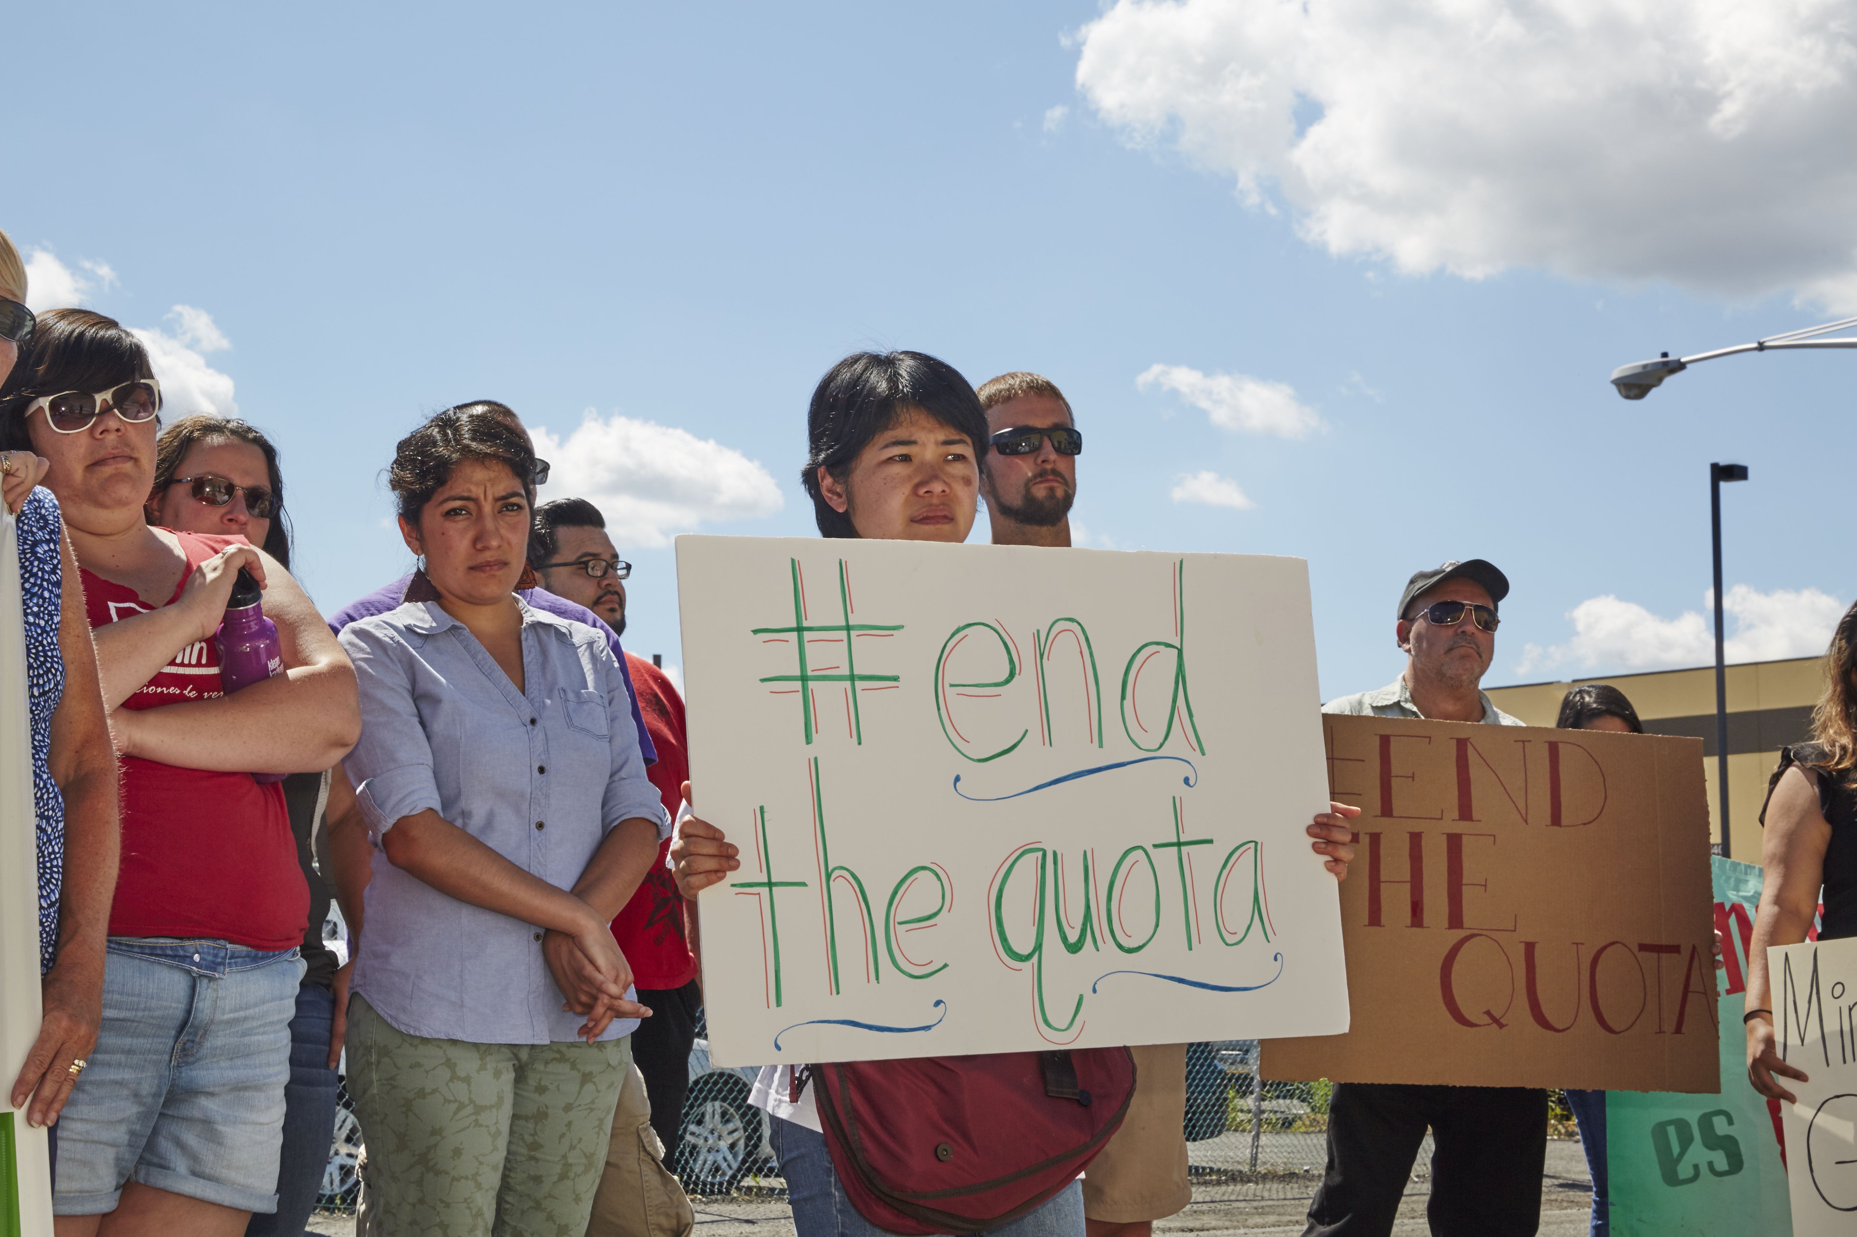

Slide 13
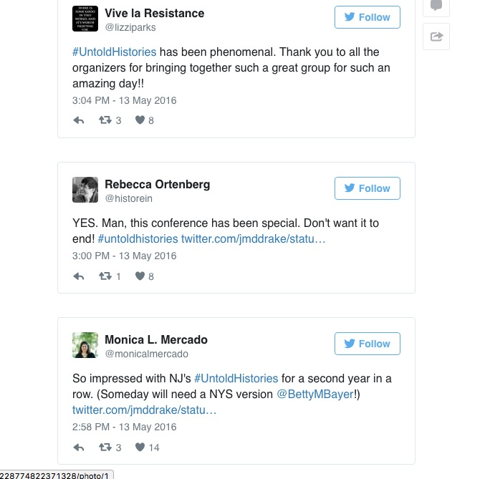

Slide 14
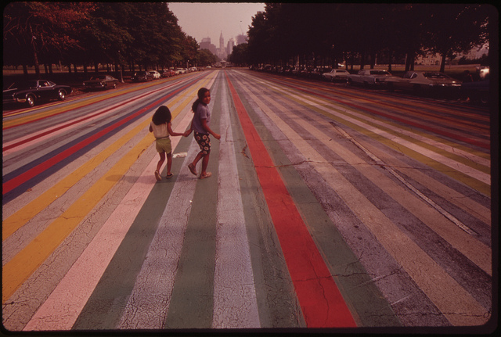

Slide 15
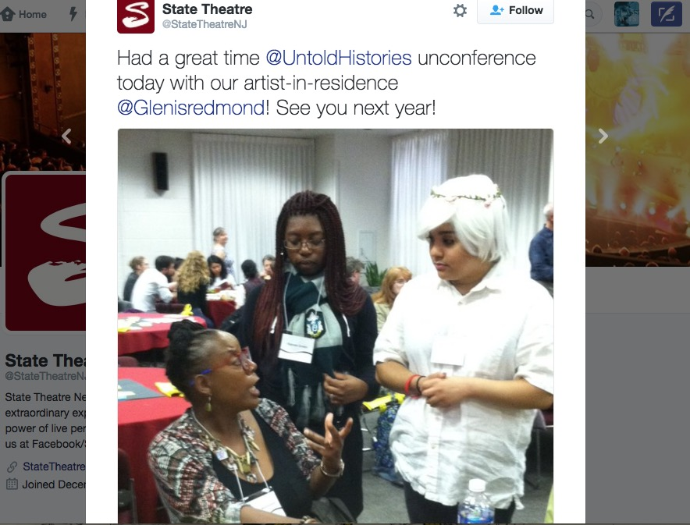

Slide 16
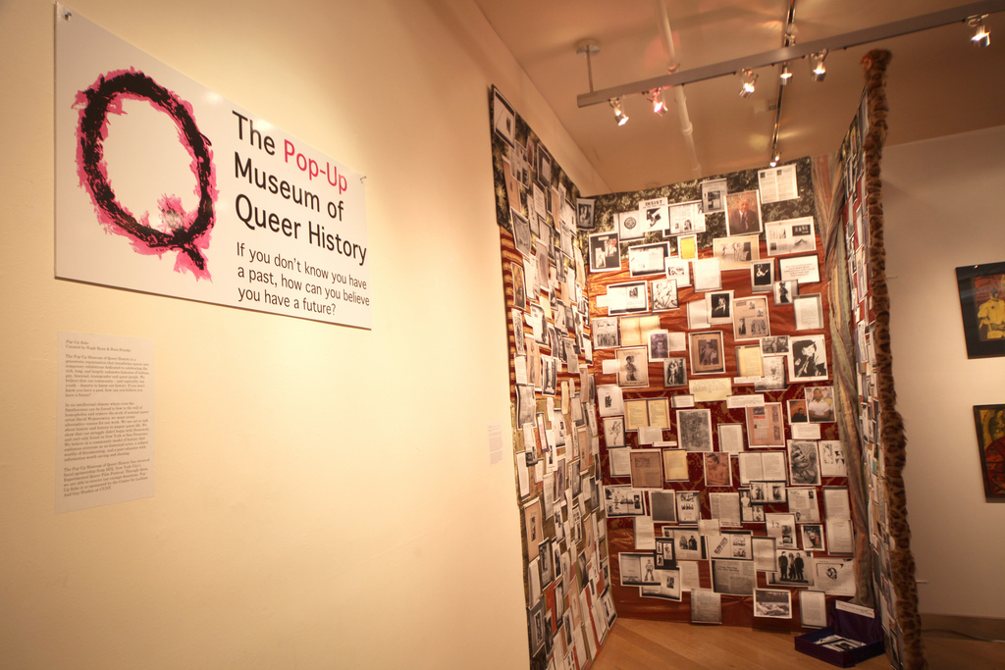

Slide 17
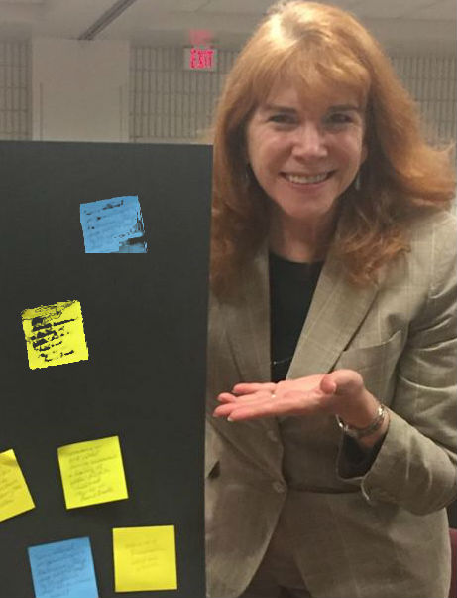
“I greatly appreciated having a community comprised of a wide range of ethnicities, ages, professions (including high school students!!!).
I am actively thinking of how to build more inclusive communities for discussion.”

Slide 18
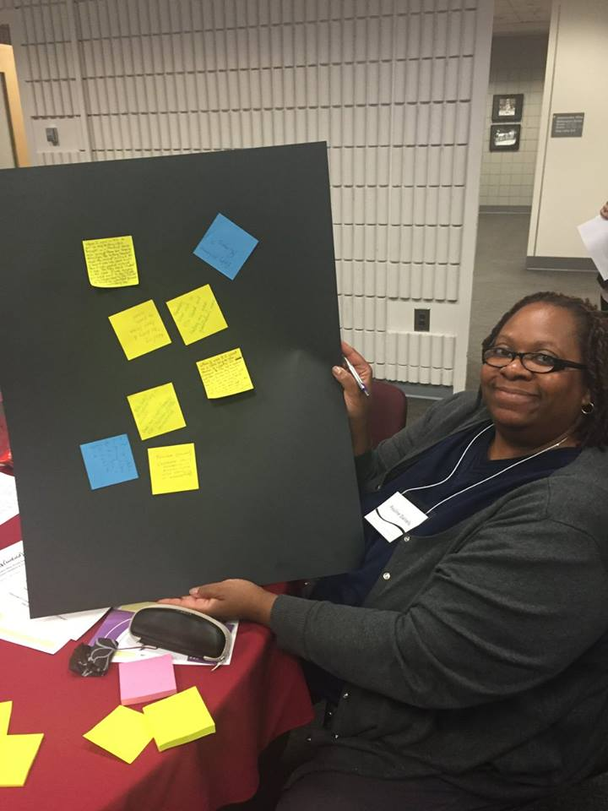
“What I appreciated most about the unconference was its accessibility and the diversity of people who were there – very different from the archives conferences I usually go to.”

Slide 19
Keep in Touch!
@untoldhistories
www.facebook.com/groups/TellingUntoldHistories
Untoldhistories.wordpress.com

Slide 20
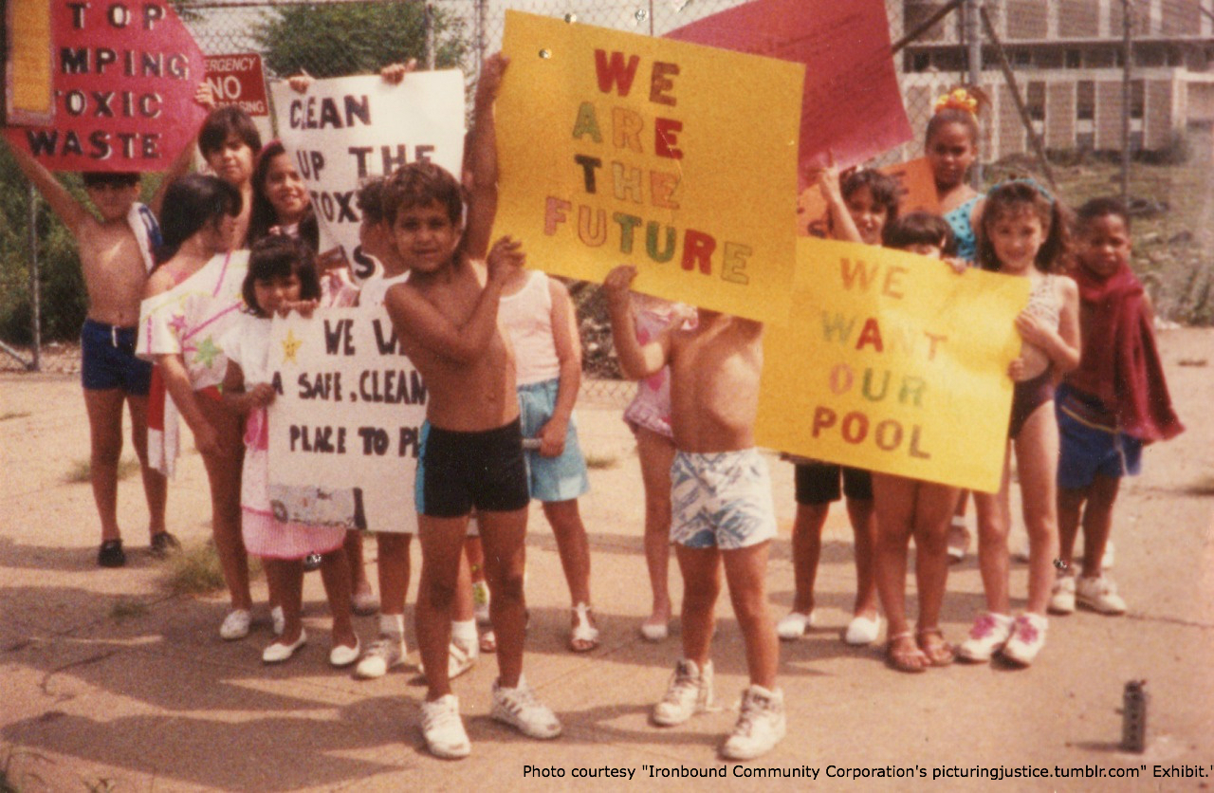
Join us May 2017 in Newark

