Slide 1
Anti-racist Collection Development
Robin Bradford * LibraryLinkNJ and NJLA
Robin.Bradford@gmail.com

Slide 2
Anti-racist vs. Not Racist
No one is born racist or antiracist; these result from the choices we make. Being antiracist results from a conscious decision to make frequent, consistent, equitable choices daily. These choices require ongoing self-awareness and self-reflection as we move through life. In the absence of making antiracist choices, we (un)consciously uphold aspects of white supremacy, white-dominant culture, and unequal institutions and society. Being racist or antiracist is not about who you are; it is about what you do.
National Museum of African American History & Culture

Slide 3
Same Old World….

Slide 4
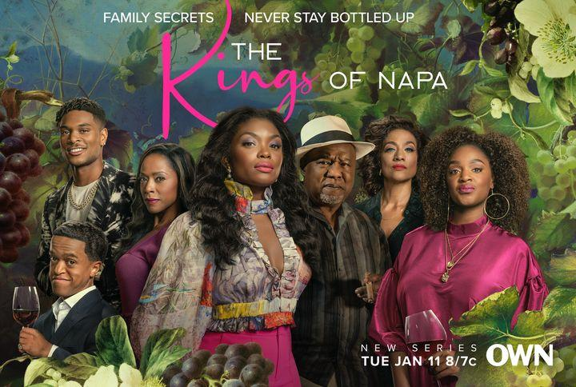
Same Old World, All new casting.

Slide 5
Old Tropes, New Life

Slide 6
The beautiful words of Dr. Rudine Sims Bishop
“Books are sometimes windows, offering views of worlds that may be real or imagined, familiar or strange. These windows are also sliding glass doors, and readers have only to walk through in imagination to become part of whatever world has been created and recreated by the author. When lighting conditions are just right, however, a window can also be a mirror. Literature transforms human experience and reflects it back to us, and in that reflection we can see our own lives and experiences as part of the larger human experience.”

Slide 7
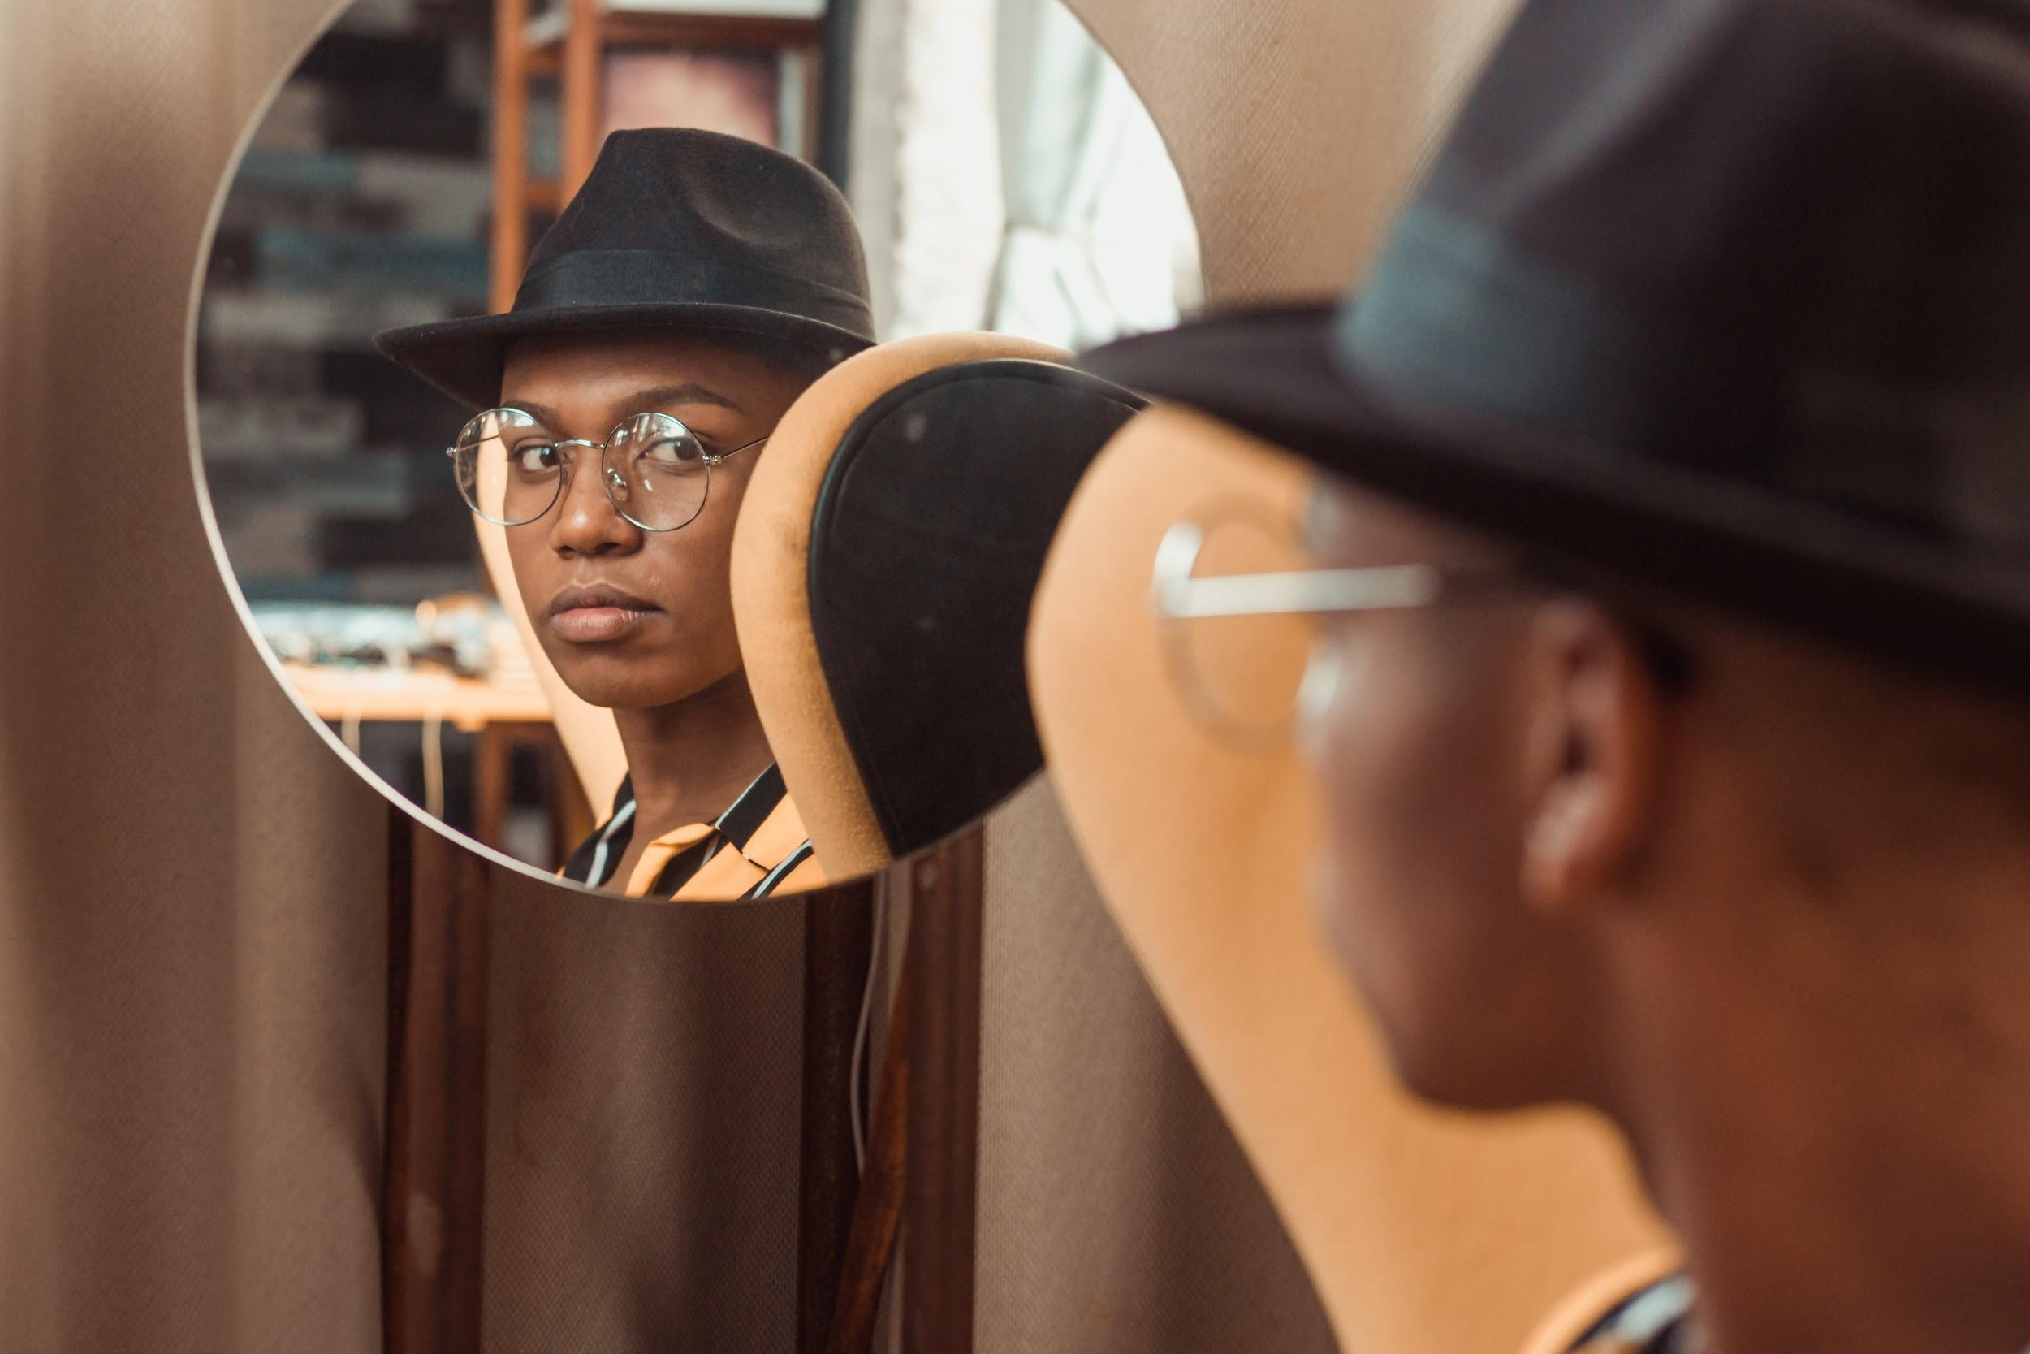
Not dependent on demographics
Mirrors and windows are still important but…
A book can be each of these to the same person via different access points.
It’s time to take the next step to recognizing that books written by diverse authors, featuring diverse characters, are for anyone. All the time.

Slide 8
Collection Development
Buy
Display
Promote
Read?

Slide 9
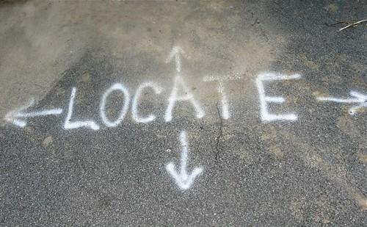
Buy
Discover
Locate
Purchase
This Photo by Unknown author is licensed under CC BY-SA-NC.
This Photo by Unknown author is licensed under CC BY-SA.

Slide 10
First, the general ground rules
The Ground Rules:
You will make mistakes -- you either win or you learn. No life or death stakes here.
You must be adaptable
You must be curious
Buying diverse materials is remarkably similar to buying materials by white, Christian, straight, cis people.
Your job is to open the floodgates, not be a gatekeeper.

Slide 11
Discover
Discoverability of titles by diverse authors is getting easier, but it is still going to take some extra work.
Abolish the expectation that it's only worth doing if it is easy to do.
Where are you looking for books? Who has your attention?
Do you audit your orders?
Let's you know not only what you're ordering, but keeps it front of mind what you're seeing in your usual discoverability spaces

Slide 12
The progress train keeps moving along
Overdrive, Baker & Taylor, and Ingram all have tools for diversity audits in the works.
The devil is definitely in the details. Be sure you know what you’re paying for.
Think about what you want the product to provide.

Slide 16
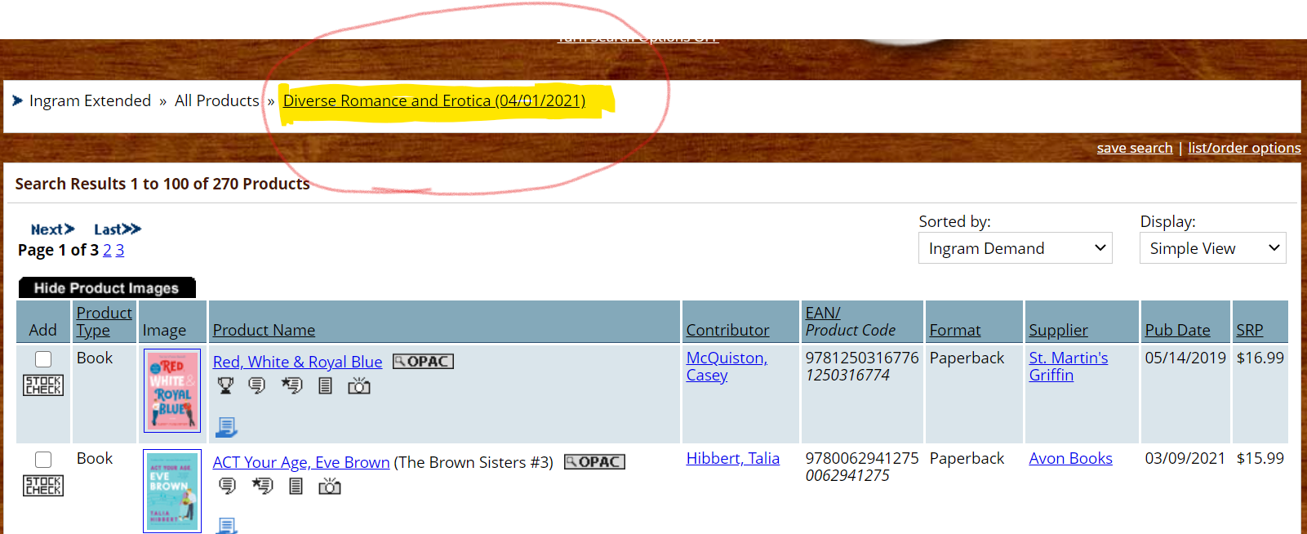
Take advantage of vendor work

Slide 17
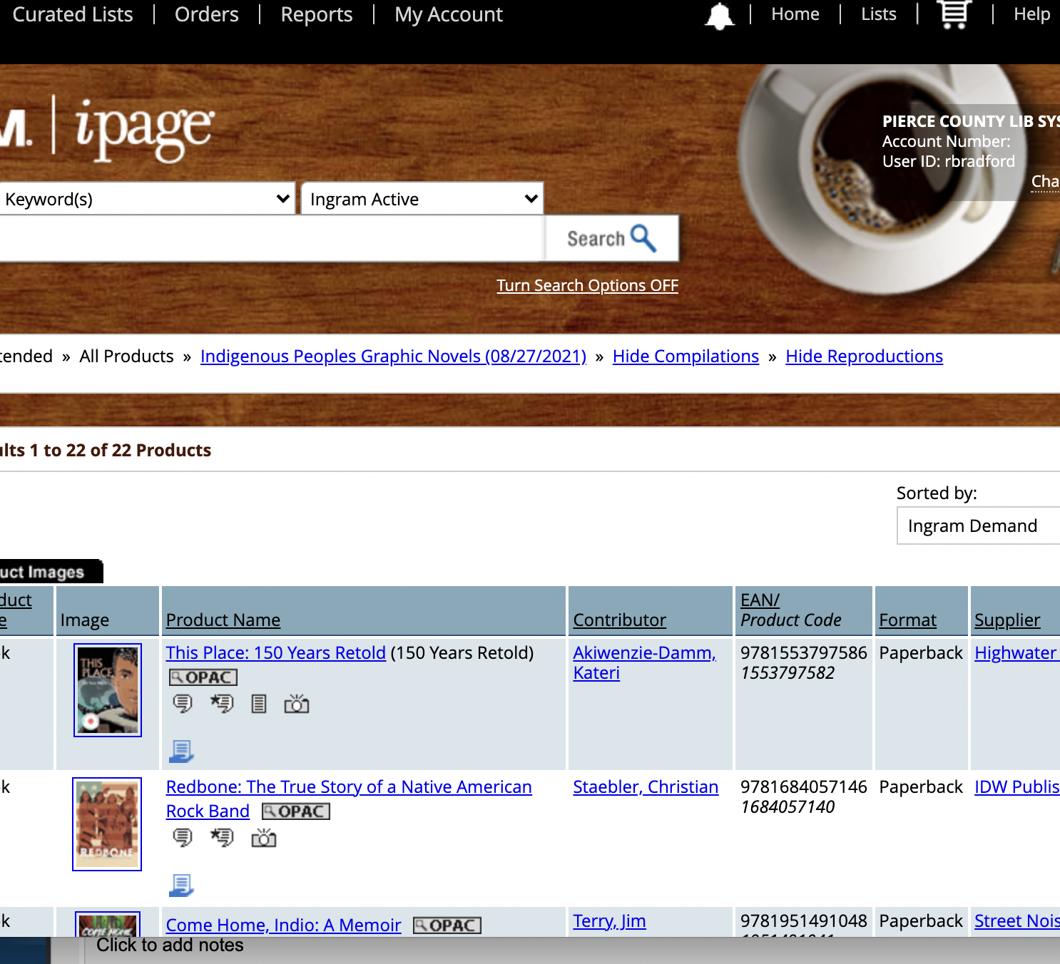
Take advantage of vendor work

Slide 18
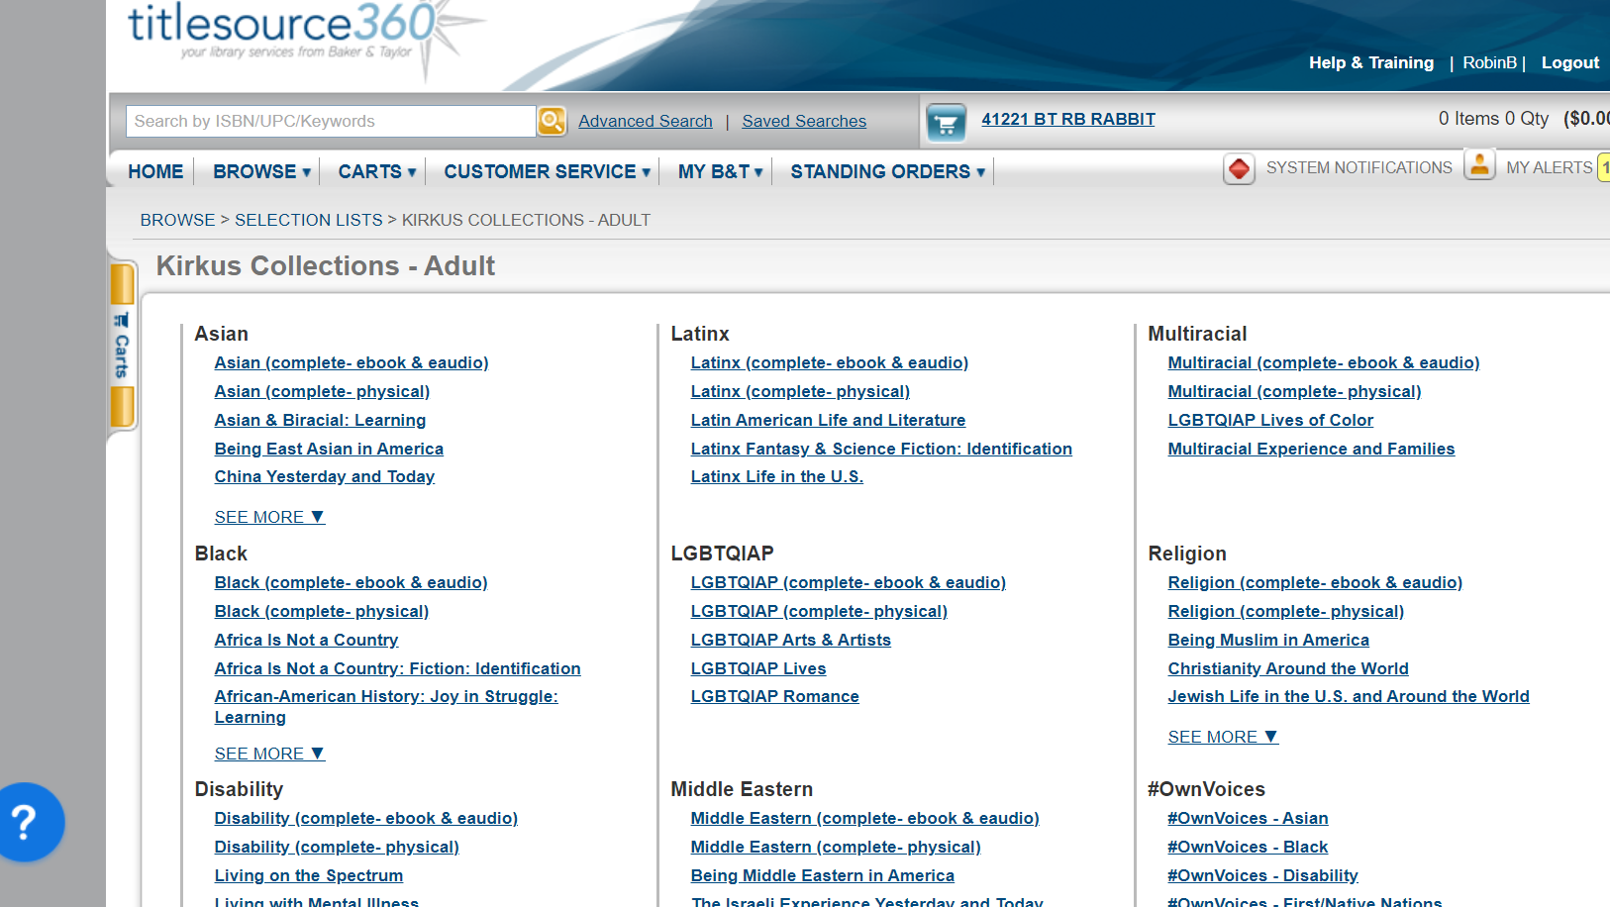

Slide 19
Locate
The vendors have created things to help identify titles
Some vendors are better than others at carrying items, especially self and indie published items

Slide 21
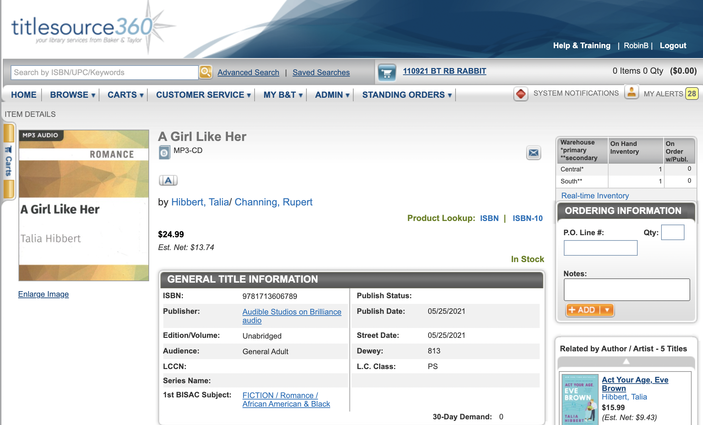
Purchase?

Slide 22
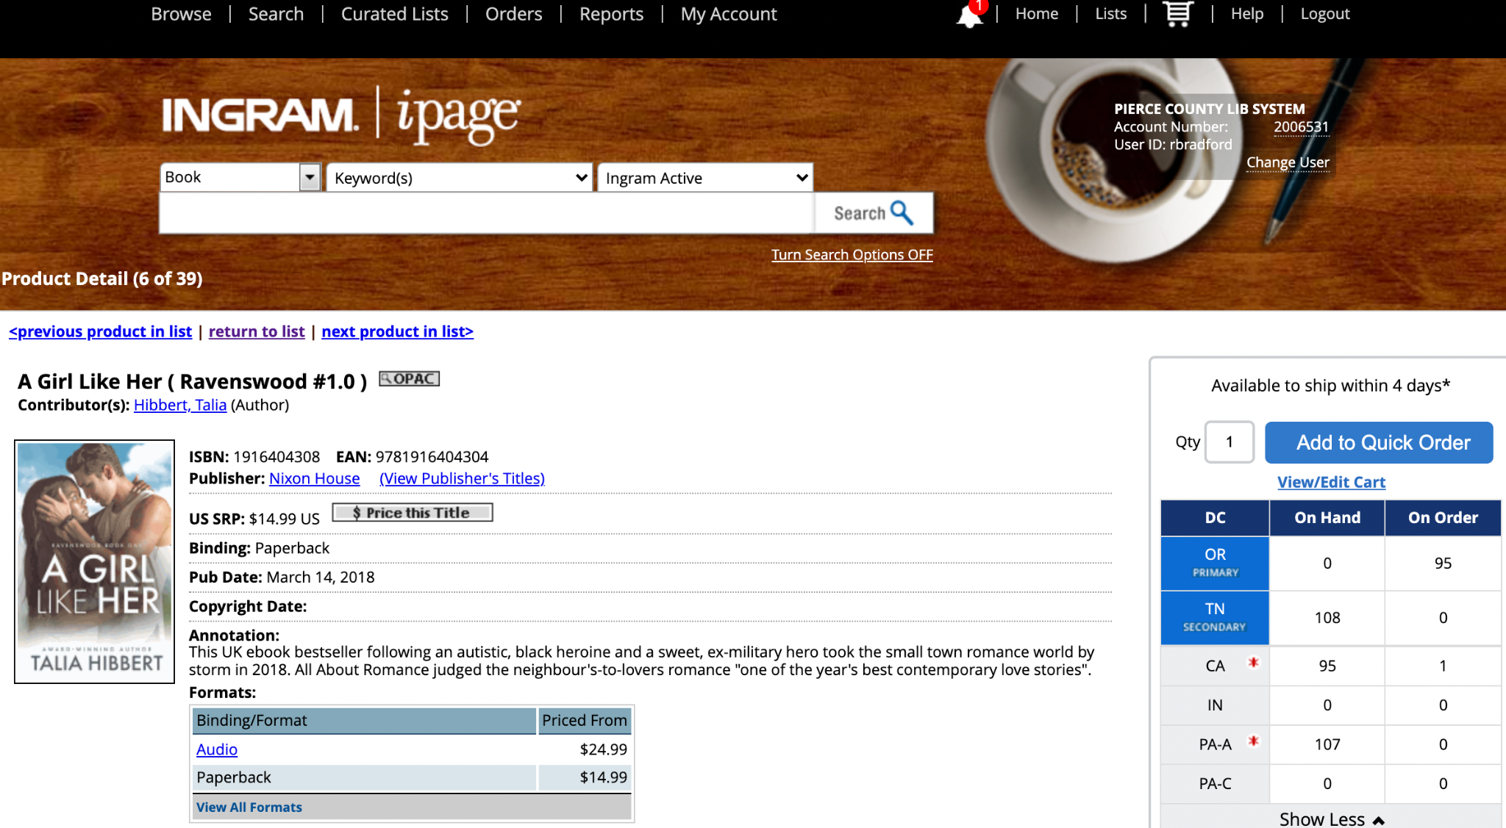

Slide 23
In the real world
Things are getting easier to find
Effort is still required
Place the blame where it lies – low science fiction circulation = low science fiction circulation, but low science fiction circulation by authors of color = nobody wants to read books by "those" people.

Slide 24
So that’s it?

Slide 26
Display and Promote

Slide 27
Purchase is half the battle...
Once you have diverse items in your collection, then what?
Don’t ignore those items in the collection.
Give them the same treatment that you give other books in the collection.
Don’t forget them for displays and lists and every other way you will market your collection.
Books have many entry points, celebrate them all.

Slide 28
Yes, Trans character. But also…legal thriller, urban/set in New Jersey, tackling timely issues such as trafficking.

Slide 29
How else can I help?
Buy to Try not Buy and Die
Market ALL the collections, not just the physical collection

Slide 30
Buy to Try
Once you have bought material, it's time to promote and market it as you would other materials.
Your booklists are a great place to feature things you've purchased, including diverse materials
Recognize that books by diverse authors aren't marketed to the same extent that other books are, so the built in audience is smaller. That is not a reflection of the worth of the book.

Slide 31
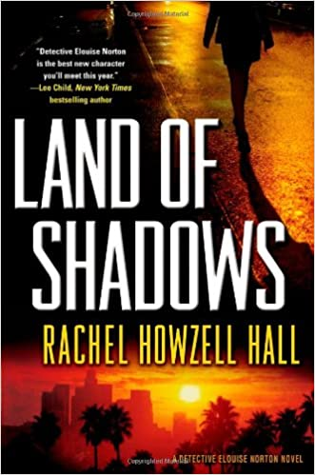
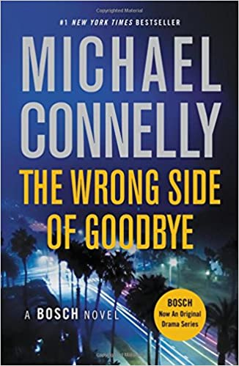
If your patrons love police procedurals…

Slide 32
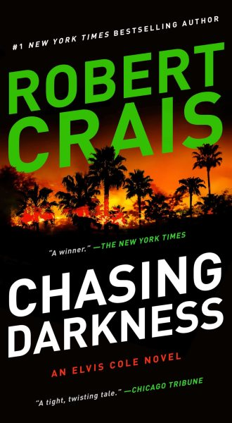
If your patrons love former police turned independent investigators…

Slide 33
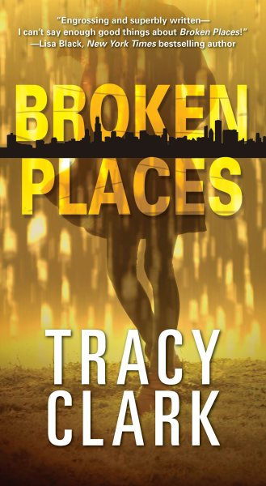
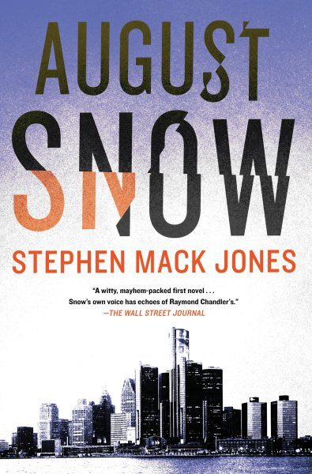
Then try these!

Slide 34
Display and Promote
There is diversity everywhere, we just don't always recognize it.
You don't have to wait until June to add LGBTQ books to any list where they might otherwise fit.

Slide 35
More than meets the eye
Yes, you can showcase this title during Pride month. But you can *also* showcase it when doing general Science Fiction, or fiction about orphans, or uncovering sinister plots...all the things that also happen in this book.

Slide 36
Decolonize your thinking
Don't limit your diverse books to subjects you think diverse people should be experts in.
Promote for the subject of the book the way you promote for author identity.
That doesn't mean stop buying books about racism, sociology, civil rights, and BIPOC history.
This isn't an Either/Or proposition, it's a Both/And proposition.

Slide 37
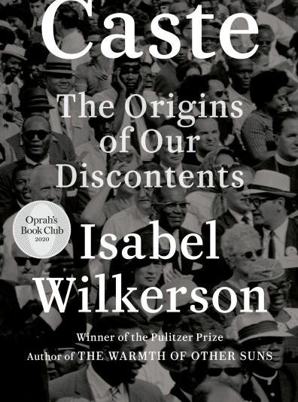
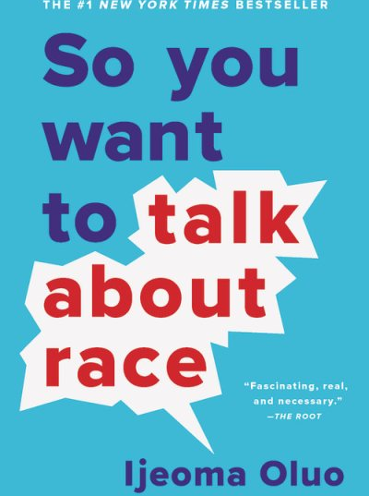
We absolutely still need these! But people can also be experts in…

Slide 38
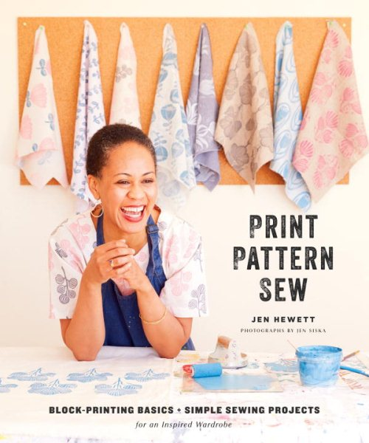
Textiles

Slide 40
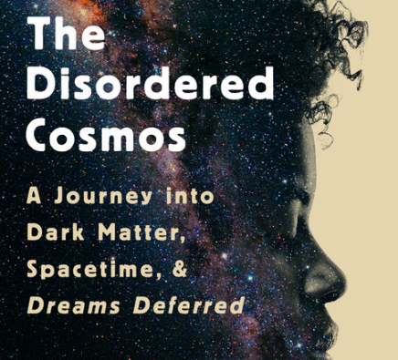

Slide 41
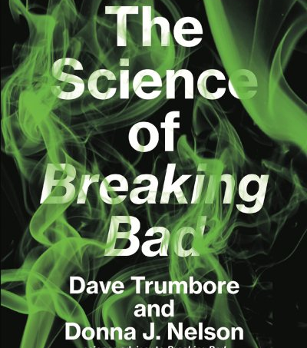

Slide 43
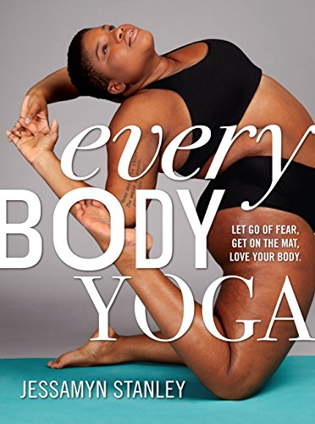

Slide 44
So what’s left to do?

Slide 45
Read!
You clearly don't have to read every book. But, reading widely is beneficial.
Trying new authors, subjects, genres, gives you a wider range of experience of what is available and what you can offer.
If not reading more books, read more things *about* books so you have more to know about and offer – even if you don't have it in your collection

Slide 46
In the words of Sonali Dev…
“So go out and buy a few diverse books, read them, maybe you’ll travel to fantastic and heartbreaking places. Or maybe you’ll find that hearts break in much the same way no matter who you are. And just to know that, to feel that, it might be worth it.”
Contemporary Romance Writers blog May, 2014

Slide 47
YOU are the valuable commodity
Books may be the picture, but YOU (and your skills and abilities) are the frame.
Without you, none of this works on any level.
Diverse books exist and have existed for years. YOU are the bridge that get them into your patrons hands. Buy them, read them, rec them and your patrons will do the same.

Slide 48
Thank you
Robin.Bradford@gmail.com
Twitter: @Tuphlos

