Slide 1
Making Makerspaces More Welcoming to Girls & People of Color
Casey McCoy
Public Librarian
San Jose, CA

Slide 2
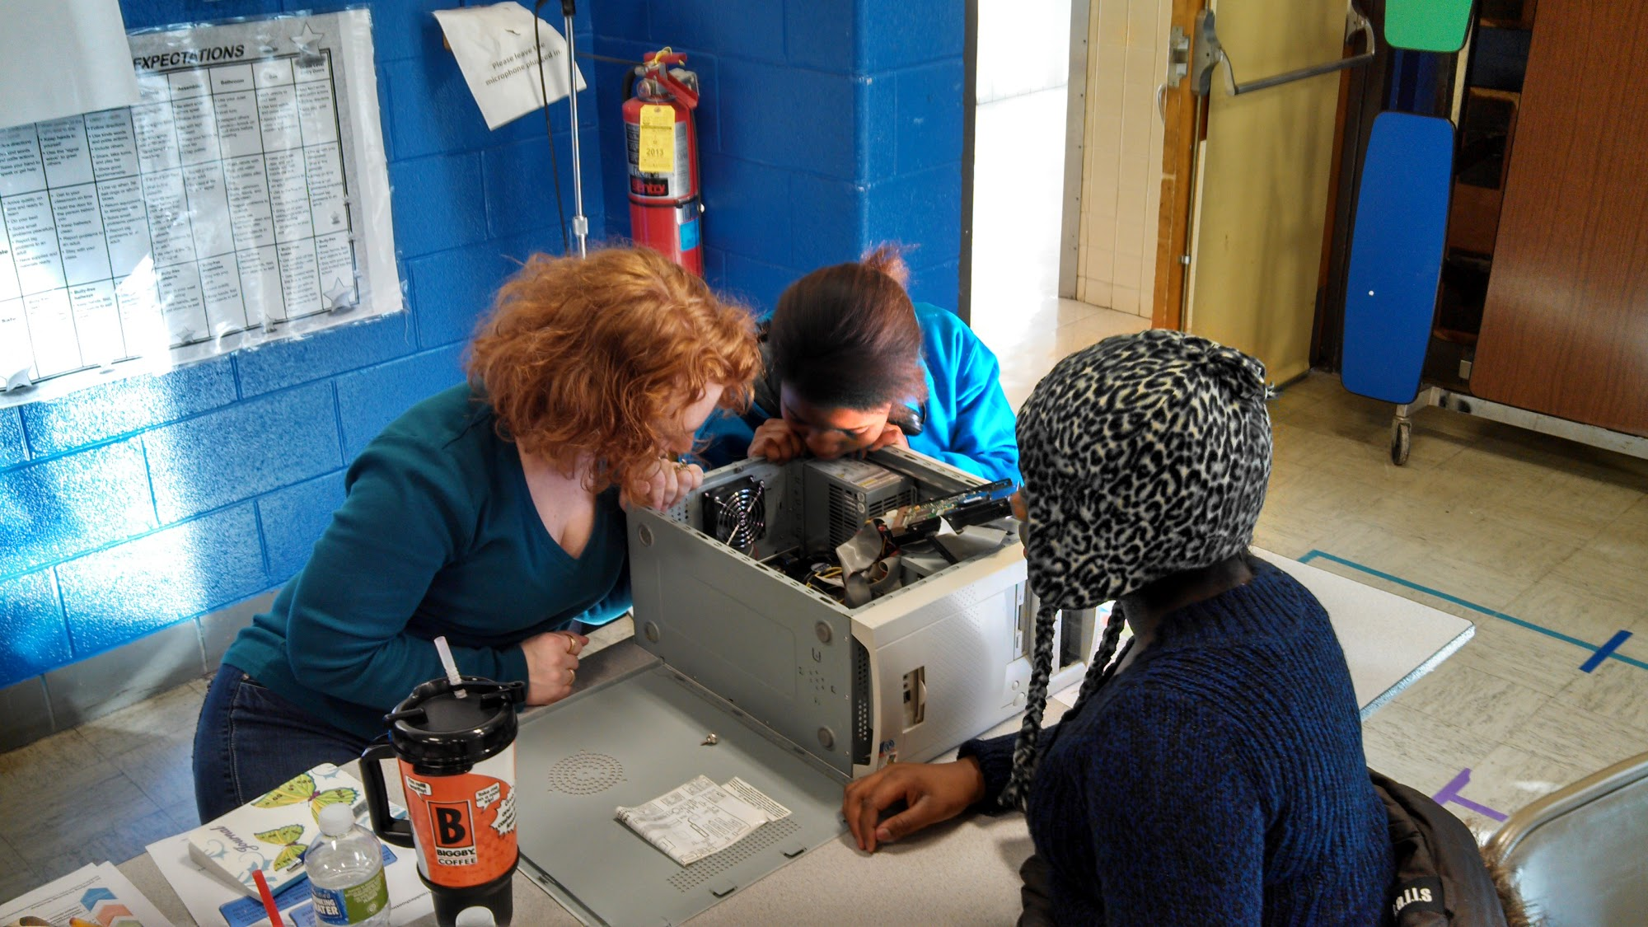
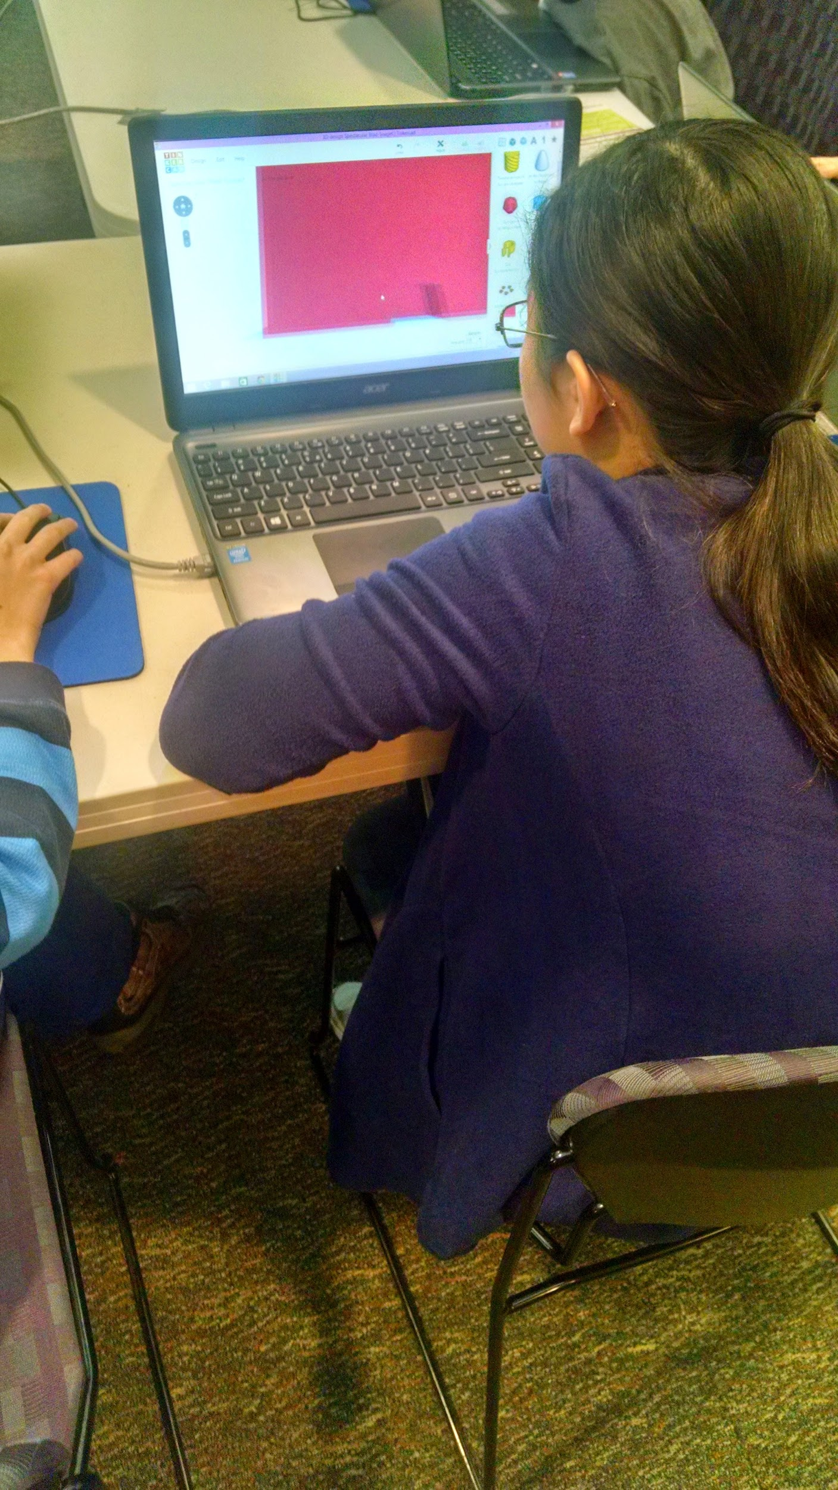
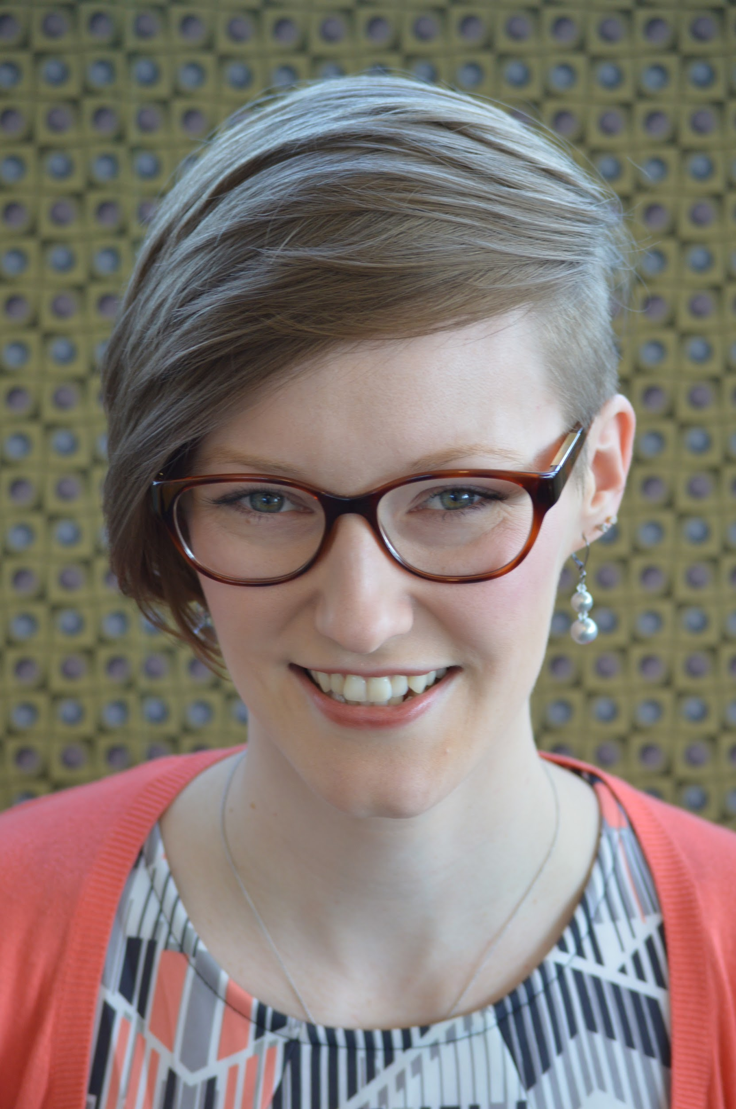
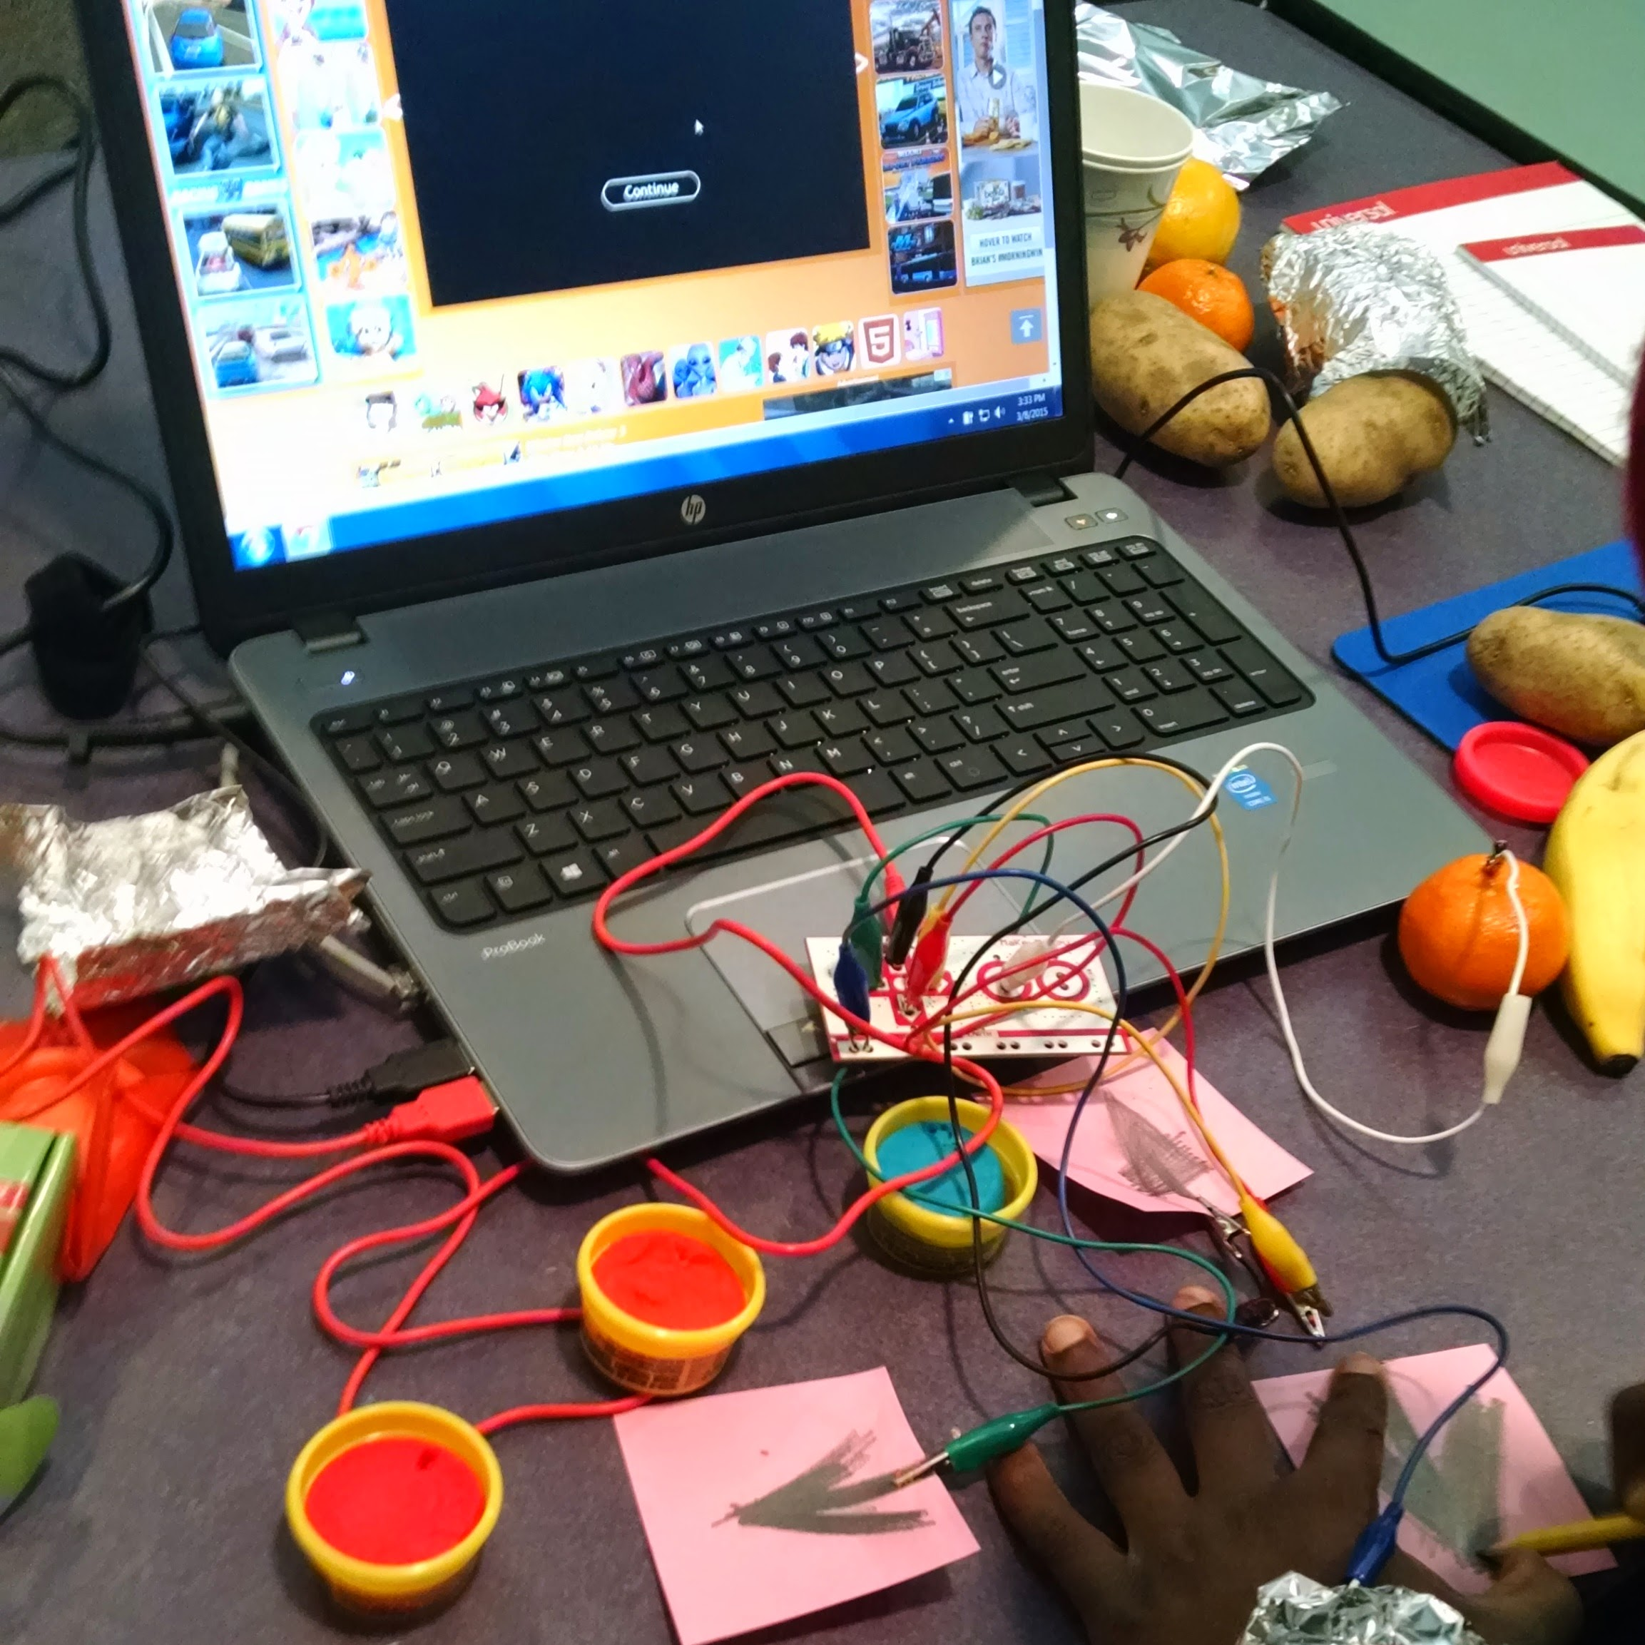
About Me
Notes:
University of Illinois, Champaign-Urbana: “micro-urban”, 16% African American, high rate below poverty line, Kenwood over 70% free/reduced lunch
Kenwood/Community Informatics Studio: Technology, Literacy for Community (TLC)
Urbana Free Library
Lincolnwood - Program Coordinator: 29% Asian, nuclear family suburb with above average income
STEAM Night
Teen Tech Week
San Jose - Branch Librarian: urban area, over 60% Asian, majority bachelor degree or higher and very low free/reduced lunch rate
Girls Who Code: 6 girls, mostly Asian

Slide 3
My favorite subject is…
Computers
Notes:
School: Second grade, group rotations, independent computer station: task followed by free play
At home role models: home computer in 3rd grade, older male cousin tech role model, best friend’s mom work with computers
Community Informatics: connect passion of working with people and technology, public libraries!

Slide 4
“makerspaces are community centers with tools”
-Makerspace
“The idea of a “makerspace” is a shaggy concept, encompassing a wide range of ideas and no foolproof recipes for success.”
-Made in Baltimore
“The contemporary Makerspace is really about bringing people together to create something using digital or analog technology.”
-LibraryLinkNJ
Notes:
Made in Baltimore: step by step process of creating a new makerspace to serve as a guide to creating your own makerspace on any scale or budget
Raise Hands: Who has a makerspace of any kind in your library or school?

Slide 5
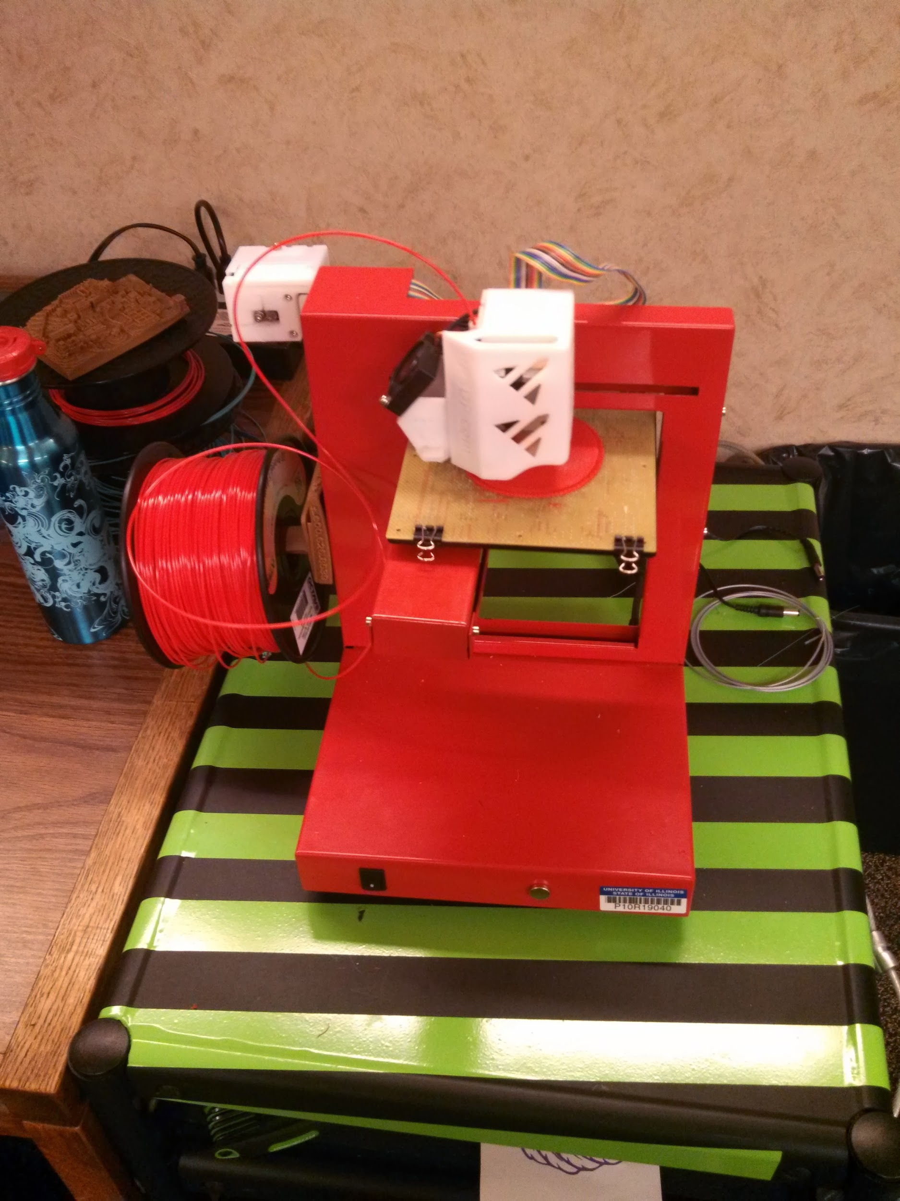
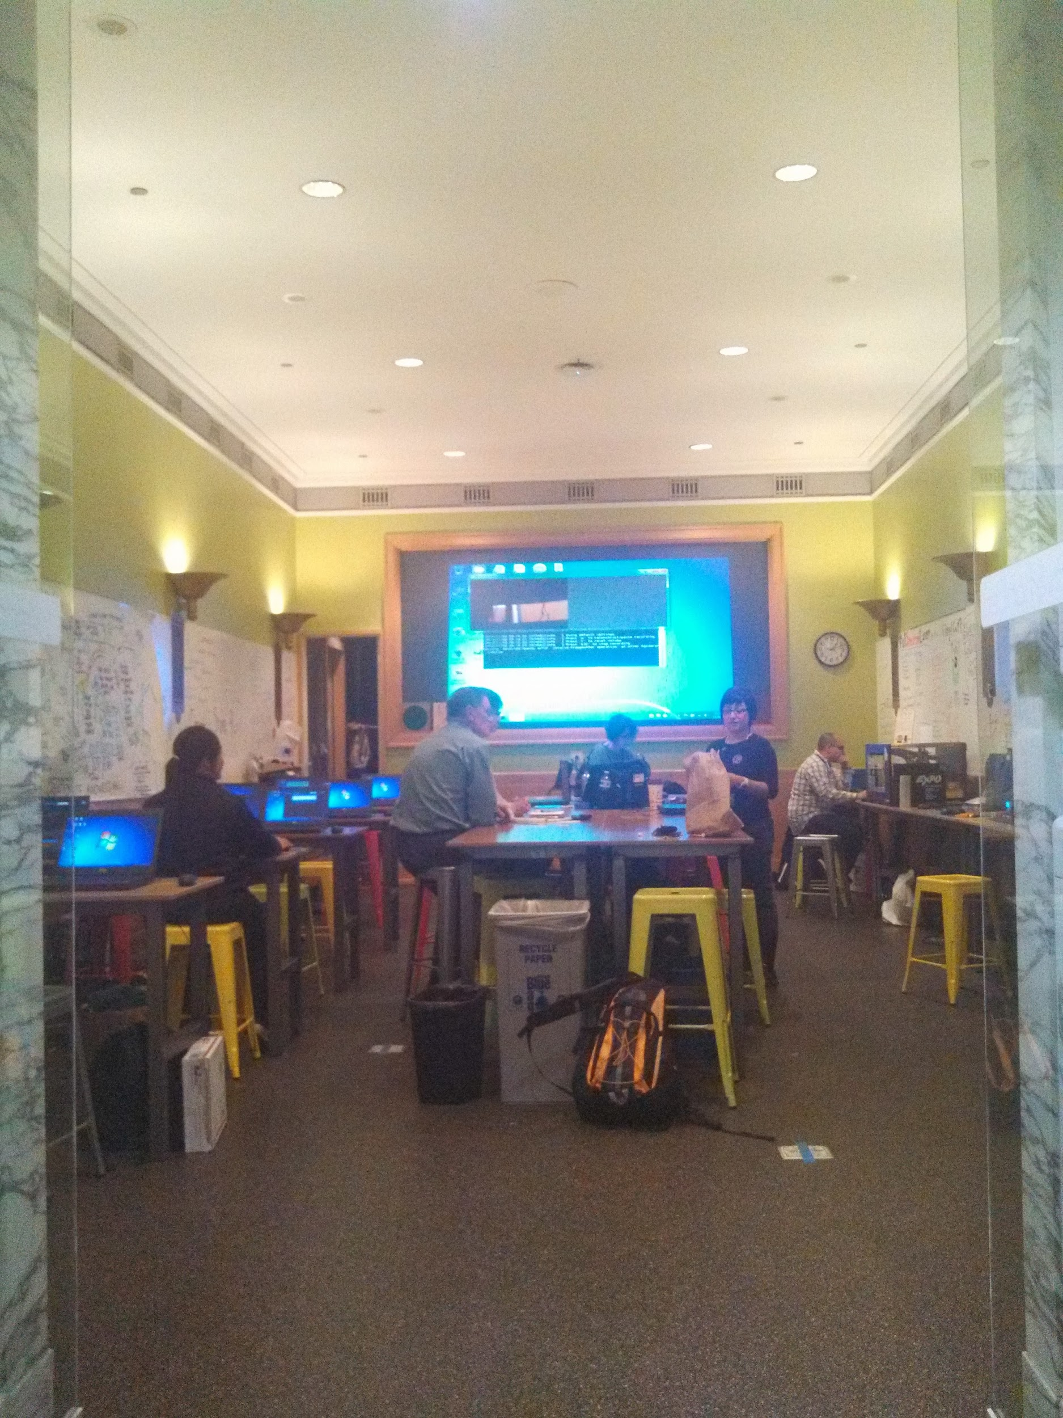
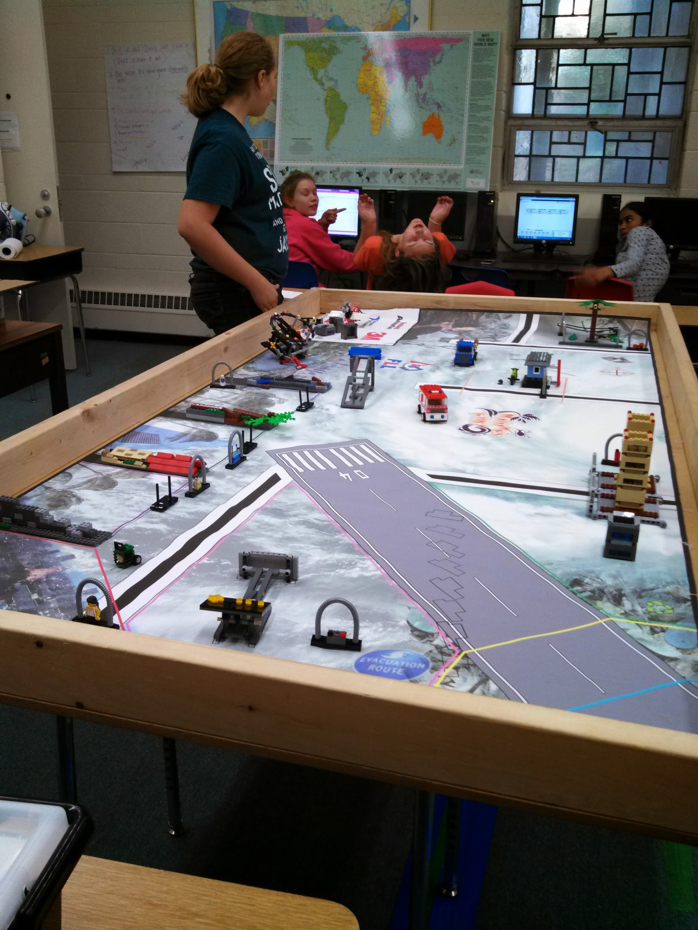
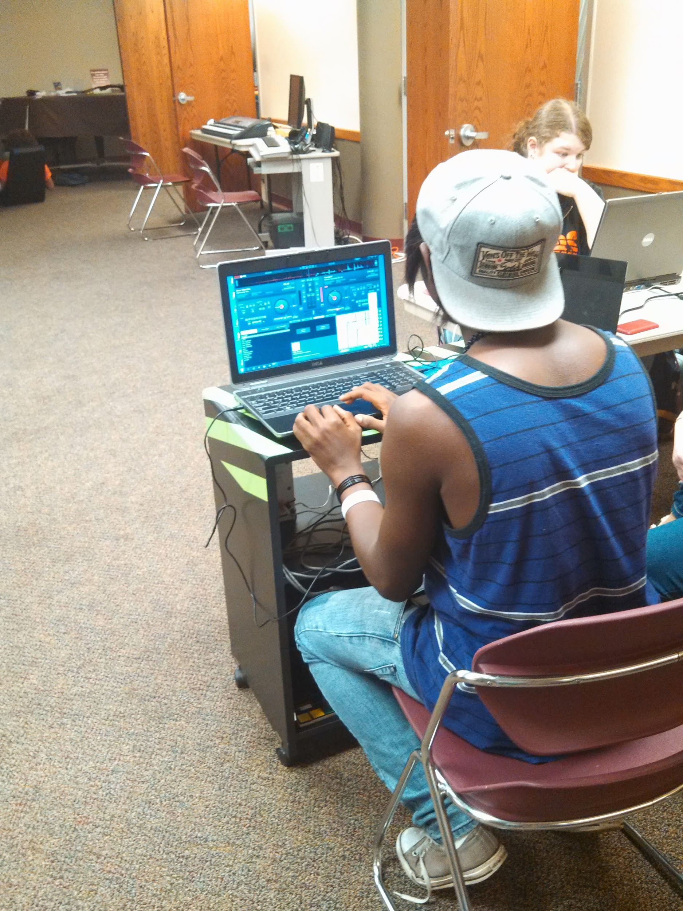
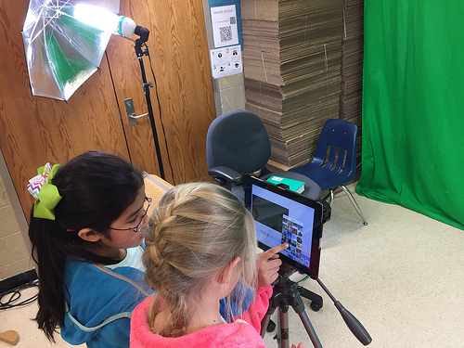
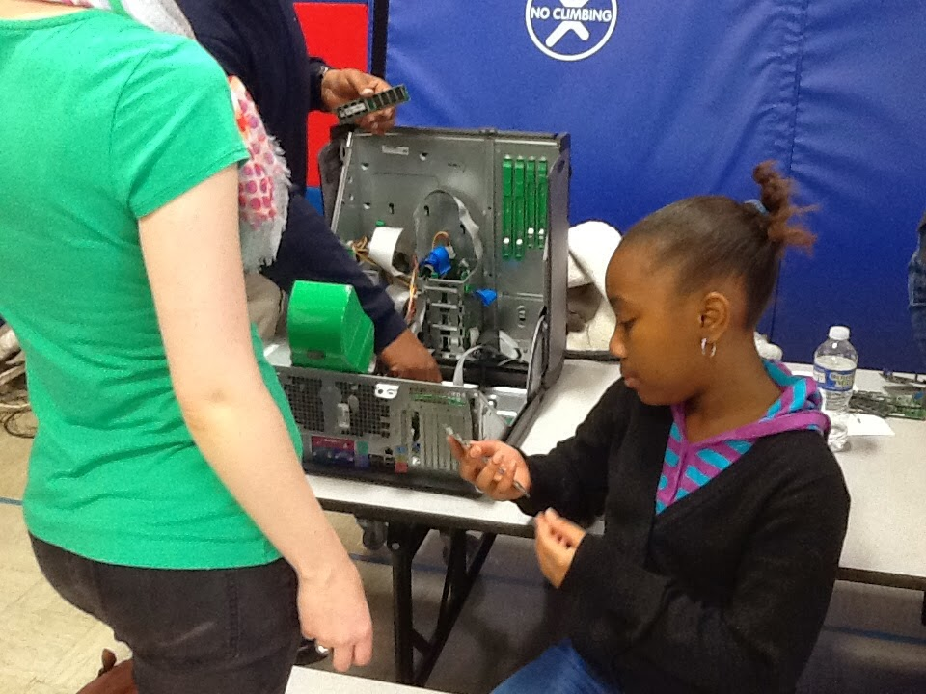
Notes:
High Tech: TUFL Teen Lab 3D printer, CPL Maker Lab, LEGO Mindstorms for First LEGO League, Kenwood’s Demystifying Tech Workshop for Families, TUFL Teen Lab DJ, green screen for video production

Slide 6
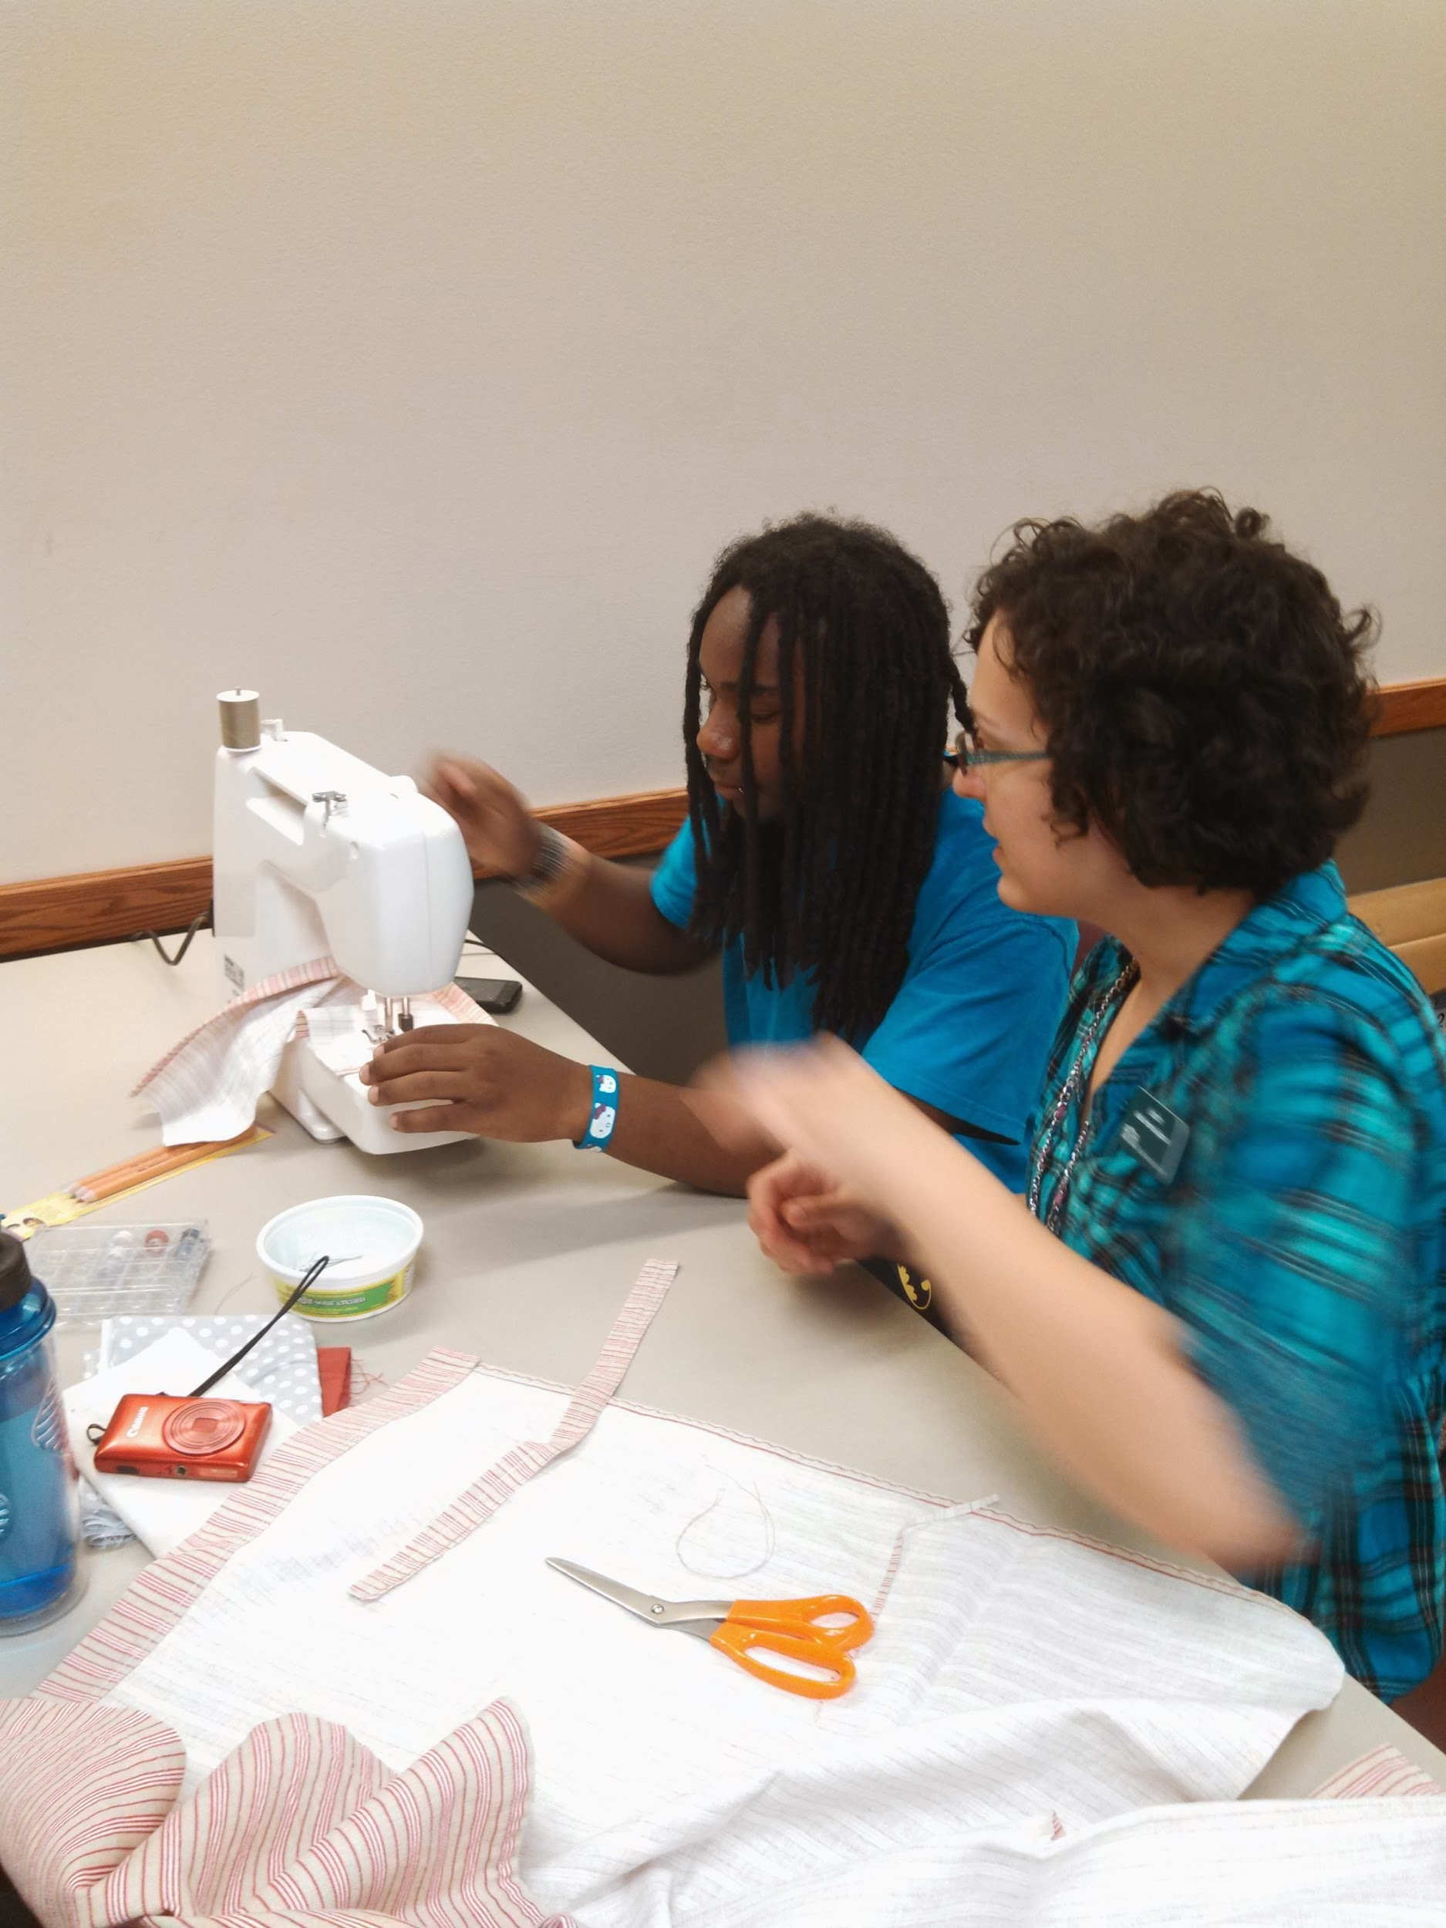
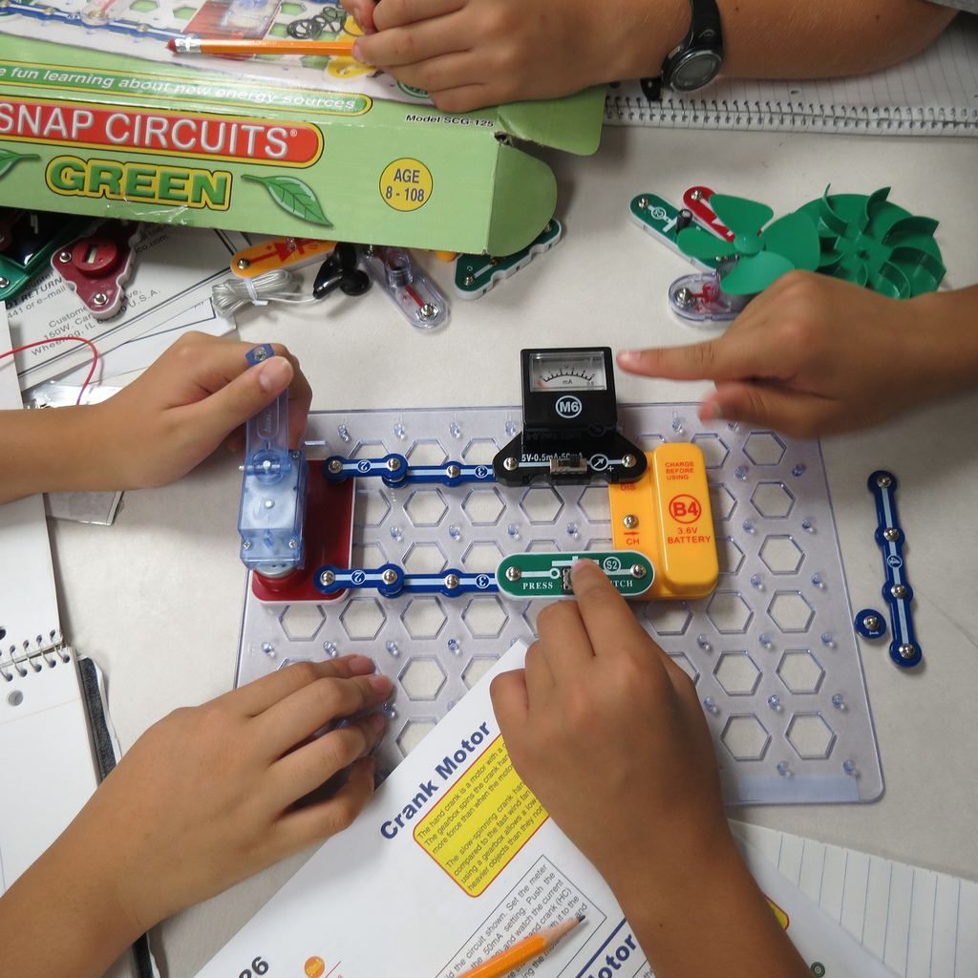
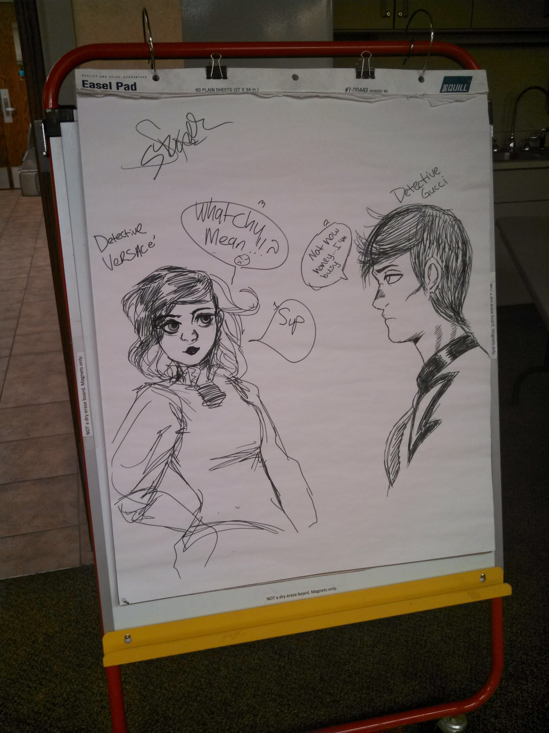
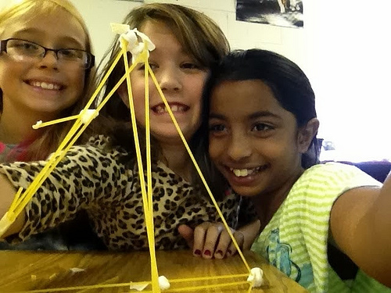
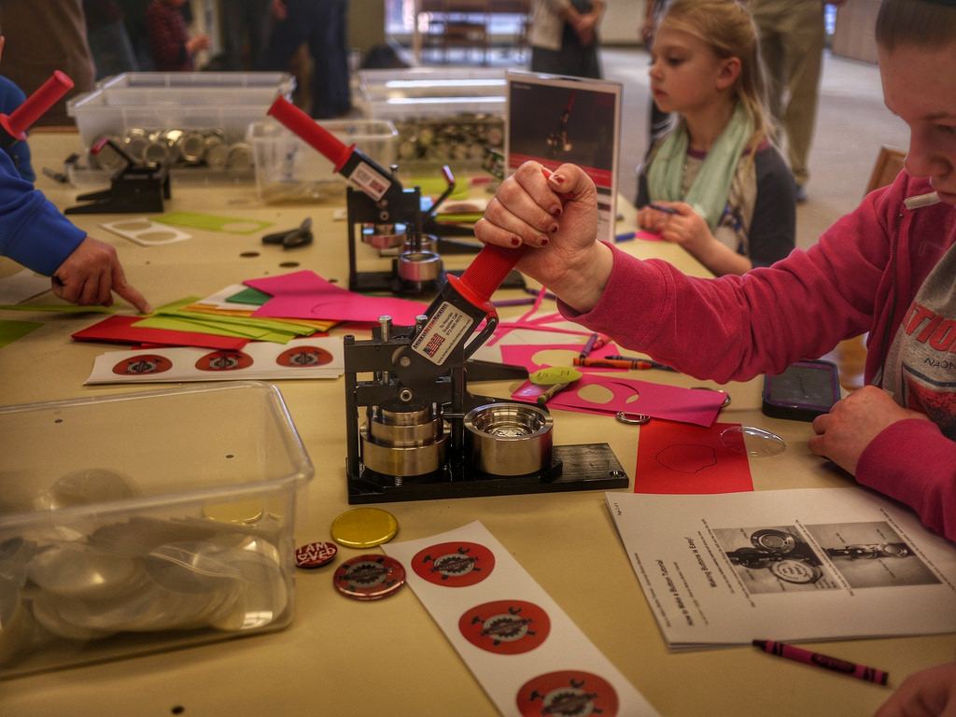
Notes:
Low Tech: TUFL Teen Lab sewing, simple STEM kits like snap circuits, TUFL Teen Lab drawing, engineering projects like spaghetti and marshmallow towers, button making

Slide 7
But why focus on girls and people of color?
Notes:
Bigger picture of women in computing majors and career force

Slide 8
U.S. Women & Technology (2014)
57% of professional occupations
26% of professional computing occupations
6% of corporate Chief Information Officer positions
56% of AP test-takers
47% of AP Calculus test-takers
20% of AP Computer Science test-takers
57% of 2013 bachelor’s degree recipients
18% of 2013 Computer and Information Sciences bachelor’s degree recipients
vs
37% of 1985 Computer Science bachelor’s degree recipients
Notes:
https://www.ncwit.org/sites/default/files/resources/btn_04032015_web.pdf

Slide 9
26% women in computing
5% Asian
3% African-American
1% Hispanic
Notes:
https://www.ncwit.org/sites/default/files/resources/btn_04032015_web.pdf

Slide 10
Girls...
Lack sufficient female role models in computer science and engineering
Prefer sciences that are clearly connected to helping others
Turned off by the “isolated geek” stereotype that dominates their view of computer science and engineering
Don’t tinker
-Teaching Girls to Tinker
Notes:
Teaching Girls to Tinker: http://www.edweek.org/ew/articles/2009/11/11/11damour.h29.html
Same can be said for minorities, or any non-white male that still dominates STEM field
-71% non-hispanic white, 74% men according to Census 2011: https://www.census.gov/prod/2013pubs/acs-24.pdf

Slide 11
What can libraries do?
Identify needs and assets of underrepresented populations in your communities
Implement plans and policies to create a welcoming space for girls and people of color to "make"
Initiate ongoing reflections and dialogue with staff, community leaders and participants

Slide 12
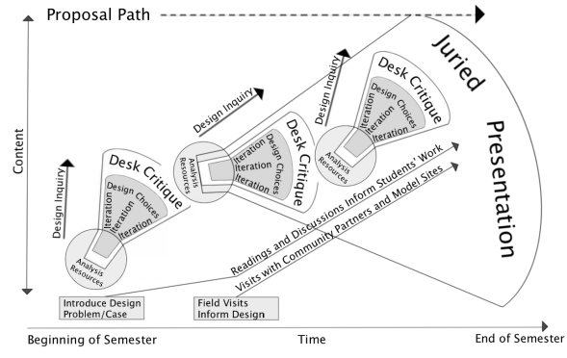
Community Informatics Studio model based on Kay Brocato’s Studio Based Learning proposal path

Slide 13
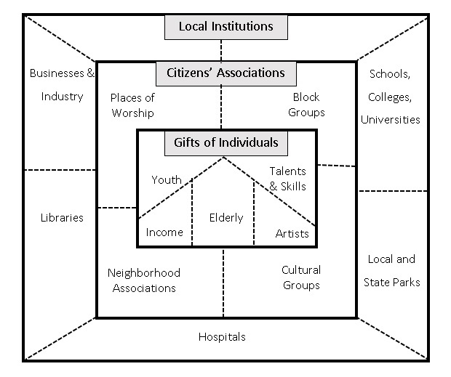
Identify Needs and Assets
Analysis & Resources
Community Asset Map “Asset mapping involves understanding the array of capacities and social networks, what some call social capital, on which social change projects can be built. Asset mapping diagnoses what is present.”
“Always ask the turtle.”
Notes:
Randy Stoecker, Research Methods for Community Change
Asset mapping is part of the asset-based community development (or ABCD) model made famous by John Kretzmann and John McKnight.
Focusing on needs-based community development “portrayed poor communities as helpless and powerless. Consequently, resources were directed to outside experts and service providers rather than to the community itself, reinforcing the perception that the community was incapable of helping itself.” pg 11
Kenwood: partner with UofI, old computers from state, multiple programs turn students into experts
Gloria Steinem, My Life on the Road pg. 177

Slide 14
Give ‘em What They Want
Public Librarian from Vermont:
We scoured the interwebz and expedited pink, purple, and whatever accompanying 'girl' minifigs we could find for the next week. You should have seen the smiles! One of the girls, maybe 5 or 6 said "it just magically turned pink because I'm amazing and I wanted to make it that way." Making makerspaces welcome might only require letting them have the pieces they want to make with.
Public Librarian from Texas:
Good mix of genders up until age 12, then mostly boys. Over the Christmas break we had two "mini-camps" - the LEGO Mindstorms program was mostly boys, the stop-motion animation was mostly girls. These were small groups (around 10 kids each), so it's hard to make generalizations. But I know some of the girls who came to the stop-motion camp came because the content was more interesting to them than the more technology/circuits/robots stuff we do.
Notes:
Vermont: LEGO program where overheard girls asking why there weren’t girl LEGOs, they didn’t have any purple clothes, etc.

Slide 15
Implement Plans and Policies
Iteration & Design Choices
Solicit feedback and input in the design and creation of the space
Provide a library space that reflects the community in which they live
Ensure the space has appropriate acceptable use and age policies to make them feel welcome and safe
Provide furniture and technology that is practical yet adaptive
-YALSA’S Teen Space Guidelines
*Collaboration*
-Center for Research on Girls
Notes:
YALSA’s Teen Space Guidelines: http://www.ala.org/yalsa/guidelines/teenspaces
Engaging Girls in STEM: Collaboration: http://www.ncgs.org/Pdfs/Resources/Collaboration.pdf
The research literature on engaging girls in STEM fields shows that girls prefer STEM work when they are able to work in collaboration with each other.
Studies have identified several additional benefits of collaboration for women in STEM fields: higher quality work produced in less time than working alone, improved understanding of course material, improved course completion rates and performance on exams, and increased enjoyment of activities such as computer programming.
Be Flexible! Story of TUFL start with a couple laptops and teens...

Slide 16
“A lot of the way we acquire intellectual ability and skills and how we learn new content is pretty similar,” Willingham says. Teachers, he said, should think about what they want students to take away from the lesson and then find a way to make sure that’s what they are thinking about during the lesson.
You may think you learn better in a certain way. You actually don’t

Slide 17
Initiate Reflection and Dialogue
Desk Critique
Stop focusing solely on attendance, instead measure:
Improvement of knowledge and confidence
Impact on community
Long-term goals
Work with participants to create tools to measure effectiveness:
Pre- and post-surveys
Conduct evaluations often
Redesign evaluation tools as needed
Respond and update programs
Share with stakeholders
-YALSA’s Teen Programming Guidelines
Notes:
YALSA’s Teen Programming Guidelines: http://www.ala.org/yalsa/sites/ala.org.yalsa/files/content/TeenProgramingGuidelines_2015_FINAL.pdf
Kenwood: ongoing program

Slide 18
#5. Having a “growth mindset” means understanding that we are not born knowing how to do things, but instead learn how to do new things and improve our skills. Rather than saying, “You’re smart,” celebrate persistence by saying, “What did you learn from that project?” Learning from mistakes is an important step in gaining new skills.
Top 10 Ways Families Can Encourage Girls’ Interest in Computing
Notes:
Back to step one!
Example: Kenwood “girls only” coding club

Slide 19
Use Others (re: don’t reinvent the wheel)
San Jose Public Library (CA): Girls Who Code
Sunnyvale Public Library (CA): Make-Her
Kenwood Elementary School (IL): Library Media Center blog
The Urbana Free Library (IL): Teen Open Lab
Chicago Public Library (IL): YOUmedia and Maker Lab
Skokie Public Library (IL): Grrrls Code
Clover Middle School (SC): Makerspace
Make South Bend (IN): Female founder, “Chick-In-Charge”
Local:
NJ Makerspaces Project Contract Award Winners
NJ Library Makers Toolkit Workshop
NJ Makers Day

Slide 20
Use Others (re: don’t reinvent the wheel)
Girls Who Code
Black Girls Code
Made with Code
Hour of Code
Girlstart
CompuGirls
National Center for Women & Informational Technology
What other organizations can help provide programs and resources for your community?
“More girls tried computer science than in the last 70 years.”
-Hour of Code
Notes:
Made with code: design Zac Posen dress, Disney Inside Out, Female Mentors

Slide 21
“It’s not really a question of what you’re good or bad at. It’s a question of what you want to learn.”
Maddy Maxey, Made with Code Mentor

Slide 22
Presentation Resources
Makerspace: http://spaces.makerspace.com/
Made in Baltimore: http://makezine.com/2016/01/13/made-in-baltimore-what-kind-of-makerspace-to-build/
LibraryLinkNJ Makerspace Resources: http://librarylinknj.org/projects/makerspaces#contract
U.S. Women & Technology (2014): https://www.ncwit.org/sites/default/files/resources/btn_04032015_web.pdf
Teaching Girls to Tinker: http://www.edweek.org/ew/articles/2009/11/11/11damour.h29.html
Community Informatics Studio model: http://prairienet.org/op/demystifying/de-mystifying-technology-workshop-for-families/design-rationale/
Kay Brocato, Stuio Based Learning: http://ed602.weebly.com/uploads/3/2/6/7/3267407/studio_based_learning_in_higher_ed.pdf
Stoecker, Randy. Research Methods for Community Change: A Project-based Approach. Thousand Oaks: Sage Publications, 2005. Print.
Steinem, Gloria. My Life On the Road. First edition. New York: Random House, 2015.
YALSA’s Teen Space Guidelines: http://www.ala.org/yalsa/guidelines/teenspaces
Center for Research on Girls: http://www.ncgs.org/Pdfs/Resources/Collaboration.pdf
You may think you learn better in a certain way. You actually don’t: http://qz.com/568617/you-may-think-you-learn-better-in-a-certain-way-you-actually-dont/
YALSA Teen Programming Guidelines: http://www.ala.org/yalsa/sites/ala.org.yalsa/files/content/TeenProgramingGuidelines_2015_FINAL.pdf
Top 10 Ways Families Can Encourage Girls’ Interest in Computing: https://www.ncwit.org/resources/top-10-ways-families-can-encourage-girls-interest-computing/top-10-ways-families-can
Made with Code Mentor: https://www.madewithcode.com

Slide 23
Casey McCoy
Twitter @CayMcCoy
camccoy90@gmail.com
http://caseyamccoy.wordpress.com

