Slide 1
Actively Anti-Racist Service to Leisure Readers- RA
Presented by: Becky Spratford
LibraryLinkNJ & NJLA
January 21, 2022
bspratford@hotmail.com
@RAforAll

Slide 2
Not Racist vs Anti-Racist
Start with:
Libraries are NOT Neutral
Systemic racism is real [please click and watch]
Get comfortable with being uncomfortable
We have BIG problems with these simple edicts.
Anti-Racist requires ACTION and it will be uncomfortable
EDI is more than racism but we will start there

Slide 3
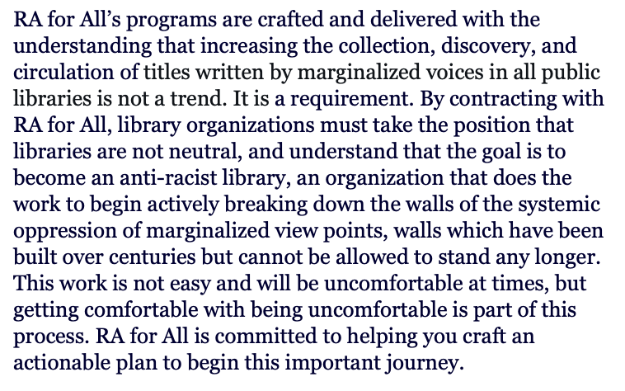
Action Step: Mission Statement
RA for All: EDI MIssion Statement

Slide 4
Action Step: Document It
Craft policies & procedures for actions steps
Policies- board level
Procedures- staff level
You need to ensure change sticks & demonstrate your commitment
Empowers all staff to act
Can write up those who don’t comply
You can’t fix racism but you can make it against the “rules”

Slide 5
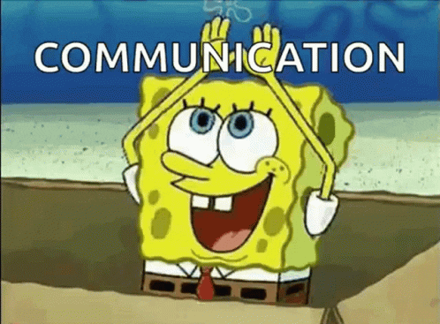
Action Step: Communicate Better
The public doesn’t understand what we do:
Less inflammatory exs
Our Collections need to represent the world
“Cancelling” is not accurate:
Classics change!
Dr Seuss real talk
“Consequences Culture”

Slide 6
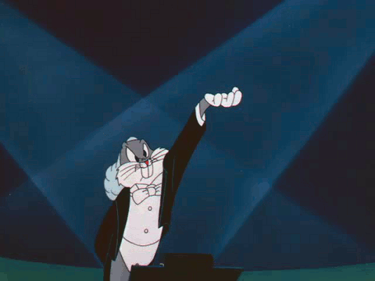
Action Step: Include All Staff
Our support staff are more diverse
Don’t burden marginalized staff to “teach” you
Include staff from all levels in EDI decision making
Front lines deal with conflict
Acknowledge and empower
Show staff you are serious
Normalize using pronouns
Allow them to speak up
Offer CE to all levels of staff
PTO for every employee no matter how few hours they work.

Slide 7
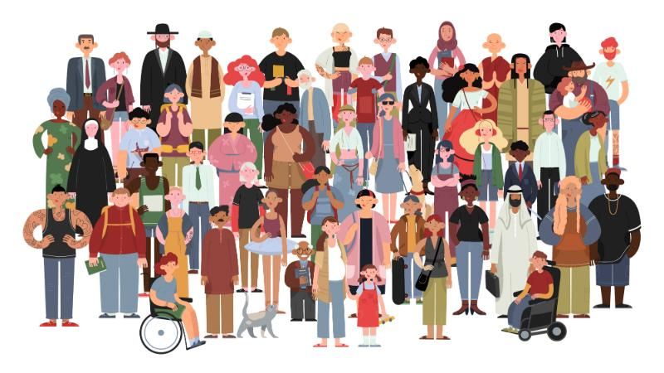
Action Step:
Audit Your Suggestions
Why reading diversely is important*
Move on to action!
Hold yourself and everyone accountable
Institute a marginalized voices requirement!
On everything!
Go back and fix old lists
When suggesting- focus on appeal NOT diversity
Diversity is not a “superpower”
It also is not a genre
*I am done with that passive BS though
Notes:
I used to say passive things like read diversely and suggest diversely. Done. Audit-- hold yourself and everyone accountable

Slide 8
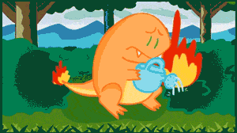
Action Step:
Improve Discovery
Use your catalog, not your spaces to improve discovery
Titles that show real life, not just stereotypes
Luis Alberto Urrea readalikes and a mini-rant
Diverse readalikes for David Baldacci and unintentional racism
Pledge to NEVER only having straight white male readalikes

Slide 9
Action Step: But Don’t Give Hateful Books a Boost
Case Study
No new shelf
Make a spreadsheet of “Titles of Concern”
No display/lists
More aggressive weeding
Available in catalog for discovery
Notes:
https://www.amazon.com/Irreversible-Damage-Transgender-Seducing-Daughters/dp/1684510317/ref=sr_1_fkmr2_1?dchild=1&keywords=transgender+our+girls+economist&qid=1618072570&sr=8-1-fkmr2

Slide 10
Action Step: And Acknowledge Problematic Books
There are many problematic titles
And we are only beginning to identify them
Not all need to go, but we must acknowledge problems
Providing information is what we do
How to handle Little House of the Prairie [Nashville Public Library]
Kids notice the problems
How to handle American Dirt [RA for All]
Different ages, similar approach

Slide 11
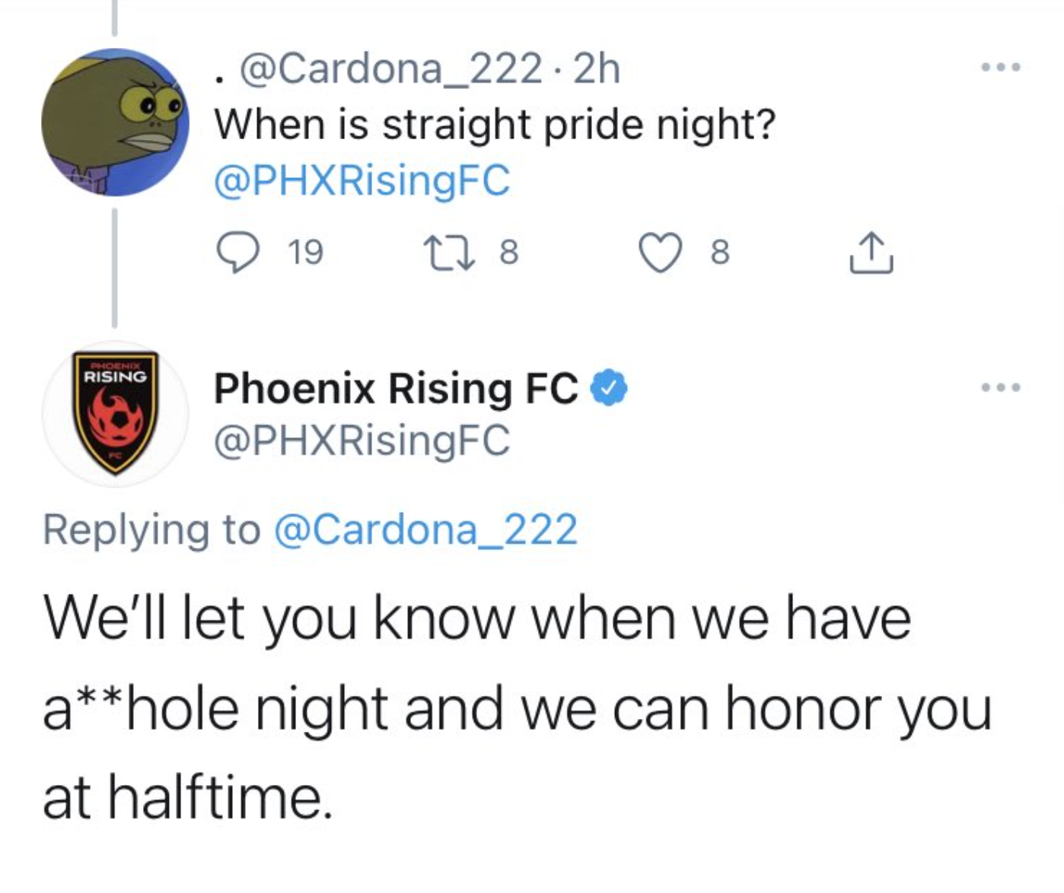
Action Step: Address Outright Bigotry Directly
Being direct is your best weapon
Most people won’t take the bait
But if they do, be prepared to throw them out
Provide talking points for all staff as issues arise
Normalize sharing uncomfortable situations and interactions
Encourage team problem solving
But always respect patron privacy
Real life examples:
I don’t want any black, gay, etc... books
Where are your “normal” books?
I feel unsafe with so many homeless people here

Slide 12
Action Step: Don’t Forget Other Equity Issues
This is about more than race, gender, sexual identity, ability, etc…
Systemic Oppression!
Use our service to readers [our brand] as an ex
Hiring
Security/policing
Internet
CE and mentorship
Stop with fines RIGHT NOW!
Seriously, stop.
Stay on top of issues:
RAILS EDI Pulse Page

Slide 13
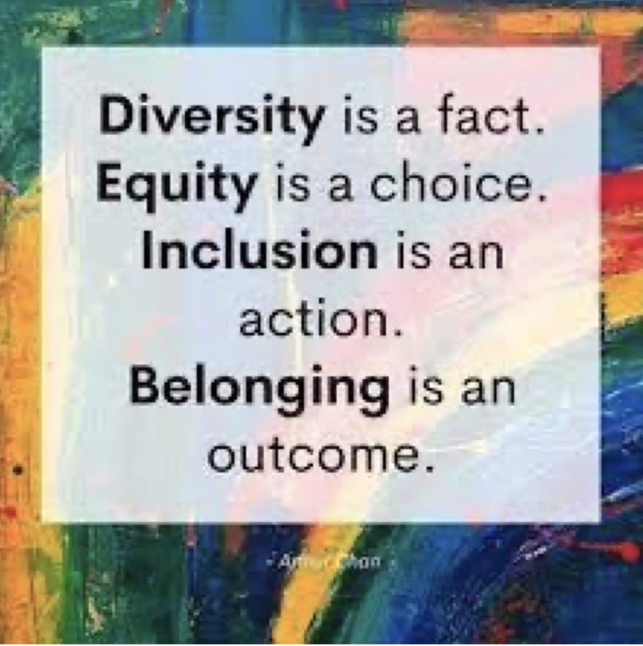
Action Step: Keep Moving Forward
It’s a marathon not a sprint
400 yrs to get here; dismantling will take time
Well meaning is not enough
Action Steps
Get it in Writing
Hold people accountable [ex]
Keep listening
Get comfortable with being uncomfortable.
Set the example for EDI with your actions.
Inspire change throughout your community and in the world
*Image quote by Arthur Chan DEI Specialist
Notes:
Quote by Arhur Chan https://www.linkedin.com/in/arthurpchan

Slide 14
Action Step: Ask Questions and Have Conversations
Links to other conversations on this topic:
LibraryReads: Actively Anti-Racist RA
NYLA Combating Racism in Libraries series
Week 2: Using Collection Development and Readers Advisory to Introduce Race Relations
Slides and more: RA for All
Actively Anti-Racist Page
Email:
bspratford@hotmail.com
Twitter: @RAforAll

