Slide 1
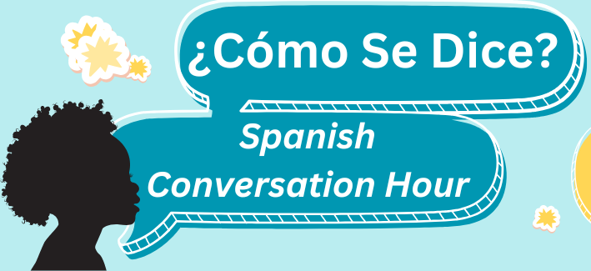

Slide 2
Meet Our Facilitators
Yesenia Lopez
Luisa Martucci
Nelida Vazquez

Slide 3
What we won’t learn here:
Complex Grammar
Advanced Vocabulary
Fluent conversation skills
Every colloquial expression for every dialect of Spanish

Slide 4
What we will learn here:
Basic conversational phrases
Essential Grammar for everyday situations
Variations in pronunciation or slang used in different Spanish-speaking countries.
Cultural insights

Slide 5
Spanish Language: Things to Know
Spanish is the majority language in 21 countries, and a commonly used language in many more
Many dialects, accents, and variations in vocabulary
“Spanglish” can make for even more variation

Slide 6
Getting Started:
Introduction of ourselves in Spanish
Spanish alphabet practice- Tips
Review Vocabulary: Programs and Events
Listening and practicing Pronunciation
Role Play

Slide 7
INTRODUCTION:
Hola, me llamo ________________
(Hi, my name is ________________)
Trabajo en ____________________
(I work at _____________________)
Mi color favorito es _________________
(my favorite color is_________________)

Slide 8
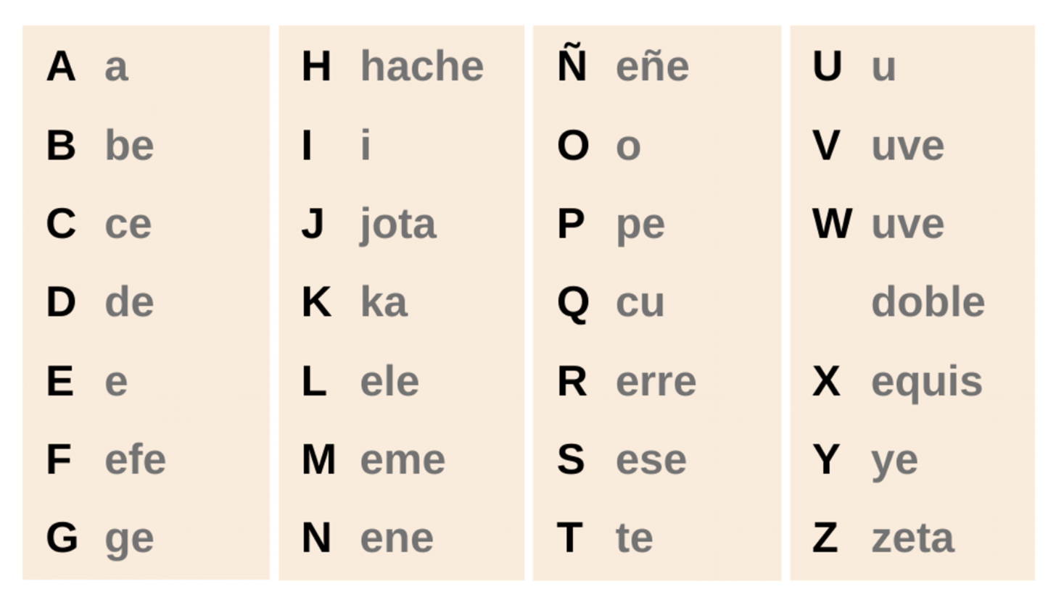
Pronouncing the Spanish Alphabet
Notes:
Warm up pronouncuation

Slide 9
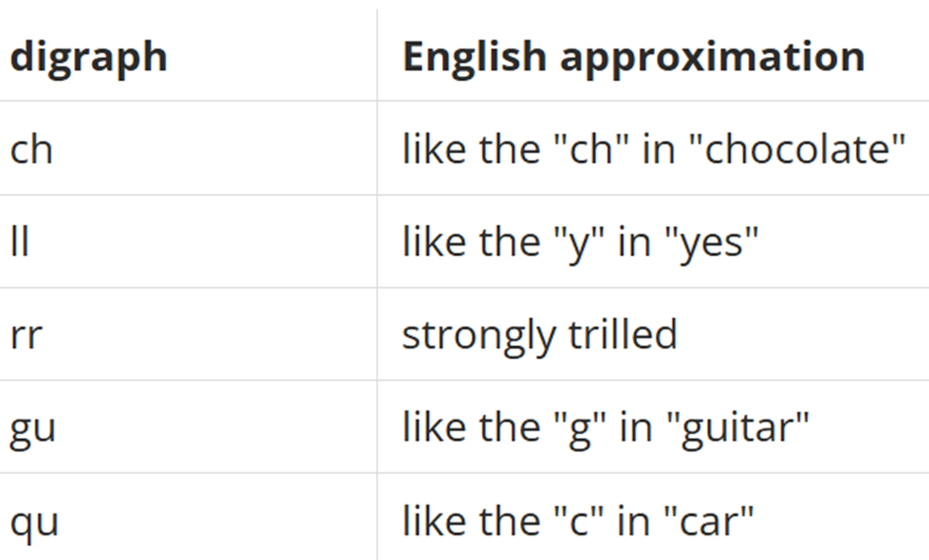
Pronunciation Tips:
Diagraf
Ch ( che) = chao (bye)
LL ( elle) = llave (key)
rr (erre) = carro (car)
Gu (geu) = gustar (like)
Qu (ku) = queso (cheese)
Notes:
Warm up pronouncuation

Slide 10
Vocabulary List 4: Programs and Events
I will first present the pronunciation
Participants will have the opportunity to pronounce the Spanish vocabulary and ask questions.
We will practice vocabulary and phrases.
Study vocabulary in small groups and share examples of patron interaction to the whole group.
Notes:
Explain better

Slide 11
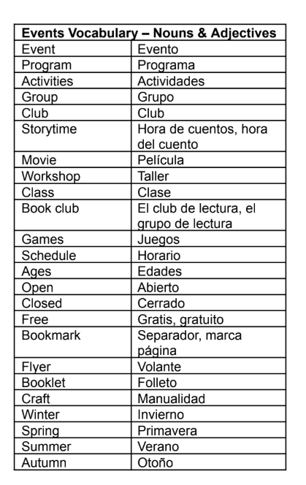
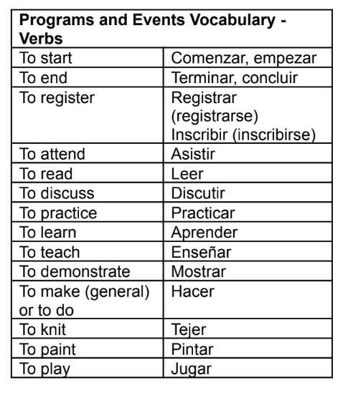
Vocabulary List 4: Programs and Events
Notes:
Add phrases?

Slide 12
​
Programs and Events Vocabulary practice
Matamoscas / Fly swatter
Comenzar, empezar
Leer
Practicar
Grupo
Tejer
Registrar
Primavera
Otoño
Edades
Jugar
Hora de cuentos /
hora del cuento
Película
Aprender
Pintar
Juegos
Evento
Actividades
Verano
Clase
Programa
club de lectura / grupo de lectura

Slide 13
Phrases for Programs and Events

Slide 14
Programs and Events Vocabulary use
​
A patron calls your library to inquire about activities available for her children and herself. Although she attempts to use English vocabulary, it seems that her primary language is Spanish. How will you respond to her call?

Slide 15
THE PATRON IS ASKING Mi nombre es Laura. I have a question please. A que hora es el Storytime?" THE LIBARARIAN ANSWER IS…
No es Necesario Inscribirse
La hora de cuentos comienza a las diez de la mañana (10:00 am)
Todos nuestros eventos son gratis.
Para todas las edades
2. THE PATRON IS ASKING: ¿canto cuesta? THE LIBRARIAN ANSWER IS ...
El taller es todos los miércoles
Es para adolecentes de grados seis a doce
Es para adultos
Todos nuestros eventos son gratis
Notes:
Listening Practice

Slide 16
3. THE PATRON IS ASKING: Hola, puedo inscribirme al programa de pintura? THE LIBRARIAN ANSWER IS ...
Es para adolecentes de grados seis a doce
Es para adultos. ¿Le gustaría registrarse?
Todos nuestros eventos son gratis.
4. THE PATRON IS ASKING: Cuando comienza el taller de Sumer Reading para niños de 3 años. THE LIBRARIAN ANSWER IS ...
La hora de cuentos comienza a las diez de la mañana.
El taller es todos los miércoles de mayo al mediodía.
Es para todas las edades.
Notes:
Key Points of WH questions and Verb To be

Slide 17
Questions?

Slide 18
Practice: Role Playing
Participants will be divided into groups of 3 to 4 people, and you will have 15 minutes to practice possible scenarios with a patron.
We will visit each room and answer questions.
Share the practice with the whole group.

Slide 19
¡Gracias!

