Slide 1
Briann Greenfield, Executive Director
New Jersey Council for the Humanities

Slide 3
Incubate with Incubation Grants

Slide 5
“The greatest glory in living lies not in never falling, but in rising every time we fall.”
— Ralph Waldo Emerson

Slide 7
The humanities examine human history, culture, values, and beliefs.

Slide 8
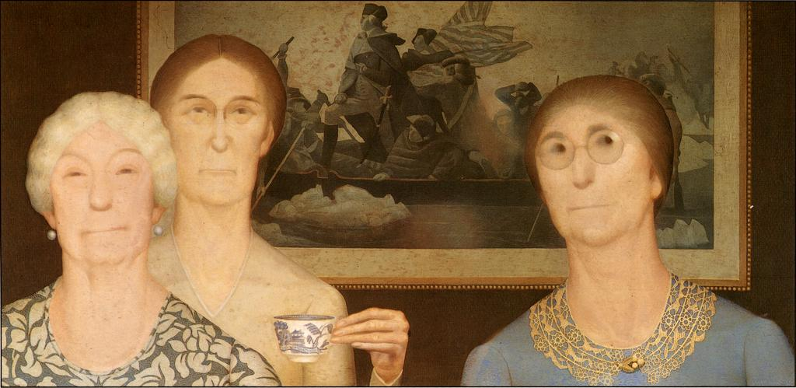
Grant Wood, Daughters of Revolution, 1932

Slide 9
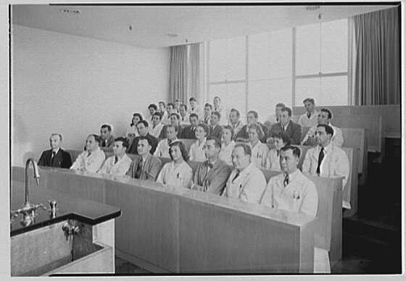
Hoffmann-LaRoche Inc., Nutley, New Jersey.
Audience, in lecture room, 1943.

Slide 12
Next Grant Deadlines
 | Action | Incubation
Intent to Apply deadline | February 22, 2017 | June 9, 2017
Application deadline | April 3, 2017 | July 14, 2017
Award notification | By June 30, 2017 | By September 29, 2017
Projects begin | No earlier than July 1, 2017 | No earlier than October 1, 2017

Slide 13
To learn more:
Gigi Naglak, Director of Grants and Programs
gnaglak@njch.org

