Slide 2
Project Management 101
The Return of…

Slide 3
Schedule - Day 2
Agenda | Time | Notes
Recap | 10:00 am | Review Content + Takeaways from Session 1
Project Timelines | 10:30 am | Building Project Schedules + Introduction to Project Tools
Real Life Example: Part 4 | 11:45 am | Create a Project Schedule (GANT)
Lunch | 12:30 pm
Proposal Submissions | 1:30 pm | Overview of Project Proposal Submissions Process
Working on your own project idea | 2:00 pm | Opportunity to ask the instructor to review your project idea, proposal or charter
Break | 2:45 pm | Short Break, Q&A
Working on your own project idea | 3:00 pm | Opportunity to ask the instructor to review your project idea, proposal or charter
Wrap Up | 3:45pm | Session Wrap Up, Next Steps (Schedule webinar sessions for Asana & Basecamp)

Slide 4
Recap: Day 1
Session 1 Knowledge Areas:
Project Concepts and Definitions, Characteristics and Roles
The Project Charter and Scope Documents
Work Breakdown Structure
Notes:
Feedback from survey: traditional courses very dry, decided to teach a course more immersive

Slide 5
Recap: Day 1
What is a Project?
Temporary in nature
Has a unique Product, Service or Result
Coordinated undertaking of interrelated activities
Business Need
What is driving the need to embark on this project?
Project Justification
Business Case- On what financial or other basis can we justify doing this project?
Tools: Cost/Benefit Analysis, Key Metrics
Notes:
Business Need: A problem could have many solutions. Our Project is being carried out to deliver one such solution
Project Justification: Why is this solution the best?

Slide 6
Recap: Day 1
Product Description/Deliverables
A tangible thing that results from the completion of the project
Could be
A Product
A Service
An improvement initiative
A result or decision
Notes:
Business Need: A problem could have many solutions. Our Project is being carried out to deliver one such solution
Project Justification: Why is this solution the best?

Slide 7
Recap: Day 1
Stakeholders
An individual, group, or organization, who may affect, be affected by, or perceive itself to be affected by a decision, activity, or outcome of a project”
Examples
Project Sponsor – Commonly has budgetary approval for the project
Project Manager – Responsible for meeting the requirements of the project
Project Team – Collectively responsible for completing the project
Customers – Beneficiaries of the deliverables of the project
Performing Organization – Specific groups performing the work on the project
Notes:
Stakeholders : People on neighboring island

Slide 8
Recap: Day 1
The Triple Constraint
Time
Cost
Scope

Slide 9
Recap: Day 1
The Project Charter
A fundamental tool used to establish the Project
Succinctly defines key characteristics of the Project
Helps to orient new members of the team
Establishes the Identify of the Project and her respective Authority level
Use this tool to help craft your Proposals

Slide 10
Recap: Day 1
The Scope Statement
Project Scope Description
Acceptance Criteria or what must be completed in order for the project to be considered a success
Deliverables which can be thought of as the end result of the project
Exclusions which typically identify the areas that are out of scope for the project
Constraints which are externally imposed restrictions on the project, such as deadlines, budgets and limited resources
Assumptions relating to the scope of the project and the potential impact of these assumptions if they are not valid.

Slide 11
Recap: Day 1
Work Breakdown Structure (WBS)
Product Orientation: What do we need to build (not how)
All of the work that has to be performed on the project
Hierarchical in nature
Decomposition: Breaking down project deliverables into smaller, more manageable components
Work Packages (4-80 hours ~ depends?)
Notes:
The WBS tells us what needs to be done.
The Activity list tells us how the work gets done
Analogy of Restaurant Menu
Handout:
Various cost estimates

Slide 12
Getting Organized – Time and Cost

Slide 13
Getting Organized – Time and Cost
What you will learn:
Activity List and Duration Estimates
Cost Estimates
Scheduling work
Exercise: Creating a Project Schedule

Slide 14
Getting Organized – Activities
Activity Definition
Based on the WBS document
What tasks must be performed in order to complete the WBS component
Try to involve experts

Slide 15
Getting Organized – Activities
Activity Duration Estimates
How long does an Activity Take?
Program Evaluation and Review Technique (PERT)
Great if you have a lot of Data!
Pessimistic: Worst Case Scenario
Most Likely: Based on prior experience
Optimistic: If everything goes well
Benchmarking

Slide 16
Getting Organized – Activities
Activity Sequencing
Correct sequence of performing activities now that they have been defined
Dependencies
Mandatory: A physical or technological limitation of the work (Must do A before B)
Discretionary: Historical/Organizational Preference

Slide 17
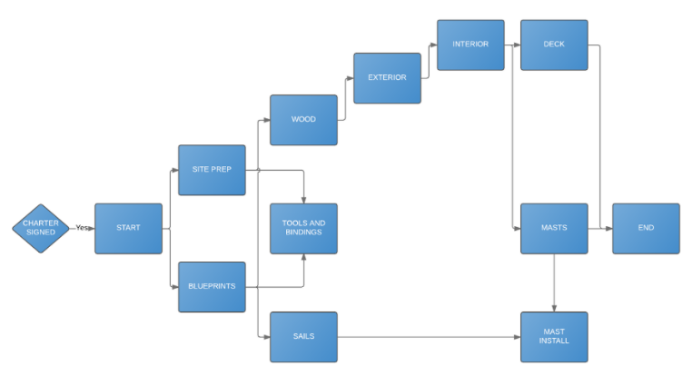
Sequencing Tools
Network Diagrams
Activities on Nodes
Lines represent relationships
Movement Left > Right

Slide 18
Getting Organized – Activity List
ID | Task Name | Duration | Assigned | Status
1 | Finalize List of Exhibitors | 24 | Pat | DONE
1.1 | Conduct Exhibitor Outreach Program | 16 |  | DONE
1.2 | Finalize Exhibit requirements | 8 |  | DONE
2 | Define Event Space | 40 | Barbara/John | In Progress
2.1 | Identify Space usage requirements | 8 | Barbara | DONE
2.2 | Identify potential layout plans | 16 | Barbara | In Progress
2.3 | Confirm Event Dates with Venue and Exhibitors | 8 | John | In Progress
2.4 | Obtain Permits from Town | 8 | John | In Progress
3 | Prepare Event Space | 100 | Joanne | Not Started
3.1 | Purchase Makerspace Equipment | 20 | Joanne | Not Started
3.2 | Finalize placement of Carts and Accessories | 20 | Joanne | Not Started
.. | .. | .. | ..
Notes:
Note that we have copied the WBS coding scheme

Slide 19
Project Schedules
Why use Schedules?
Schedules allow us to take a project list and apply it to a calendar
Allows us to incorporate real-world events (Public Holidays and Vacations)
Track project progress against dates and deadlines

Slide 20
Project Schedules
Milestones
An activity of zero duration
Identified as being significant in the project
End of a phase or task
Delivery of a work result
Expenditure of a certain amount of money

Slide 21
GANTT Charts
Henry Gantt (1861-1919)
Used during the Hoover Dam and Interstate Highway System Projects
Depicts Activities, Dates and Resources

Slide 22
Real Life Example: Project Schedule
In this exercise, we will examine the makerspace project and
60 minutes: Review the sample project proposals
15 minutes: Discussion

Slide 23
Real Life Example - Takeaways
A visual tool is useful when trying to identify solutions to common issues that arise when managing projects
Impact of a delay
Resource conflict
Date changes

Slide 24
Getting Organized –Cost Estimates
Cost Estimate Type | Characteristics
Top-Down (Budgetary Estimates) | Benchmarking: Refer to reference projects, vendor estimates Short time to assemble Lower Accuracy
Bottom-Up (Detailed Estimates | Detailed Estimates Longer time to assemble Higher Accuracy

Slide 25
Lunch
…need I say any more?

Slide 26
15 minute bonus: Running the Project
What you will learn:
The Kickoff Meeting
Task Assignment
Monitoring Progress
Closing out
Handout: Kickoff Meeting sample agenda

Slide 27
Running the Project
The Kickoff Meeting
Goals
Get everyone aligned on the Project, it’s goals and objectives
Formally establish the role of the PM
Sample Agenda:
Introduction
Review of Project Charter
Establish PM Standards
Introduce Project team members
Establish Project Communications Needs

Slide 28
Running the Project
Assigning Work
Work Authorization System:
Formal approval of the work by relevant authorities
Formal approval of the vendor or individual performing the work
Detailed description of task, including success requirements and required skills
Resource Assignment Matrix

Slide 29
Running the Project
Status Meetings
Lasts less than an hour
Goes through ongoing project tasks
Methodical and organized format.
Agenda:
Summary of Status
Open Action Items
Open Risks and Issues
Closing the meeting

Slide 30
Running the Project
Closeout
The Project Manager is responsible for tracking and recording the completion of completion of Deliverables, Phases or Milestones
How: Evaluation Criteria
Who: Sponsor/Owner Signoff

Slide 31
Running the Project
Lessons Learned
Documenting anything that the project team learned during the project or a project phase that may benefit subsequent phases or project teams in the organization.
Documented and kept in a centralized repository where it can be accessed by other users and readily accessible
Organization is doomed to repeat the same mistakes unless it can find a way to document these lessons and transmit them to others who can benefit in the future.
Do not wait too long to do this!

Slide 32
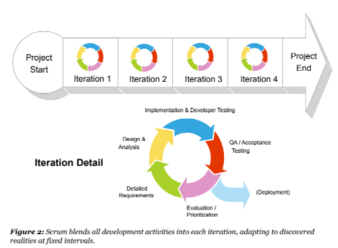
Appendix 1 - Agile
Great when you don’t understand the requirements up front
Building a bit and releasing in more frequent intervals
Waves of mini-iterations throughout project known as Sprints
Each sprint typically lasts 2-3 weeks

Slide 33
Proposal Submissions
Summary (or problem statement or background)
Project scope
Stake holders including project manager and team
Timeline
Cost
Expected outcome
Benefits realized by the project
Notes:
​As a part of our workshop series, participants will manage a small project at their own library. We will subsidize $300 for each participating library, and the libraries might put some more budget to that. And, yes, the proposal is to obtain both budget/official sign off from LibraryLinkNJ and the participating library directors. Please note this will be a small project for participants to have an opportunity to manage a project based on what they learn through our series workshops.

Slide 34
Knowledge Recap
The Charter | Document your Deliverables and Signoff Constraints > Imposed on the Project Assumptions > Write them down!
The WBS | Decomposition – That’s breaking things down The WBS elements
Time and Cost | Activity definition Activity Sequencing Task dependencies (Start to Finish, Finish to Start etc.)
Kicking Off | Kick off meeting Resource Leveling
Monitoring Progress | Project Cadence is everything Measure against your baselines
Wrapping Up | Obtain signoff, then move on Document Lessons learned quickly

Slide 35
Conclusion
Class Evaluations (Please take a minute to fill in)
Additional Resources:
Website link to download: http://www.samsena.com/PM-101-2018

