Slide 1
Simplifying Libraries
Alex Lent, Director, Millis Public Library
LibraryLink New Jersey, September 7, 2016

Slide 2
How we’ve made the Millis Library easier to use and run.

Slide 3
About Millis

Slide 4
A Standard Public Library

Slide 5
My hope is that in an hour, you’ll think that simplicity is a worthwhile pursuit

Slide 6
And that you’ll have some ideas you can bring back to your library to test out

Slide 7
Collections
Programming
Patron Service
Technology
Pre-webinar questions

Slide 8
Collections
Programming
Patron Service
Technology
Pre-webinar questions

Slide 9
Collections
Programming
Patron Service
Technology
Pre-webinar questions

Slide 10
Collections
Programming
Patron Service
Technology
Pre-webinar questions

Slide 11
Collections
Programming
Patron Service
Technology
Pre-webinar questions

Slide 12
Collections
Programming
Patron Service
Technology
Pre-webinar questions

Slide 13
But first: what I’m not talking about

Slide 14
I’m not talking about minimalism

Slide 15
Implies that simplicity is an intrinsic good

Slide 16
I think simplicity is an instrumental good

Slide 17
I’m not talking about reducing services

Slide 18
Keeping your library simple could make it possible to offer additional services

Slide 19
I’m talking about making the library as easy to use and run as possible

Slide 20
If you make your library easy to use, people will be more likely to use it

Slide 21
Everything should be made as simple as possible, but no simpler.
Albert Einstein

Slide 22
Simplicity is making the journey of this life with just baggage enough.
Charles Dudley Warner

Slide 23
Collections

Slide 24
Reference

Slide 25
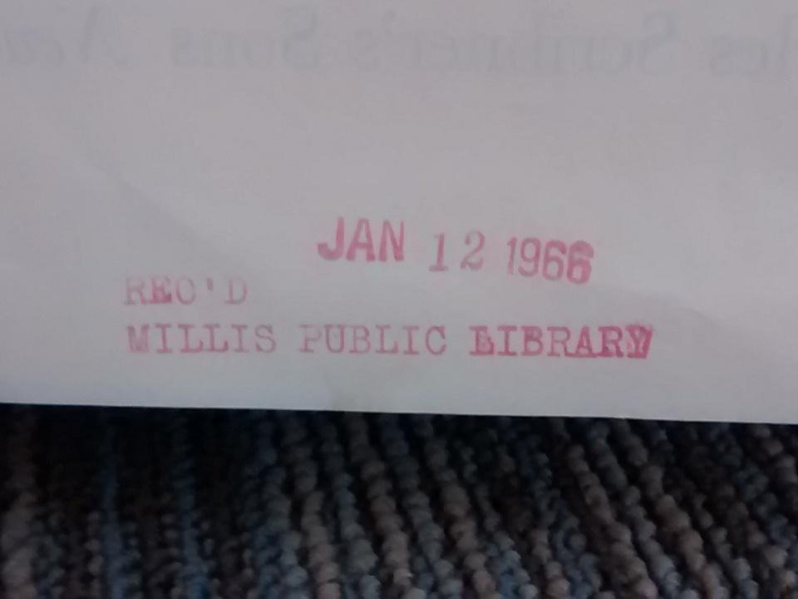

Slide 26
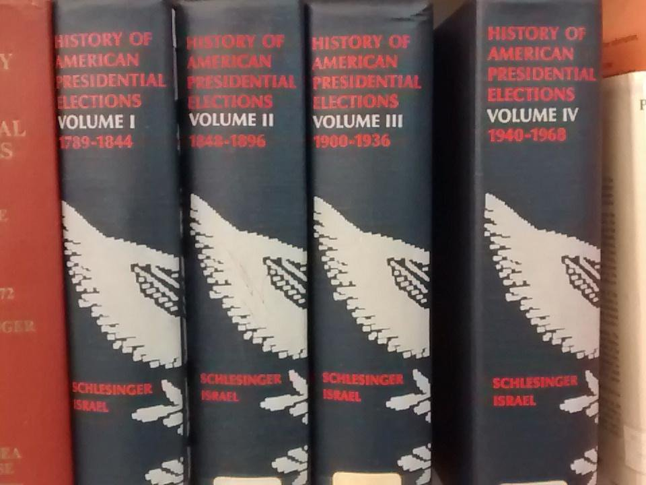

Slide 28
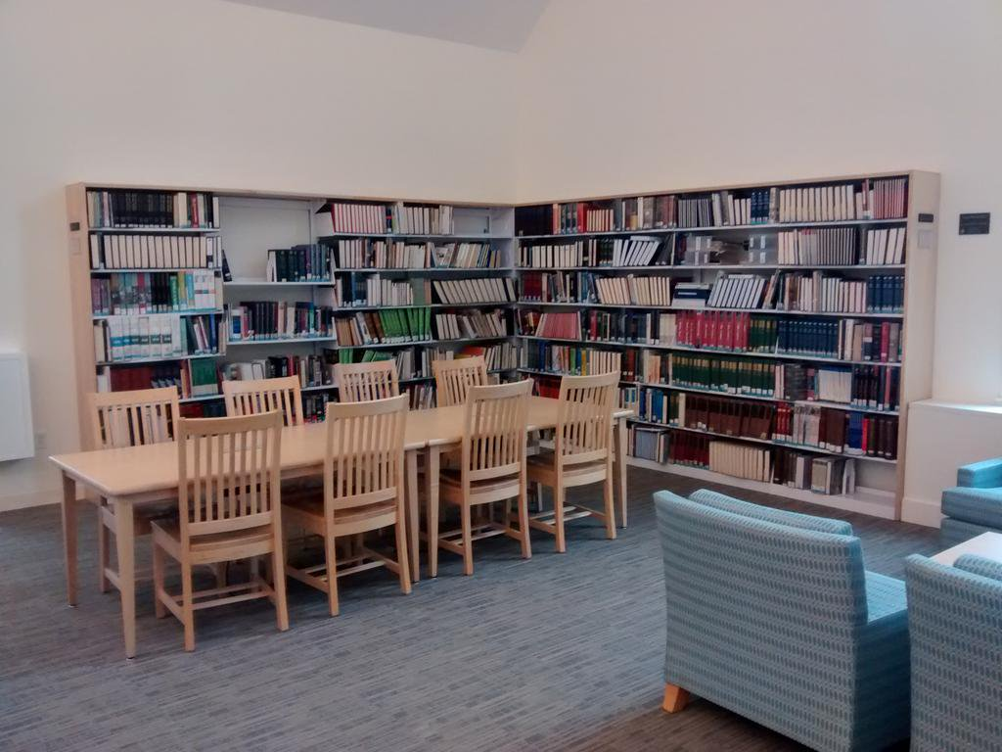

Slide 29
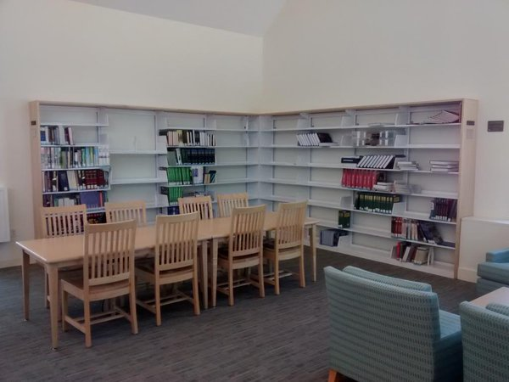

Slide 30
Surviving reference materials were added to the regular circulating collection.

Slide 31
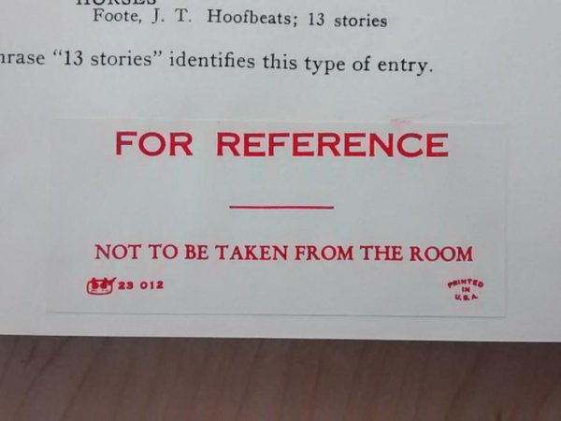

Slide 32
We decided to review all of our loan rules.

Slide 33
We realized we didn’t need most of them.

Slide 34
So we got rid of them.

Slide 35
And now we only have one loan rule.

Slide 36
Everything circulates for 2 weeks. Fines are $.10/day. Max fine per item is $5.

Slide 37
People love it.

Slide 38
“Excellent changes.”
“Smart move.”
“That’s awesome.”
“That’s so much easier, especially if you have kids.”
“Oh, that’s easy!”
“That is so much better.”
“I hadn’t been to the library for a while and I love the new lending policies.”

Slide 39
Circulation is up by 15%.

Slide 40
Magazine circulation is up by 45%.

Slide 41
New DVD circulation has doubled.

Slide 42
Fine collection has increased by 33%.

Slide 43
This was the first major simplification project and it was a success.

Slide 44
We just integrated paperback into fiction. Initial feedback has been positive.

Slide 45
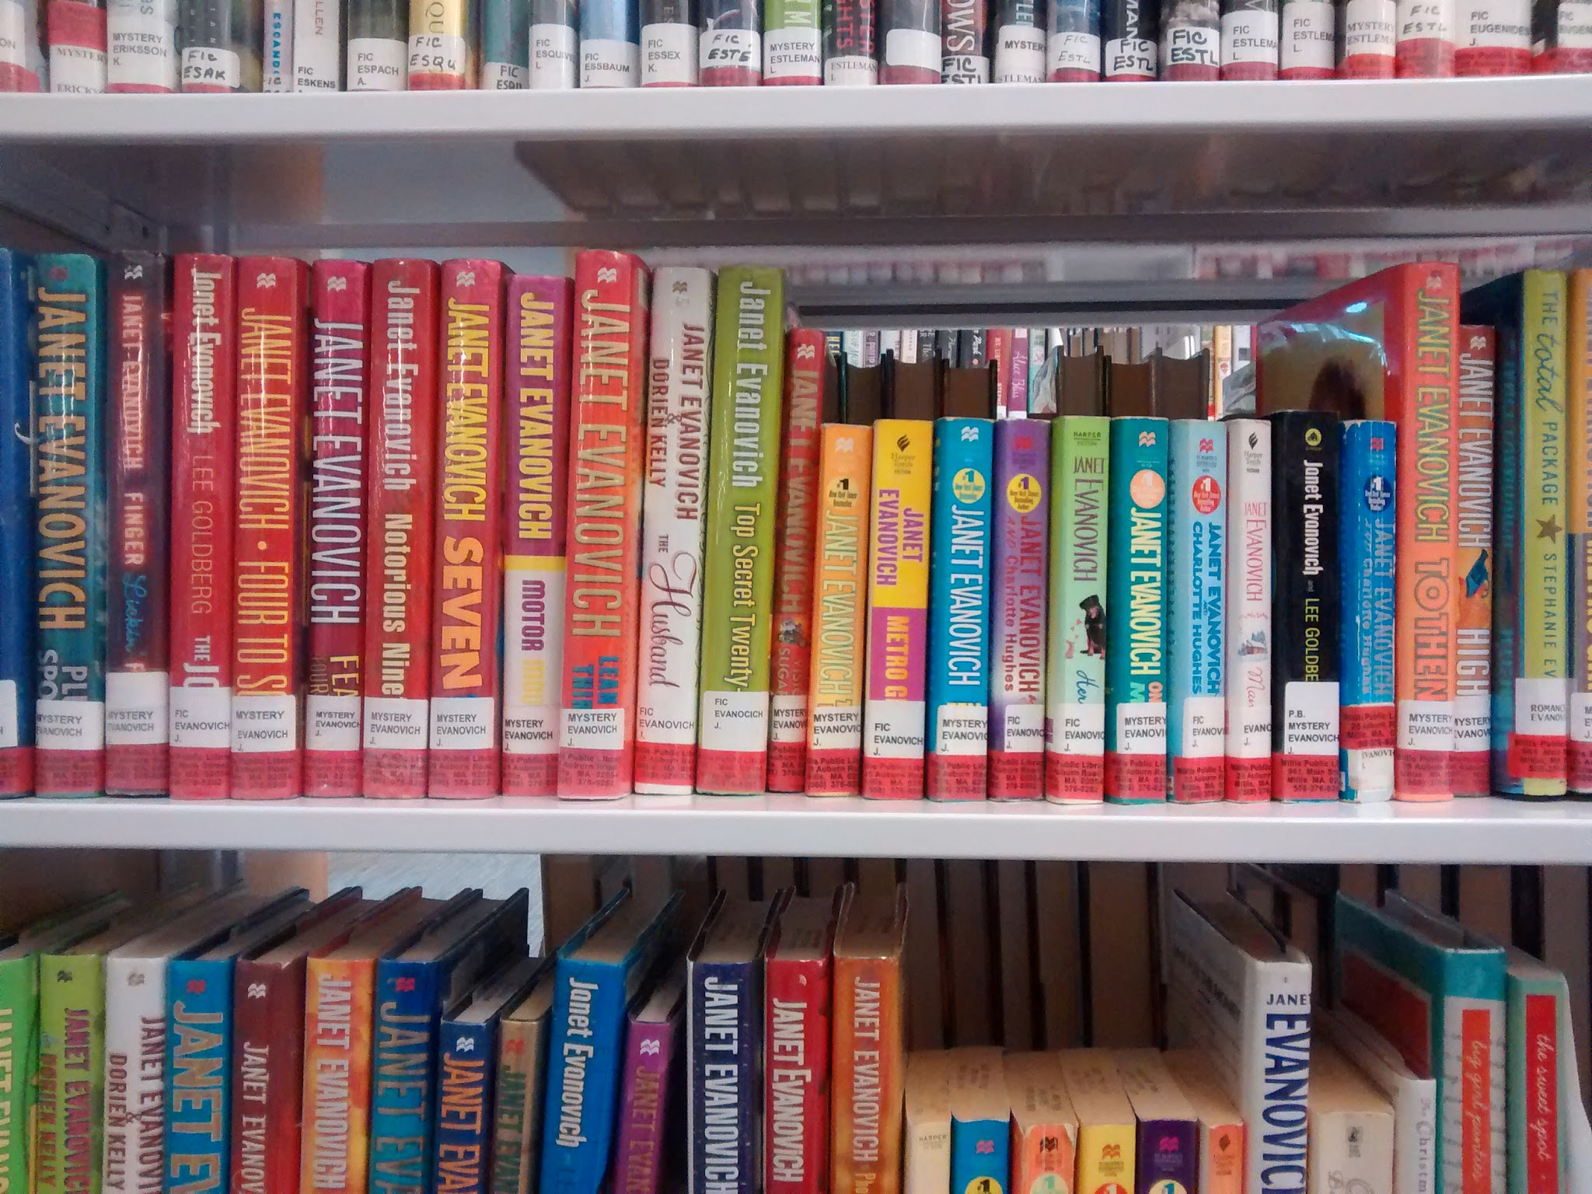

Slide 46
We’re exploring moving away from DDC.

Slide 48
Programming

Slide 49
I now spend three months planning and scheduling 12 months of programs.

Slide 50
Upside: no major program planning or scheduling during the bulk of the year

Slide 51
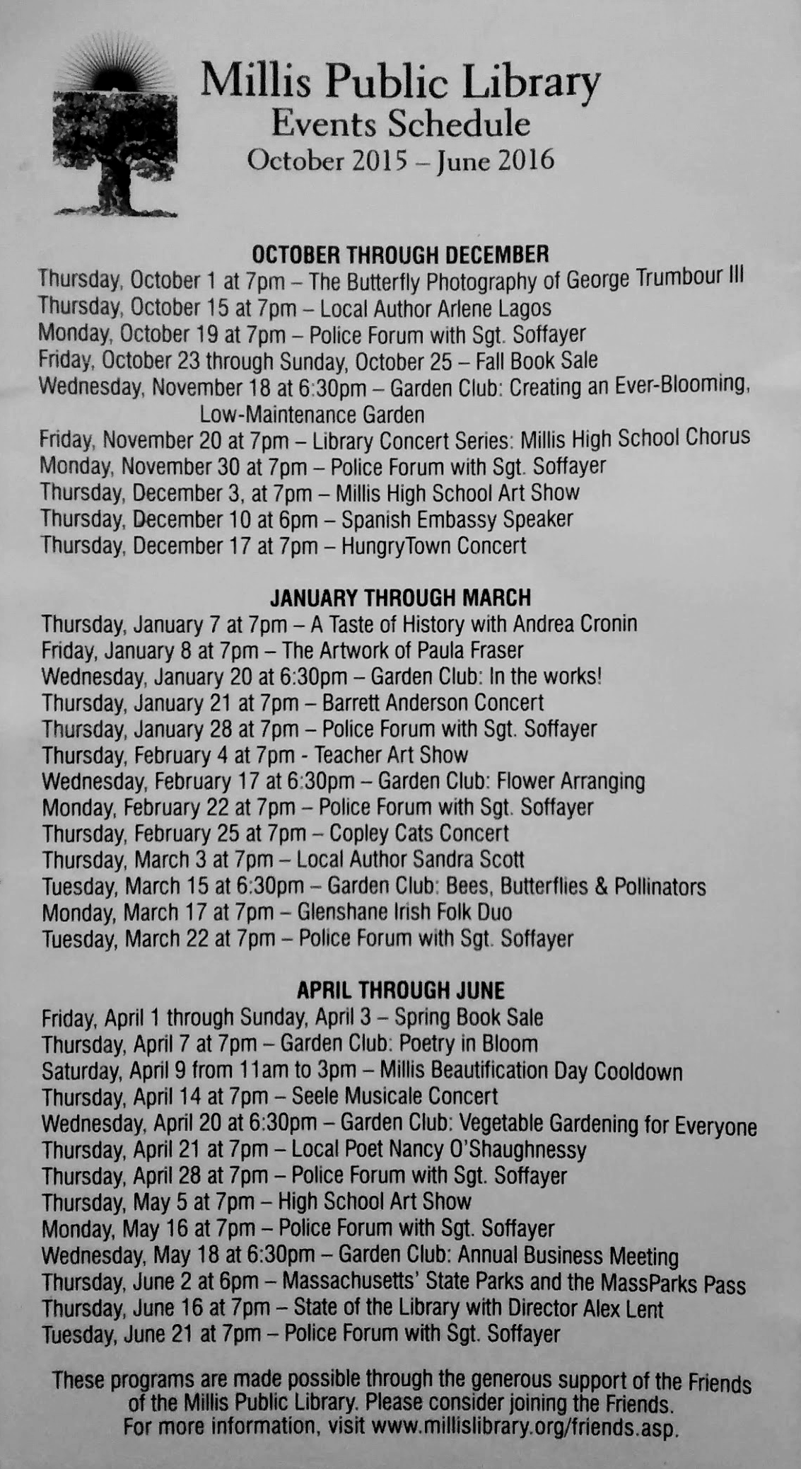

Slide 52
Program attendance increased by 60%.

Slide 53
Adult attendance more than doubled.

Slide 54
Almost everything is part of a series.

Slide 55
We can curate our events.

Slide 56
We can find and fill gaps in the schedule.

Slide 57
When a topic arises in the middle of the year, we can jump on it - no other program scheduling can get in the way.

Slide 58
All library room reservations are scheduled up to 12 months in advance.

Slide 59
Public use of library meeting spaces went up by 450%

Slide 60
We have months and months to do PR.

Slide 61
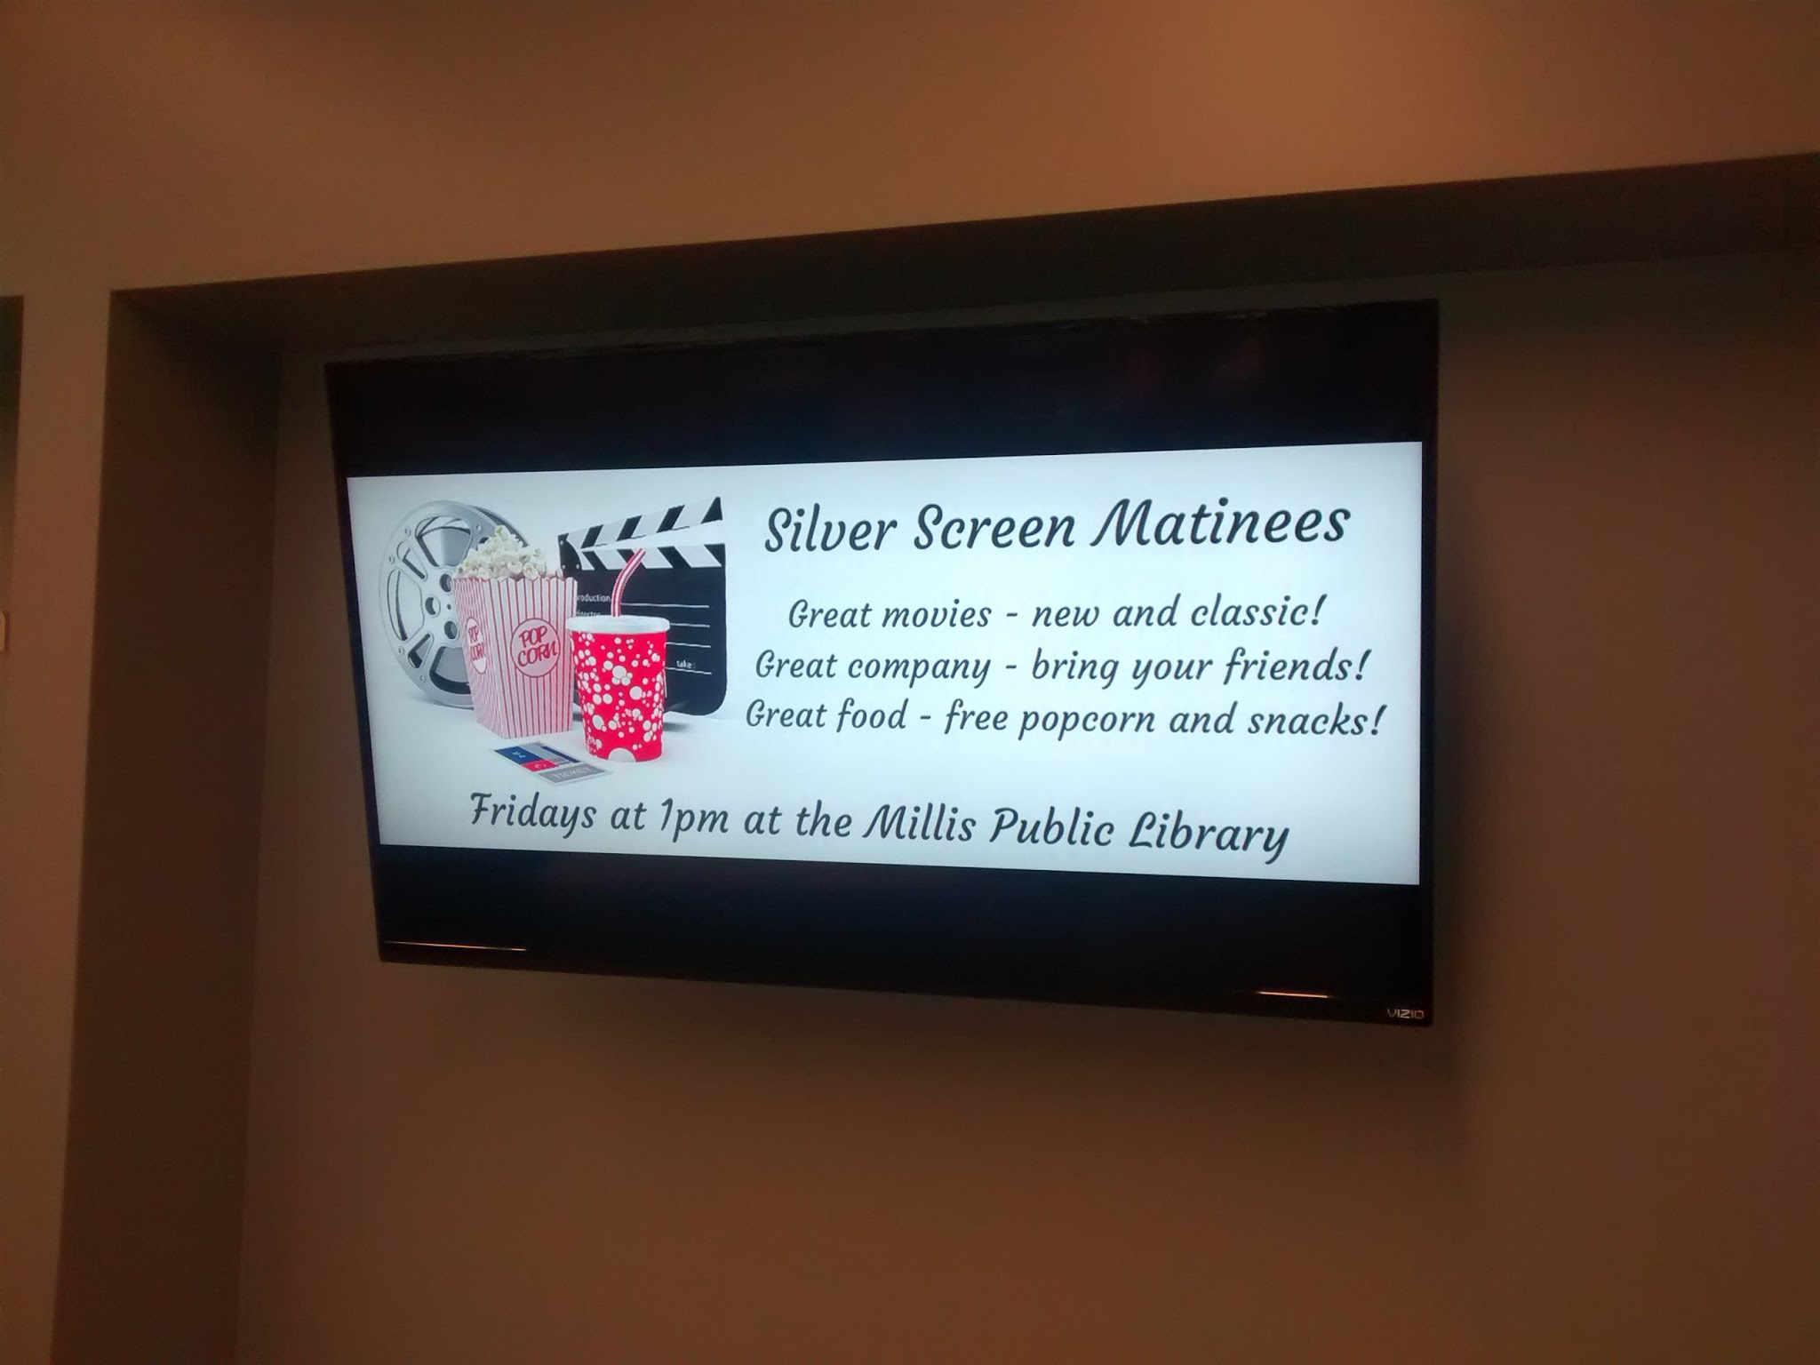

Slide 62
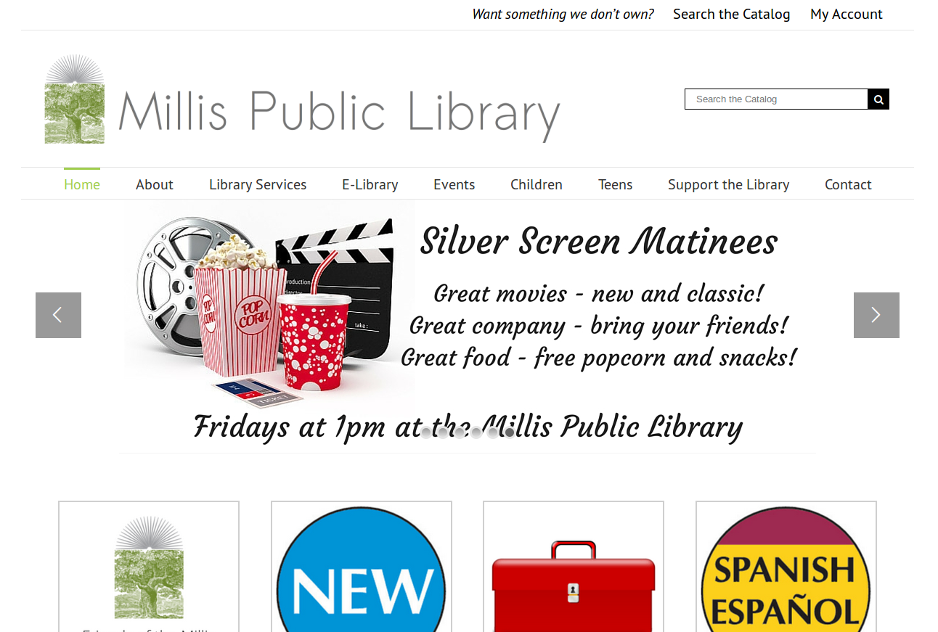

Slide 63
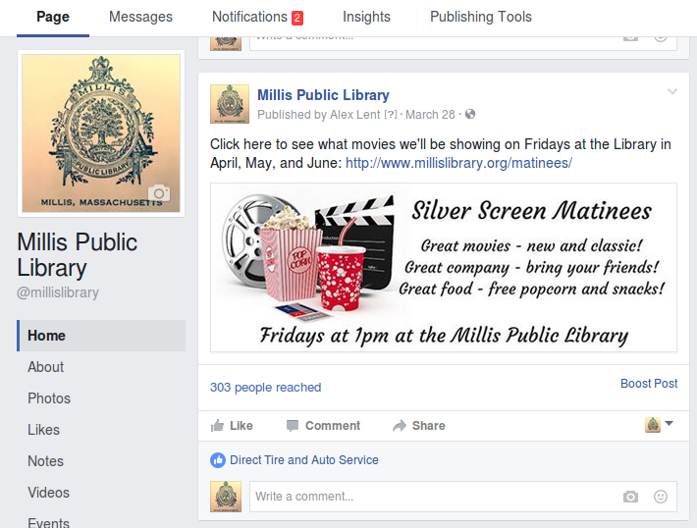

Slide 64
Public Service

Slide 65
The One-Desk Model

Slide 66
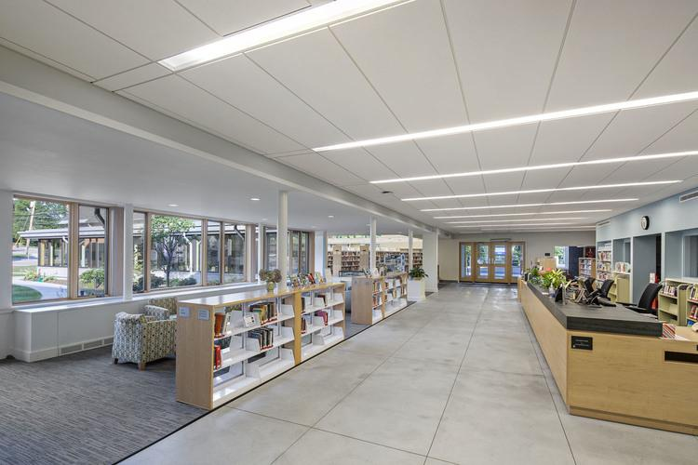

Slide 67
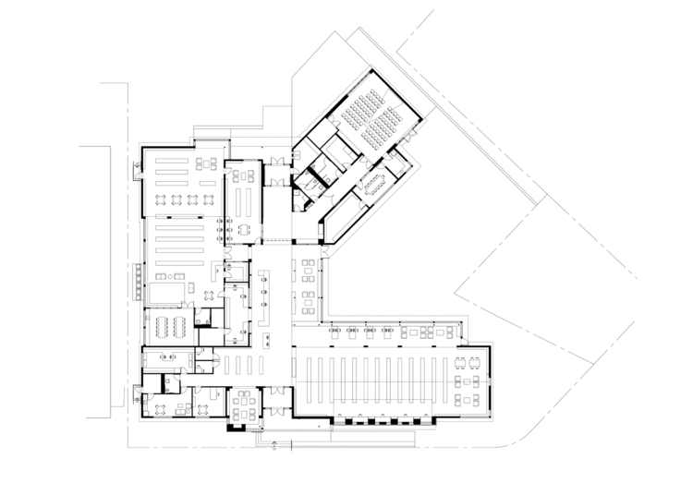

Slide 68
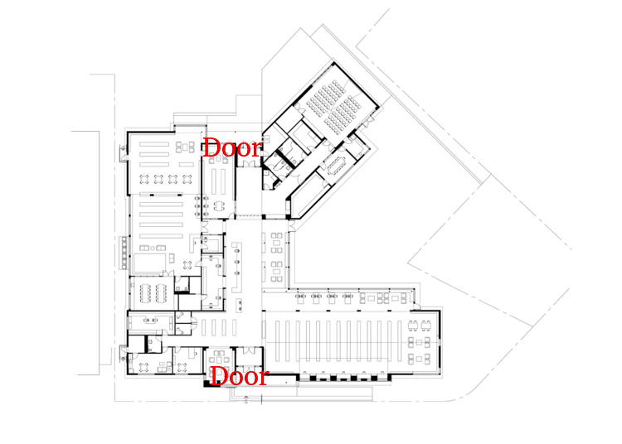

Slide 69
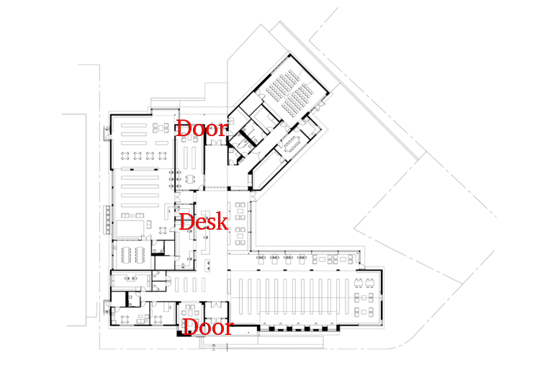

Slide 70
We don’t have a reference desk or a circulation desk.

Slide 71
We just have a desk.

Slide 72
No matter what you need - directions, tech help, a recommendation, research assistance - you go to the desk.

Slide 73
This is how it has always been.

Slide 74
But now we’re buying into it.

Slide 75
All staff need to be able to do everything.

Slide 76
A challenge - we have a largely part-time, largely paraprofessional staff.

Slide 77
Annual customer service training for all staff
All staff trained on all e-resources
All staff trained on public access technology
All staff practice readers advisory

Slide 78
Annual customer service training for all staff
All staff trained on all e-resources
All staff trained on public access technology
All staff practice readers advisory

Slide 79
Annual customer service training for all staff
All staff trained on all e-resources
All staff trained on public access technology
All staff practice readers advisory

Slide 80
Annual customer service training for all staff
All staff trained on all e-resources
All staff trained on public access technology
All staff practice readers advisory

Slide 81
Annual customer service training for all staff
All staff trained on all e-resources
All staff trained on public access technology
All staff practice readers advisory

Slide 82
An opportunity - we have a largely part-time, largely paraprofessional staff.

Slide 83
What else can we do to emphasize the one-desk model?

Slide 84
We got rid of our giant copier...

Slide 85
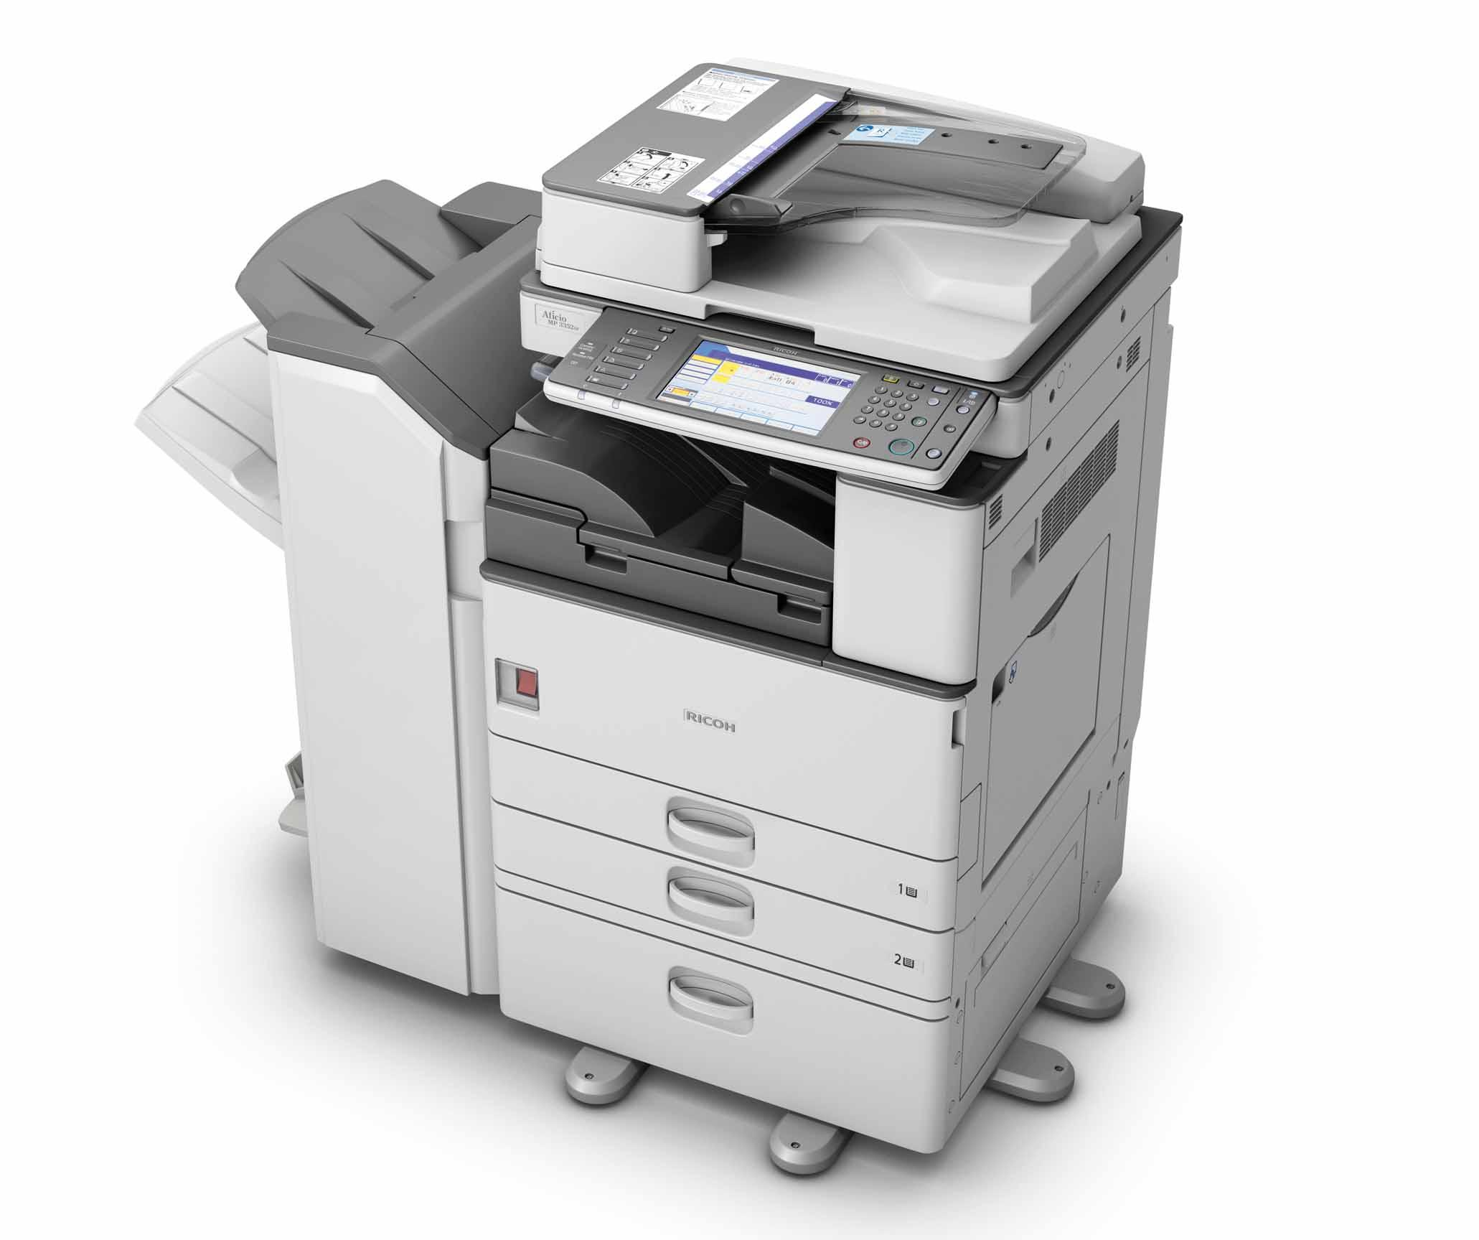

Slide 86
...and got one that fits at the desk,

Slide 87
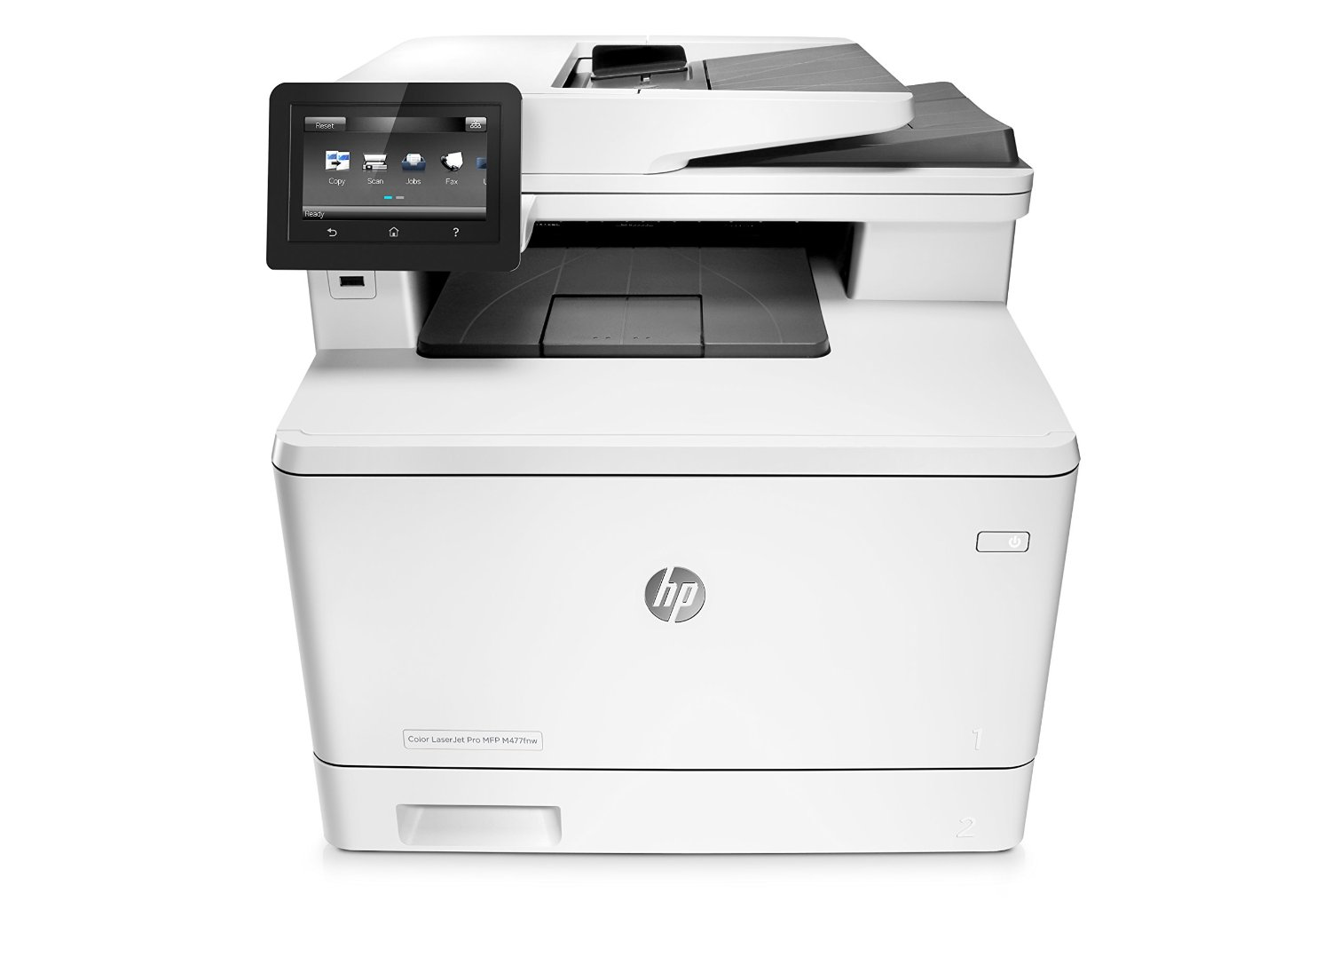

Slide 88
...making the desk even more of a hub.

Slide 89
And our 3D printer lives at the desk too.

Slide 90
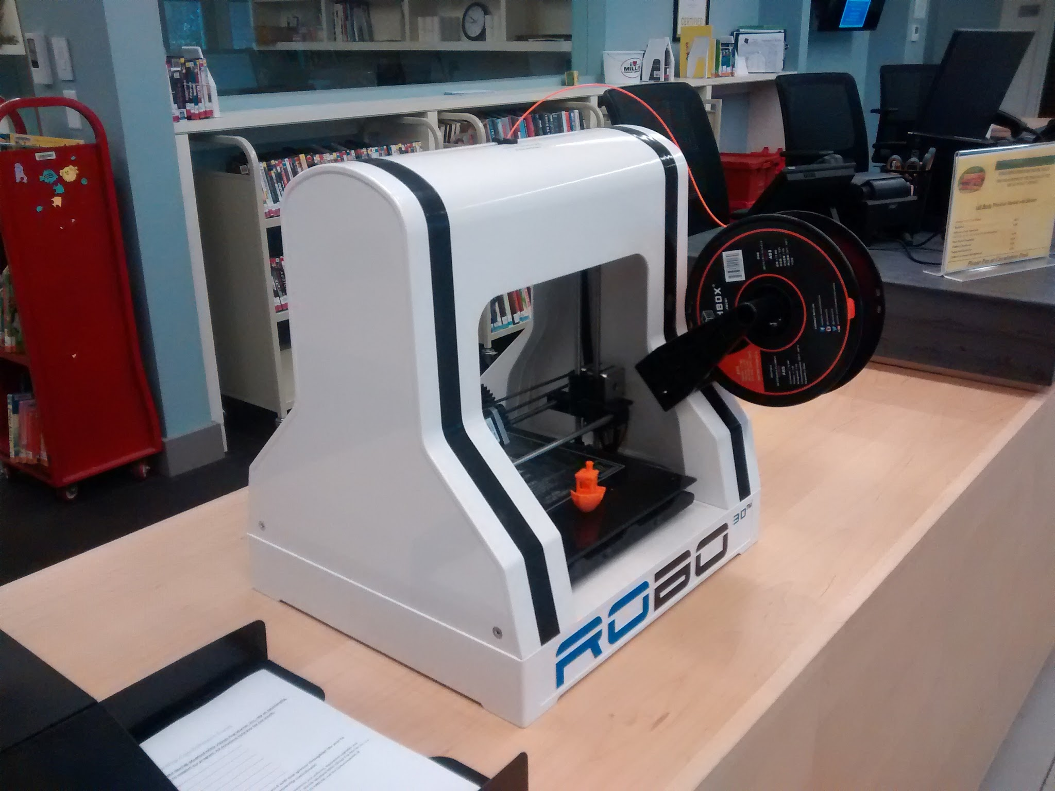

Slide 91
Forms, Policies, Rules: as few as possible, as brief as possible

Slide 92
No special forms for our unusual items.

Slide 93
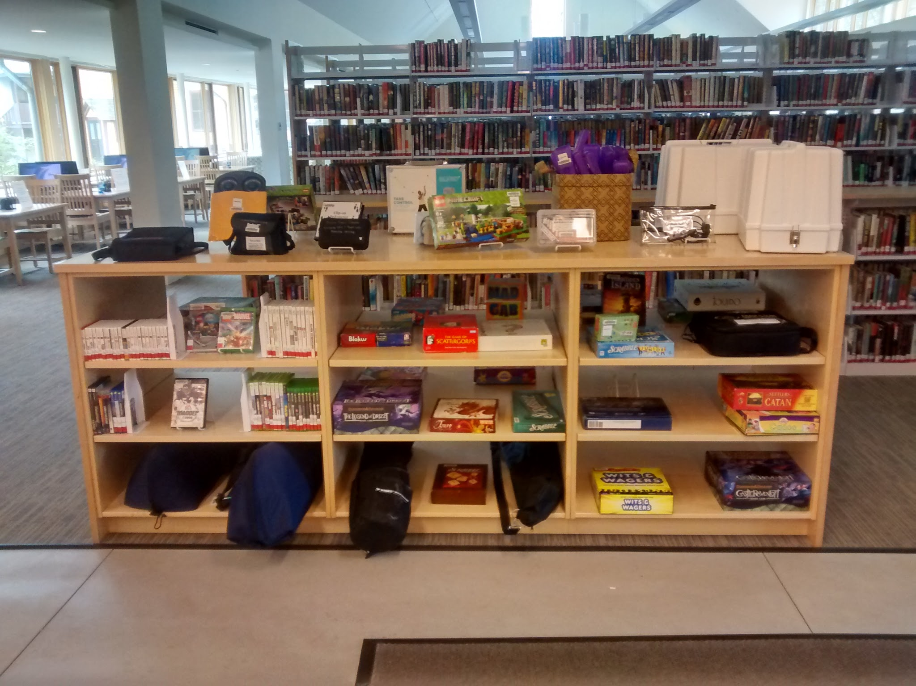

Slide 94
One-page policies

Slide 95
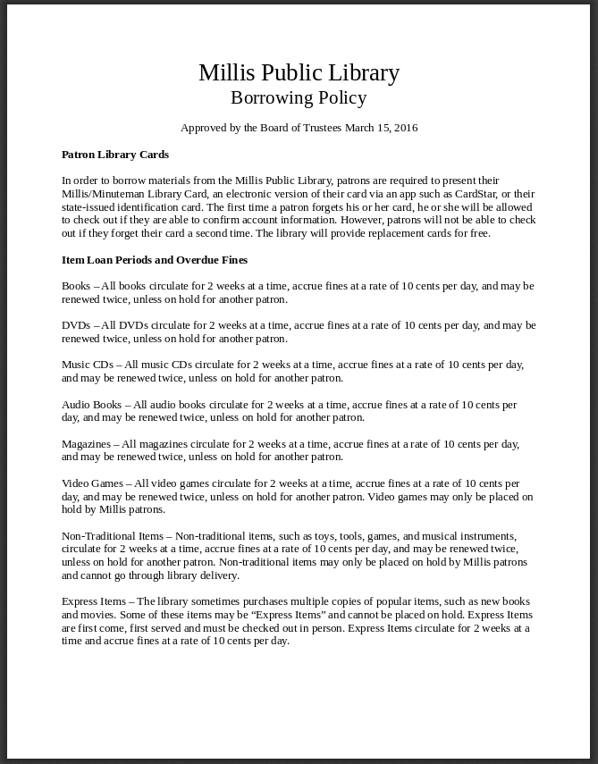

Slide 96
Technology

Slide 97
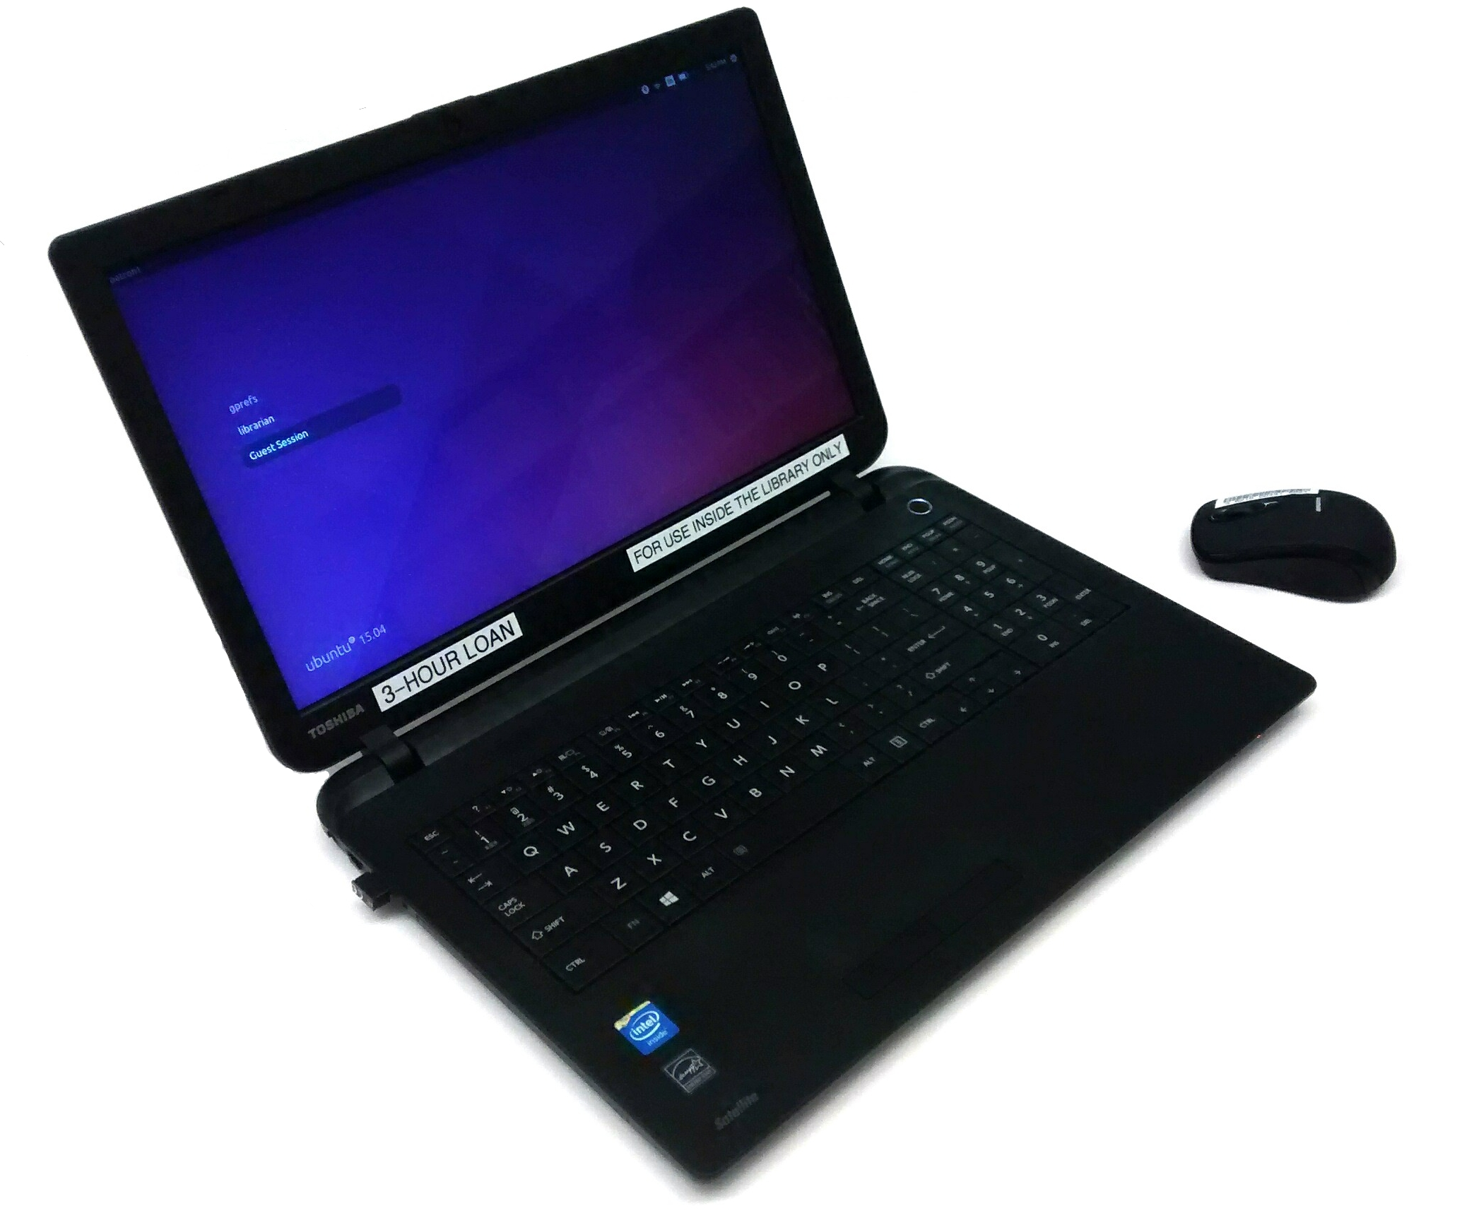

Slide 98
Pre-Webinar Questions

Slide 99
Circulation Forms

Slide 100
Library Card Sign Up Forms

Slide 101
Cataloging and Processing New Materials

Slide 102
Finding Areas to Simplify

Slide 103
“How can we make this easier?”

Slide 104
“Last Month/Next Month”

Slide 105
Pushing for simplicity when others are opposed

Slide 106
Buy-in is critical

Slide 107
Start small

Slide 108
Test Runs

Slide 109
Don’t force simplicity

Slide 110
Simplicity is a means to an end...

Slide 111
...not an end in itself.

Slide 112
Thank you for having me!
alex@alexlent.org @alexlent

